Slide 1


Slide 2
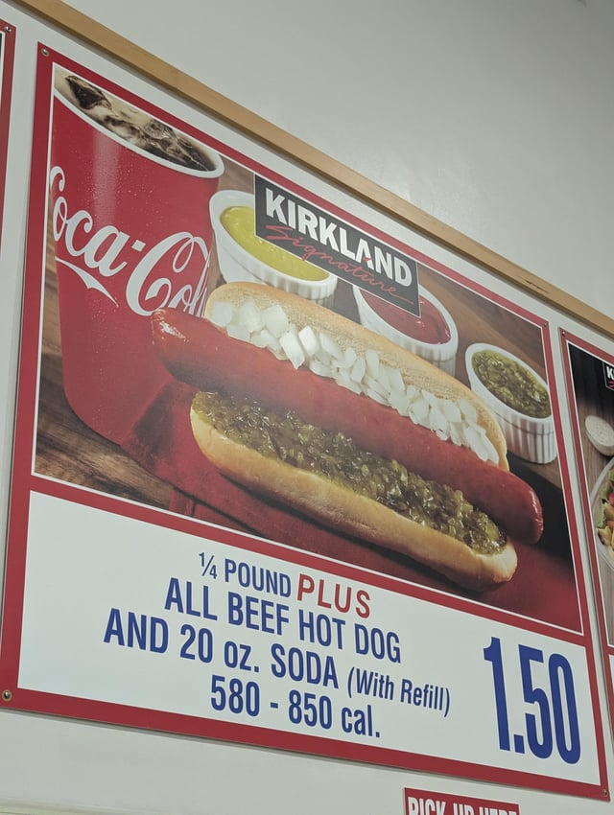

Slide 3
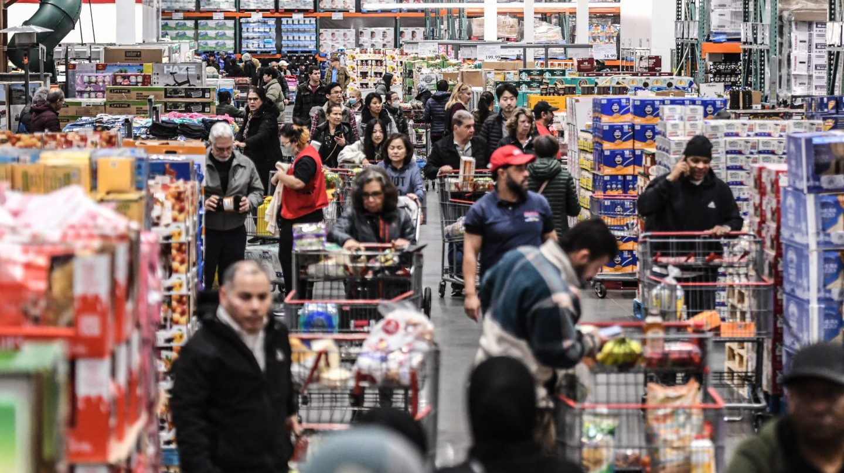

Slide 4
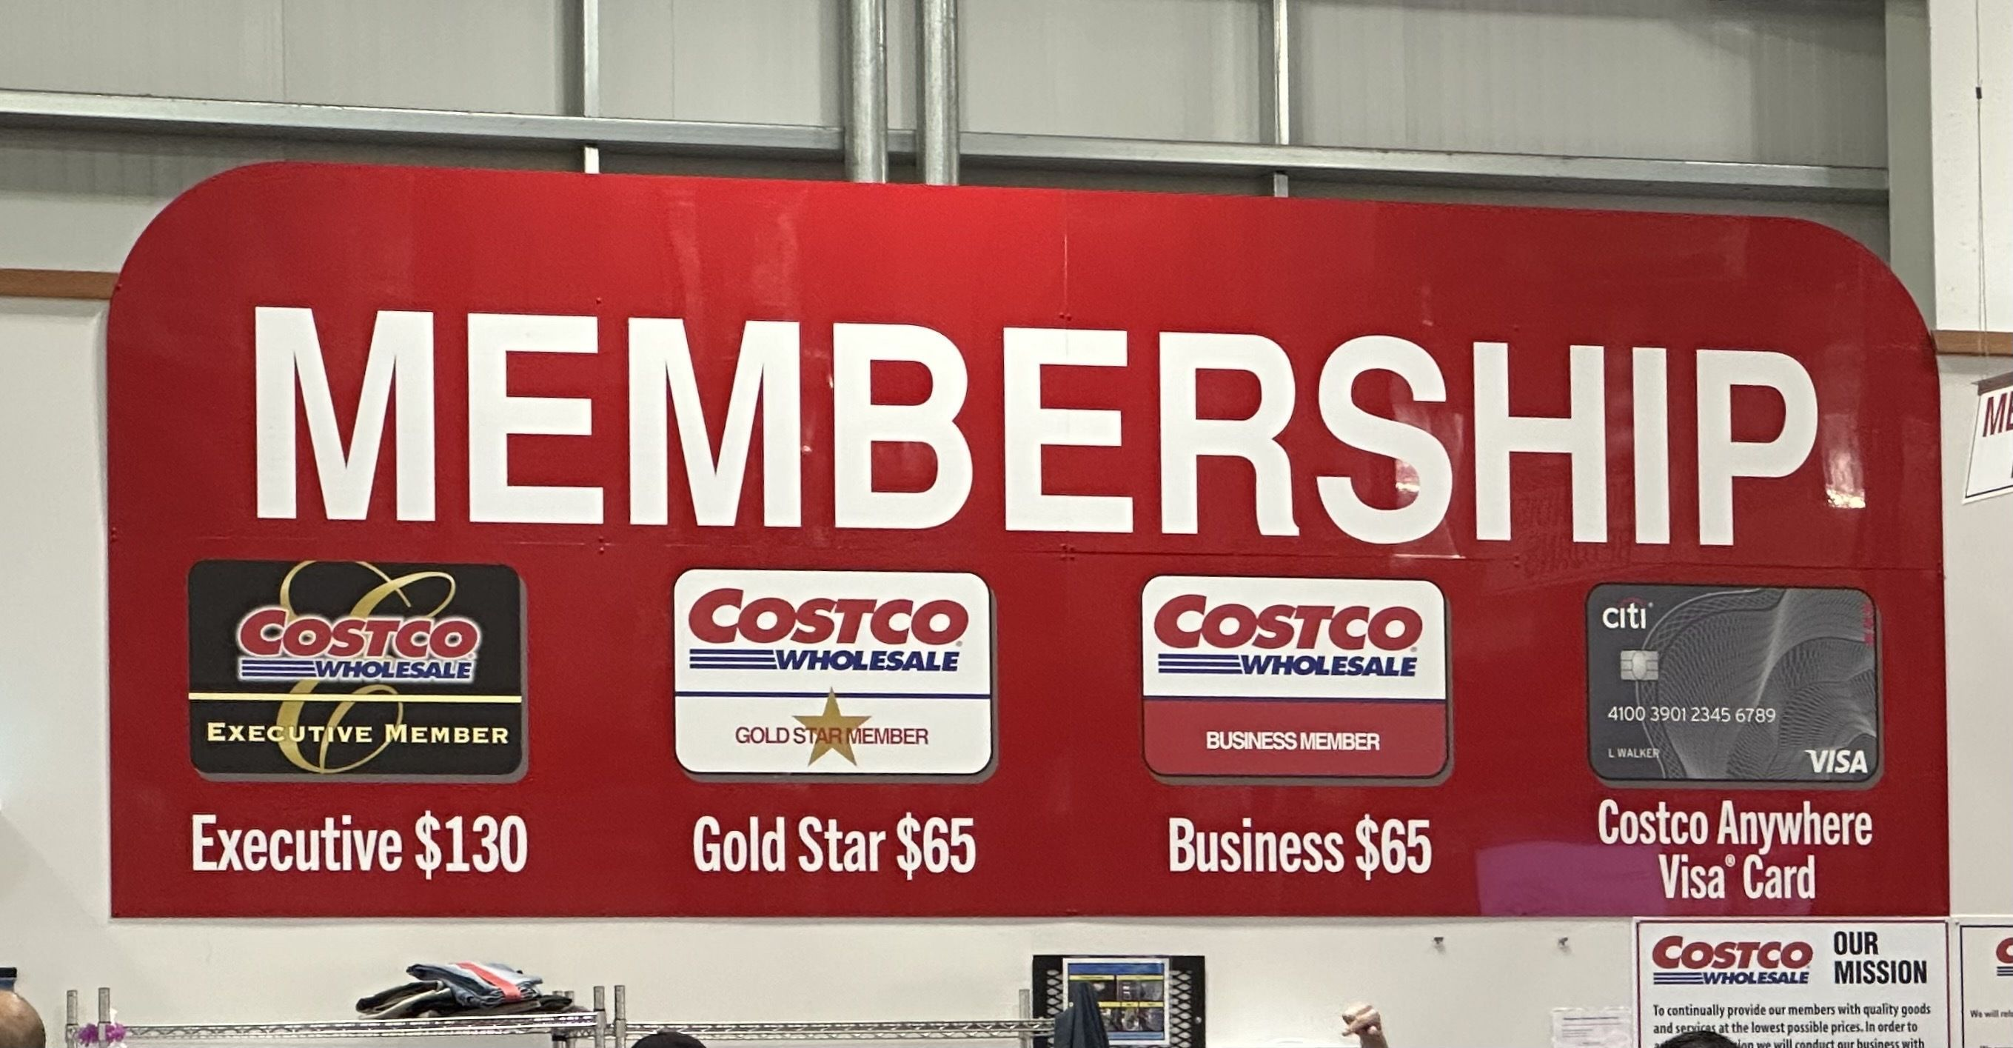

Slide 5
Luke 22:19-20
“And he took bread, and when he had given thanks, he broke it and gave it to them, saying, “This is my body, which is given for you. Do this in remembrance of me.” And likewise the cup after they had eaten, saying, “This cup that is poured out for you is the new covenant in my blood.” (ESV)

Slide 6
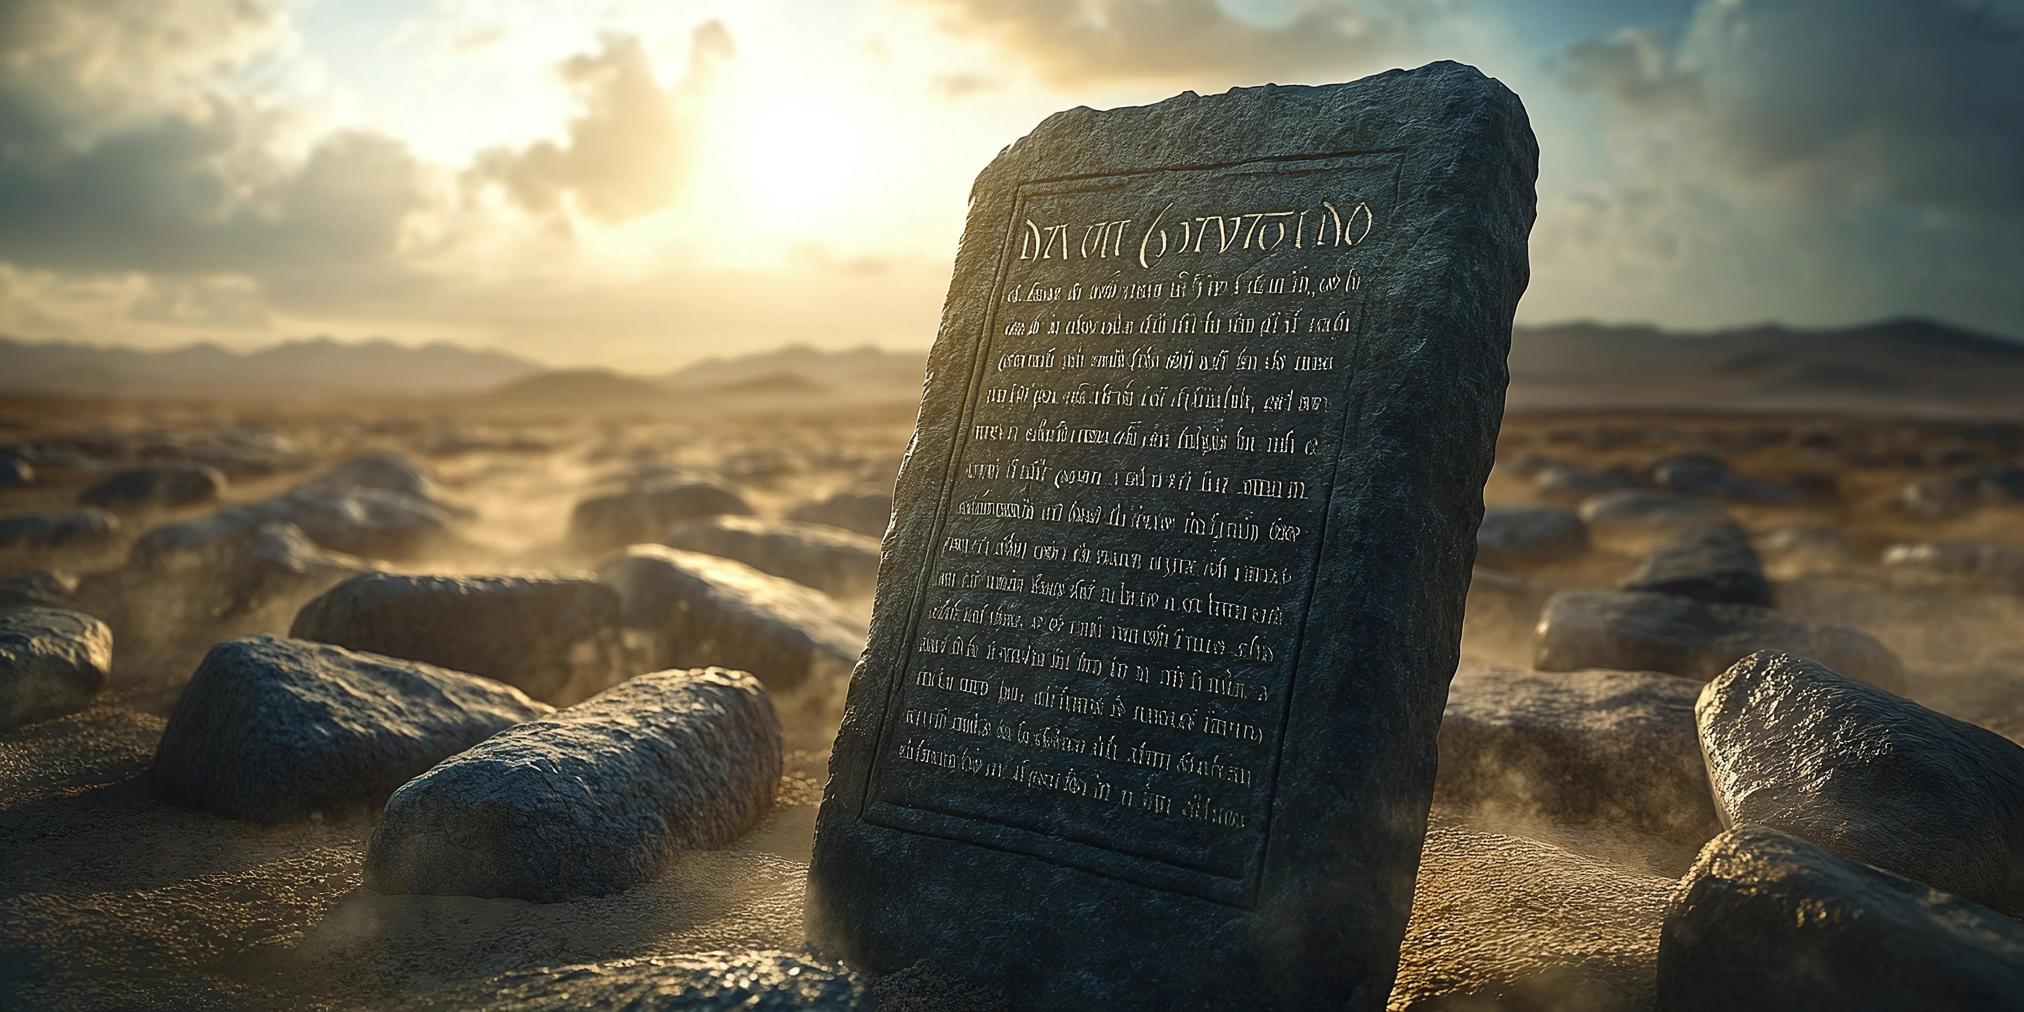
The New
Covenant

Slide 7
I am not sure if I am saved?
Does God expect anything of me?
Why This Topic Matters
All decent people are going to heaven!
I was baptized so I’m good right?

Slide 8
What Is A Covenant?
God’s Covenant
Agreement between two parties that usually have mutual benefits
Always God’s idea, with man’s blessings and consequences stipulated by Him
Has built in penalties and consequences for breaking the terms of the covenant
Built on God’s faithfulness – He will never turn away from His promises
Involved witnesses, mediation, and formality in its adoption
Covenants drive behavior and expectations

Slide 9
Genesis 9:11-13
“I establish my covenant with you, that never again shall all flesh be cut off by the waters of the flood, and never again shall there be a flood to destroy the earth.” And God said, “This is the sign of the covenant that I make between me and you and every living creature that is with you, for all future generations: I have set my bow in the cloud, and it shall be a sign of the covenant between me and the earth.” (ESV)

Slide 10
Genesis 17:1-2
“When Abram was ninety-nine years old the LORD appeared to Abram and said to him, “I am God Almighty; walk before me, and be blameless, that I may make my covenant between me and you, and may multiply you greatly.” (ESV)

Slide 11
Genesis 17:8-10
“And I will give to you and to your offspring after you the land of your sojournings, all the land of Canaan, for an everlasting possession, and I will be their God.” And God said to Abraham, “As for you, you shall keep my covenant, you and your offspring after you throughout their generations. This is my covenant, which you shall keep, between me and you and your offspring after you: Every male among you shall be circumcised.” (ESV)

Slide 12
Genesis 18:19
“For I have chosen him, that he may command his children and his household after him to keep the way of the LORD by doing righteousness and justice, so that the LORD may bring to Abraham what he has promised him.” (ESV)

Slide 13
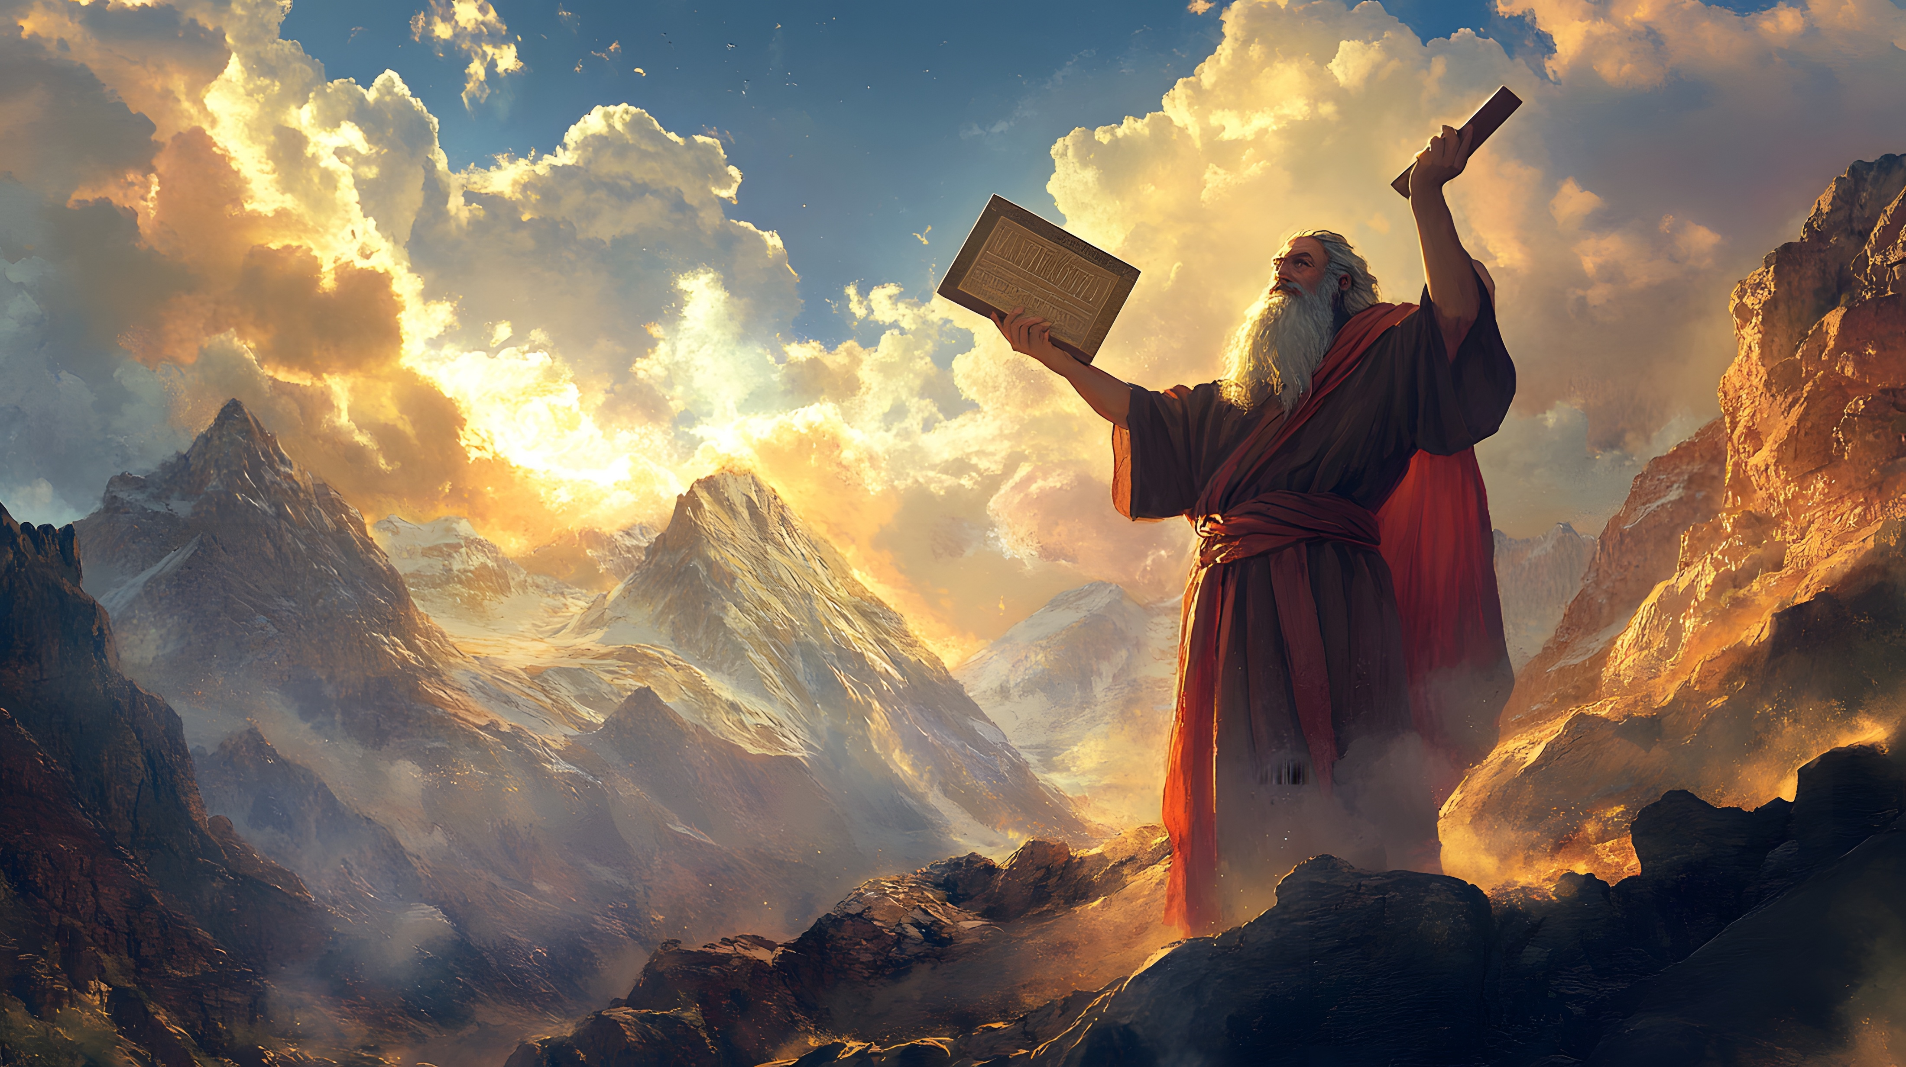
Deuteronomy 28
Moses came and told the people all the words of the LORD and all the rules. And all the people answered with one voice and said, “All the words that the LORD has spoken we will do.”

Slide 14
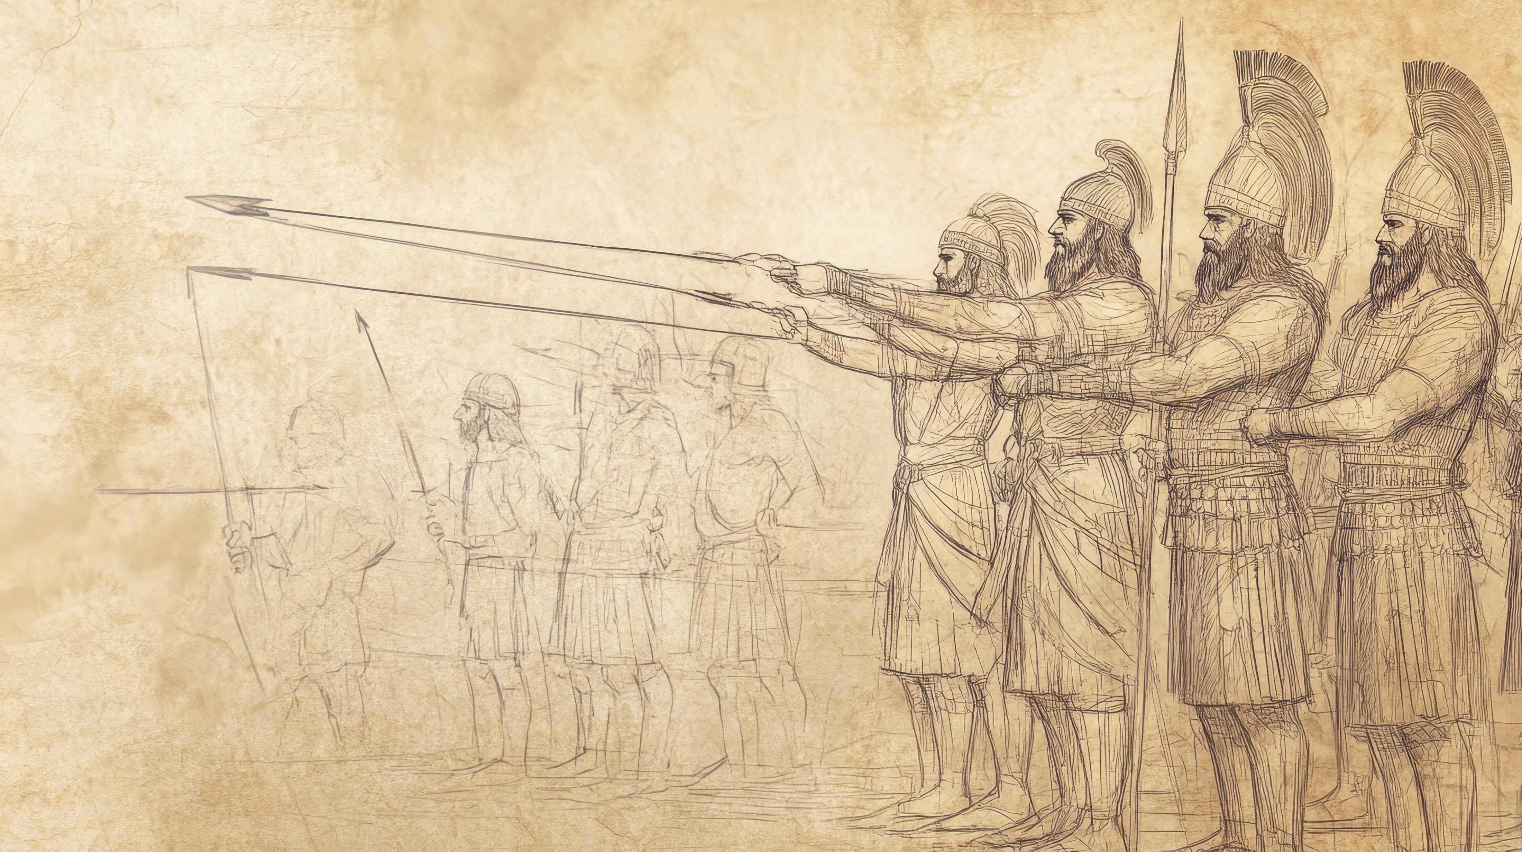
“For thus says the Lord GOD: I will deal with you as you have done, you who have despised the oath in breaking the covenant, yet I will remember my covenant with you in the days of your youth, and I will establish for you an everlasting covenant.” (Ezekiel 16:59-60)

Slide 15
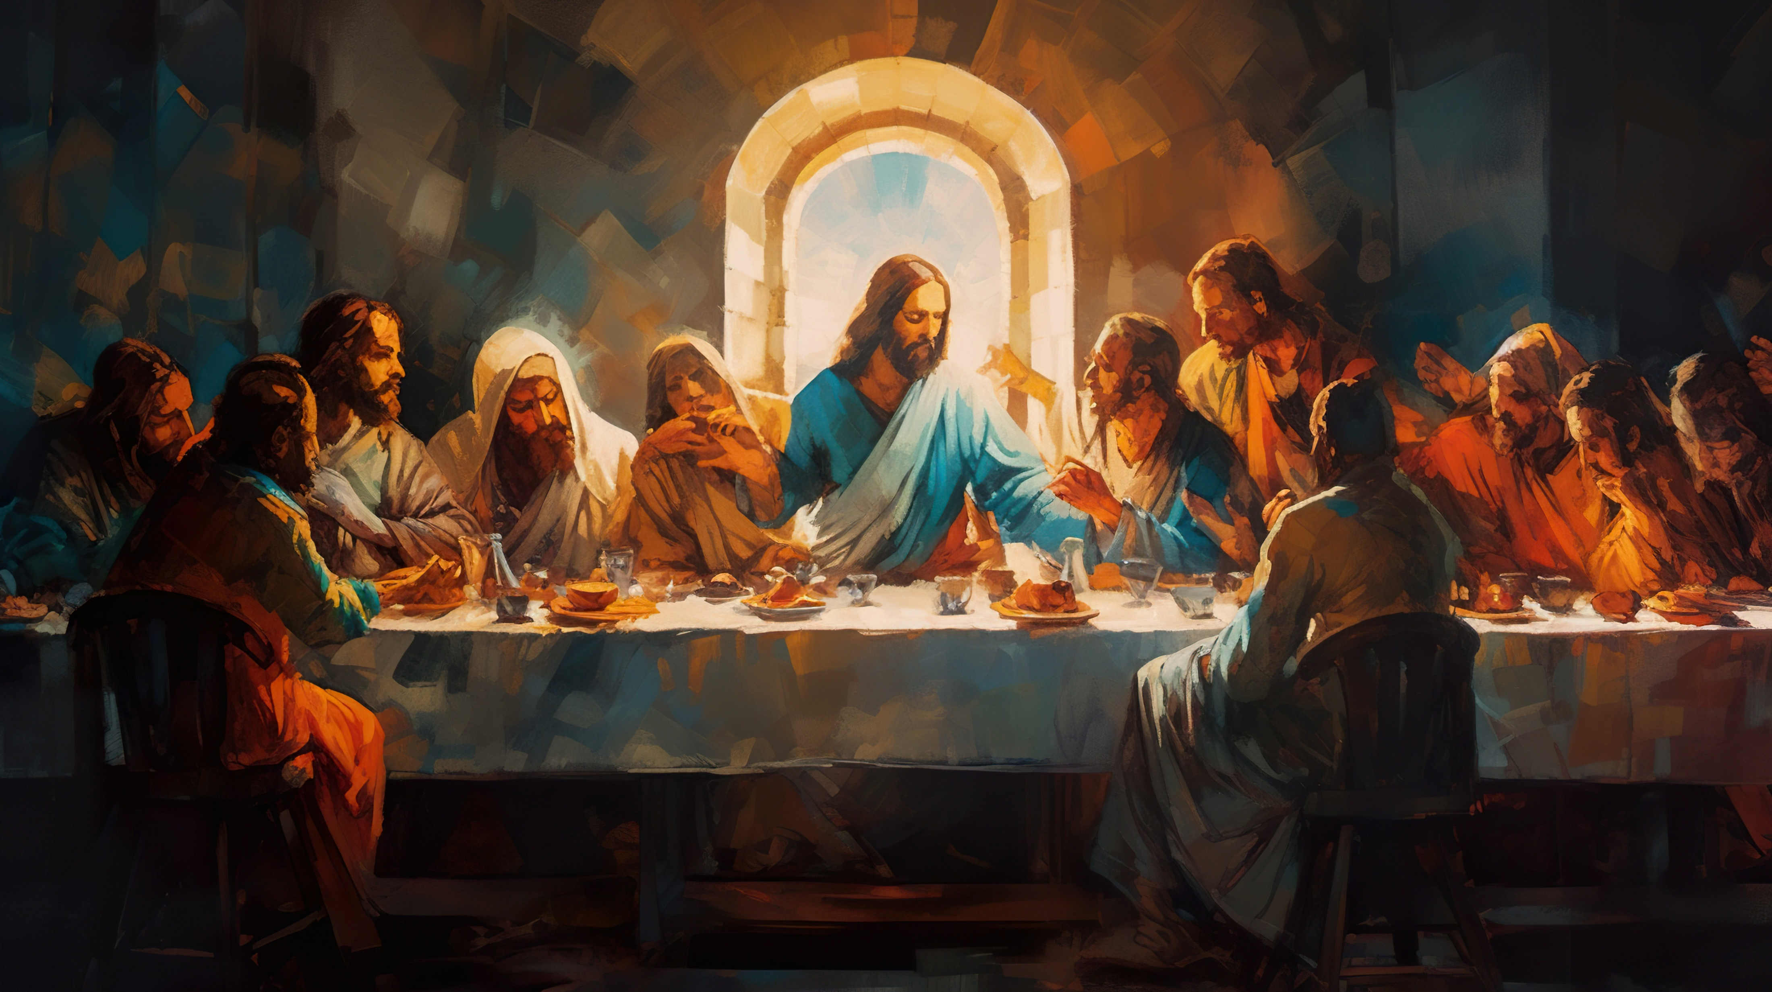

Slide 16
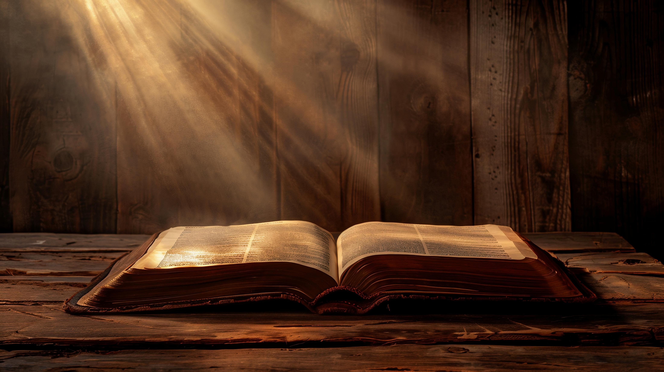
Hebrews Chapter 8

Slide 17
How Is It “New”?
Two Greek Words for “New”
“A new commandment I give to you, that you love one another: just as I have loved you, you also are to love one another.” (John 13:34)
Kainos – Refers to Quality. Emphasis is on renovation, renewal and improvement.
Neos – Chronological. Emphasis is on the latest, like in a new generation of people.
The New Covenant isn’t Just the latest, it is better in every way

Slide 18
The New Covenant
The New Covenant is Better
God will put His laws in our minds and on our hearts
Because God is working to help us change from within (Ezek. 36:26)
We will not have to be taught by someone, we will all have access to know the Lord
Everyone has equal access to the knowledge of God (Matt 11:25)
Free and full forgiveness is offered once for our sins through the death of Jesus (Hebrews 7:25)
He will give us mercy and forgiveness for our transgressions

Slide 19
Hebrews 13:20-21
“Now may the God of peace who brought again from the dead our Lord Jesus, the great shepherd of the sheep, by the blood of the eternal covenant, equip you with everything good that you may do his will, working in us that which is pleasing in his sight, through Jesus Christ, to whom be glory forever and ever. Amen. (ESV)

Slide 20

In him also you were circumcised with a circumcision made without hands, by putting off the body of the flesh, by the circumcision of Christ, having been buried with him in baptism, in which you were also raised with him through faith in the powerful working of God, who raised him from the dead. (Colossians 2:11-12)

Slide 21
Hebrews 10:28-29
“Anyone who has set aside the law of Moses dies without mercy on the evidence of two or three witnesses. How much worse punishment, do you think, will be deserved by the one who has trampled underfoot the Son of God, and has profaned the blood of the covenant by which he was sanctified, and has outraged the Spirit of grace? (ESV)

