Slide 1

Choosing Your
CHURCH
Why I Am Here

Slide 2

2nd Corinthians 11:3-4
But I am afraid that, as the serpent deceived Eve by his craftiness, your minds will be led astray from the simplicity and purity of devotion to Christ. For if someone comes and proclaims another Jesus than the one we proclaimed, or if you receive a different spirit from the one you received, or if you accept a different gospel from the one you accepted, you put up with it readily enough.

Slide 3

A Different Church for Everyone
My Favorite!
God is HERE!
This is it!
Where is the real Jesus?

Slide 4
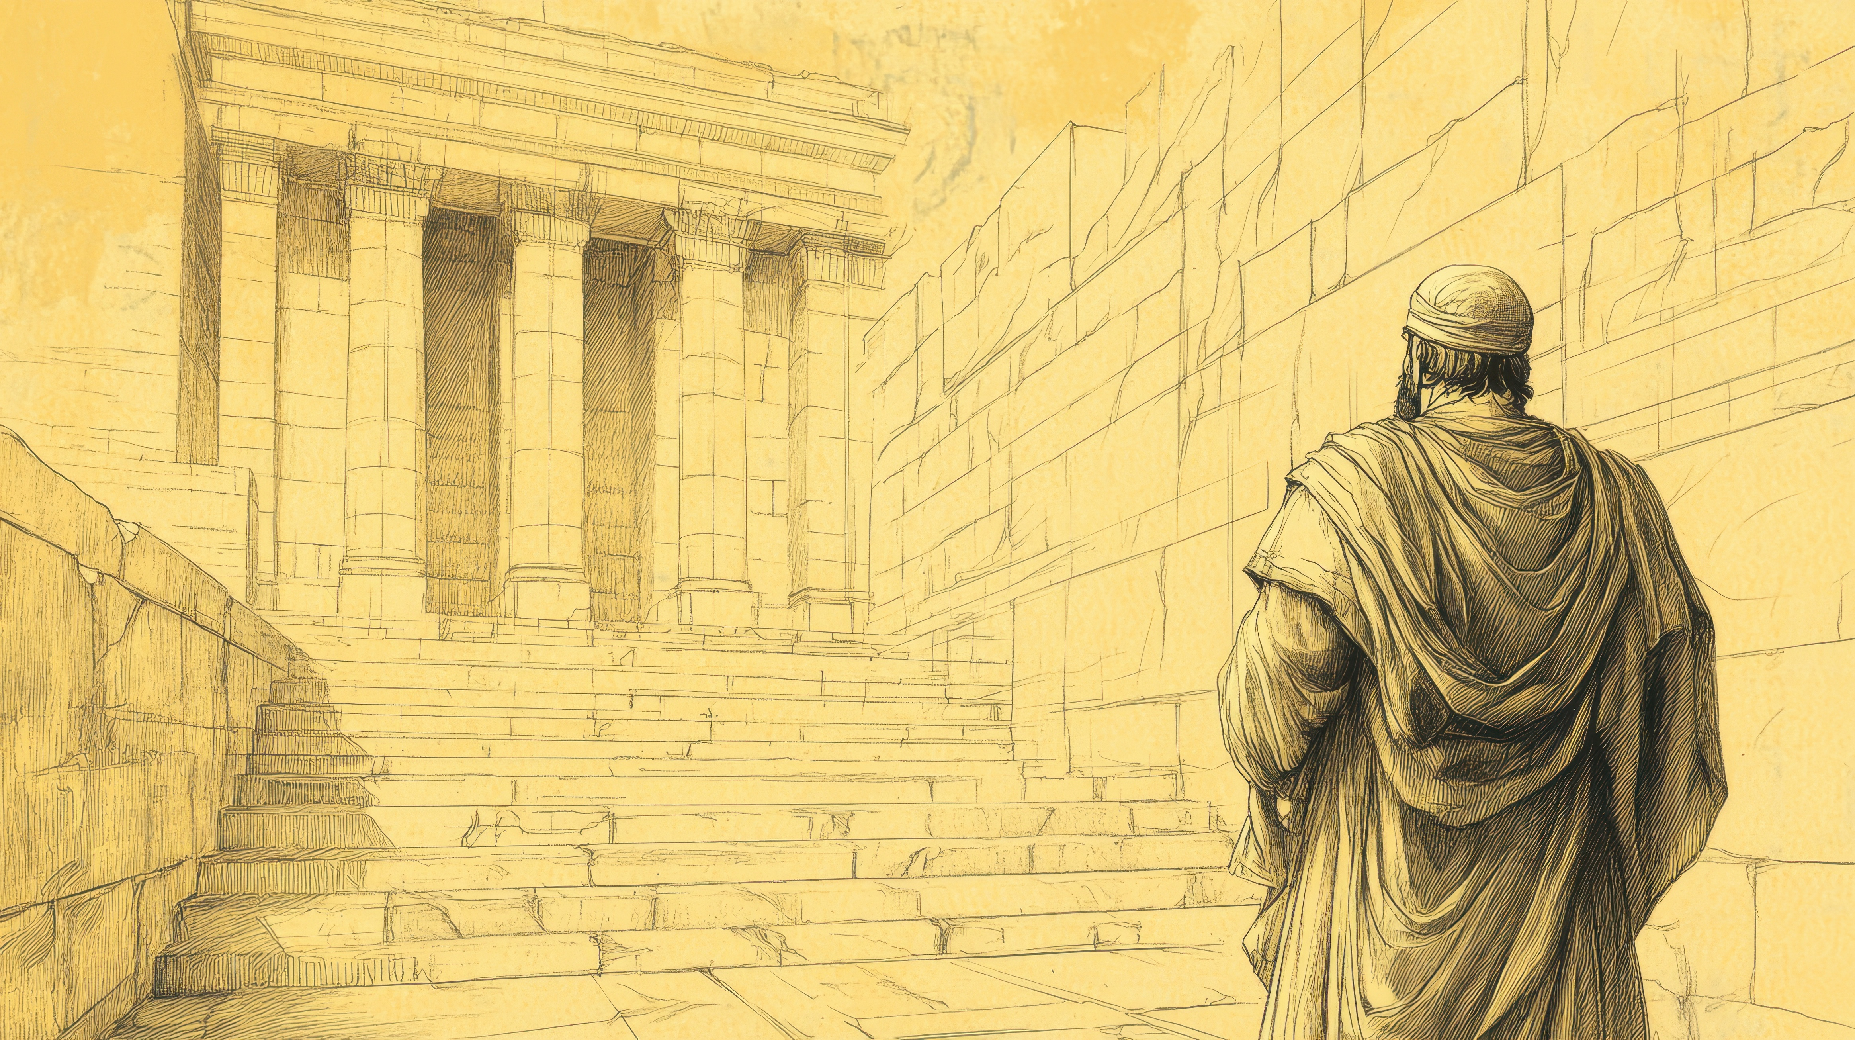
2nd Kings 22:8, 11
And Hilkiah the high priest said to Shaphan the secretary, “I have found the Book of the Law in the house of the LORD.” And Hilkiah gave the book to Shaphan, and he read it… When the king heard the words of the Book of the Law, he tore his clothes.

Slide 5
2nd Kings 23:2
And the king went up to the house of the LORD, and with him all the men of Judah and all the inhabitants of Jerusalem and the priests and the prophets, all the people, both small and great. And he read in their hearing all the words of the Book of the Covenant that had been found in the house of the LORD.

Slide 6
2nd Kings 23:21-22
And the king commanded all the people, “Keep the Passover to the LORD your God, as it is written in this Book of the Covenant.” For no such Passover had been kept since the days of the judges who judged Israel, or during all the days of the kings of Israel or of the kings of Judah.

Slide 7
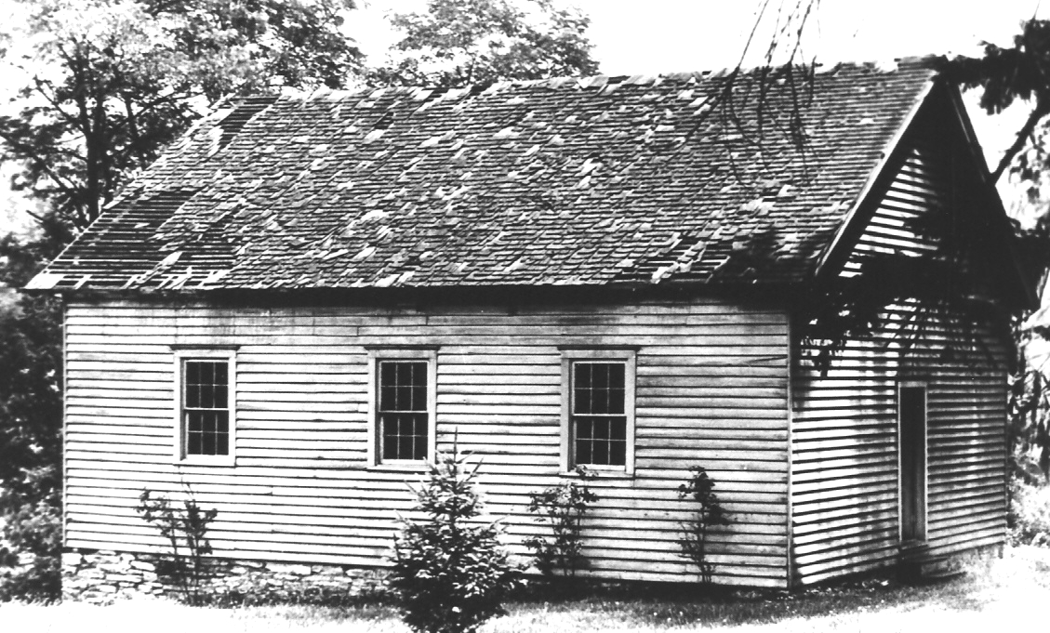
“We have no system of our own, nor of others to substitute in lieu of the reigning systems. We only aim at substituting the New Testament in lieu of every creed in existence; whether Mohammedan, Pagan, Jewish or Presbyterian. We wish to call Christians to consider that Jesus Christ has made them kings and priests to God. We neither advocate Calvinism, Arminianism, Arianism, Trinitarianism, Unitarianism, Deism or Sectarianism, but New Testamentism. We wish, we cordially wish, to take the New Testament out of the abuses of the clergy and put it into the hands of the people.”
The church that God would want us to choose is one that aligns with the teachings of the Bible

Slide 8

I believe what God says about our conversion

Slide 9
Elements of Salvation
“I am Jesus, whom you are persecuting.”
Belief in Jesus
The Church
“I was not disobedient to the heavenly vision…”
And the Lord added to their number day by day those who were being saved.
- Acts 2:47
Commitment to Change
“Rise and be baptized and wash away your sins, calling on his name.’
Baptism in Water

Slide 10
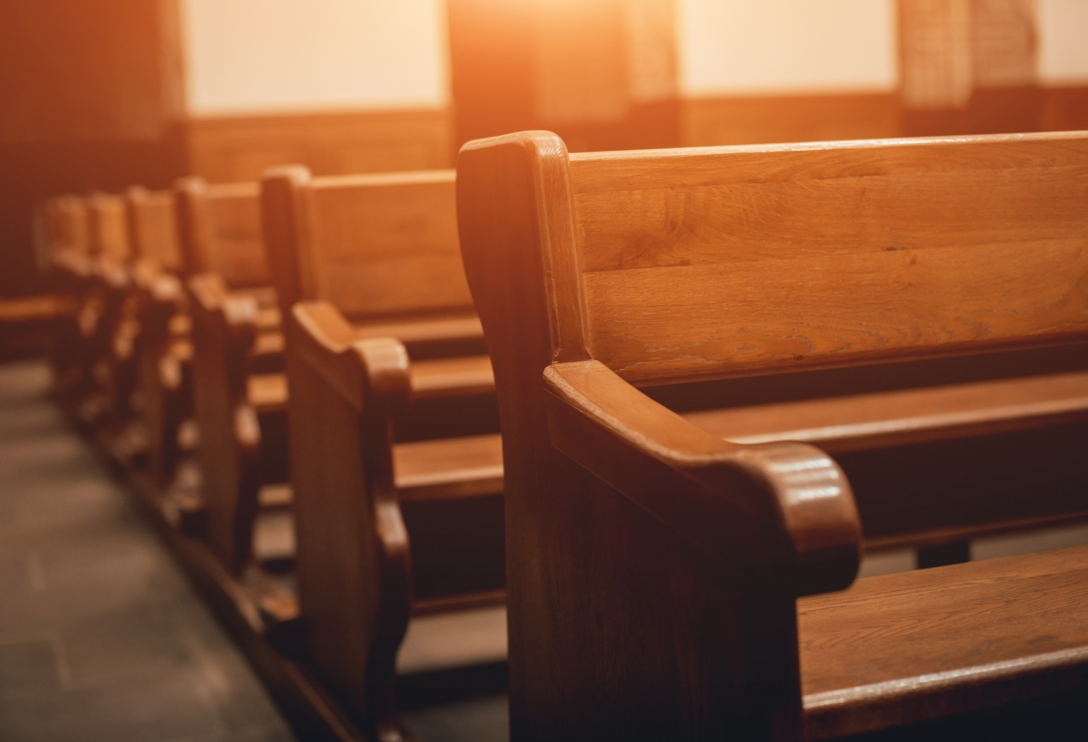
I believe in The Simplicity of the church

Slide 11
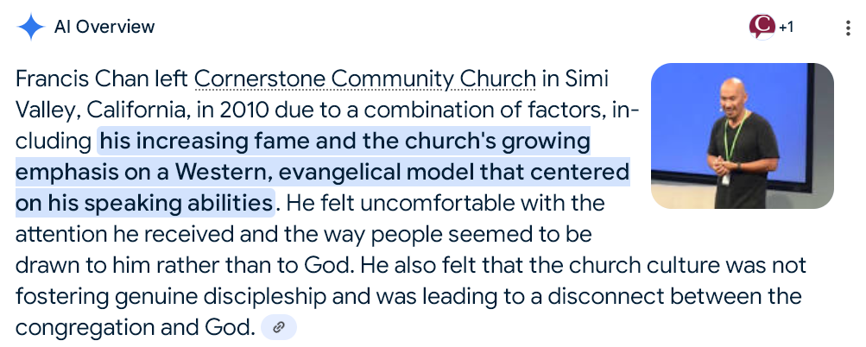
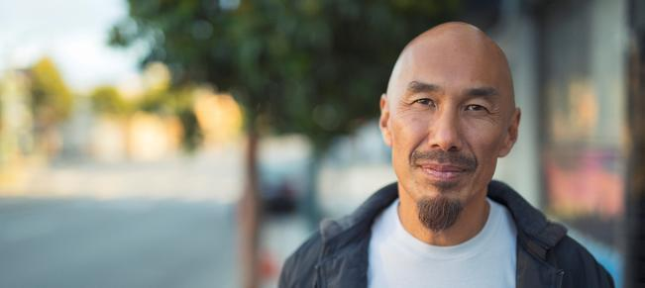

Slide 12
The Simplicity of the church
1st Timothy 4:13
Shared lives and relationships
Reading and sharing scripture
Singing hymns
Generosity
Weekly gatherings
Communion/Lord’s Supper
Prayer
Making other disciples
Until I come, devote yourself to the public reading of Scripture, to exhortation, to teaching.

Slide 13
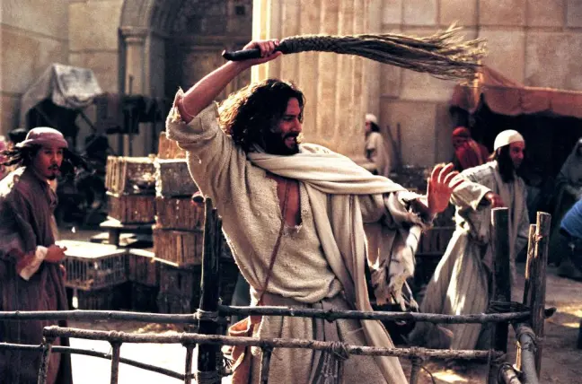
His disciples remembered that it was written, “Zeal for your house will consume me.” - John 2:17

Slide 14

I believe In the timeless Morals of the Bible

Slide 15
Galatians 1:6-8
I am astonished that you are so quickly deserting him who called you in the grace of Christ and are turning to a different gospel— not that there is another one, but there are some who trouble you and want to distort the gospel of Christ. But even if we or an angel from heaven should preach to you a gospel contrary to the one we preached to you, let him be accursed.

Slide 16
1st Corinthians 6:9-10
Or do you not know that the unrighteous will not inherit the kingdom of God? Do not be deceived: neither the sexually immoral, nor idolaters, nor adulterers, nor men who practice homosexuality, nor thieves, nor the greedy, nor drunkards, nor revilers, nor swindlers will inherit the kingdom of God.

Slide 17
Matthew 19:9-10
And I say to you: whoever divorces his wife, except for sexual immorality, and marries another, commits adultery.” The disciples said to him, “If such is the case of a man with his wife, it is better not to marry.”

Slide 18
2nd Peter 2:18-19
For, speaking loud boasts of folly, they entice by sensual passions of the flesh those who are barely escaping from those who live in error. They promise them freedom, but they themselves are slaves of corruption. For whatever overcomes a person, to that he is enslaved.

Slide 19
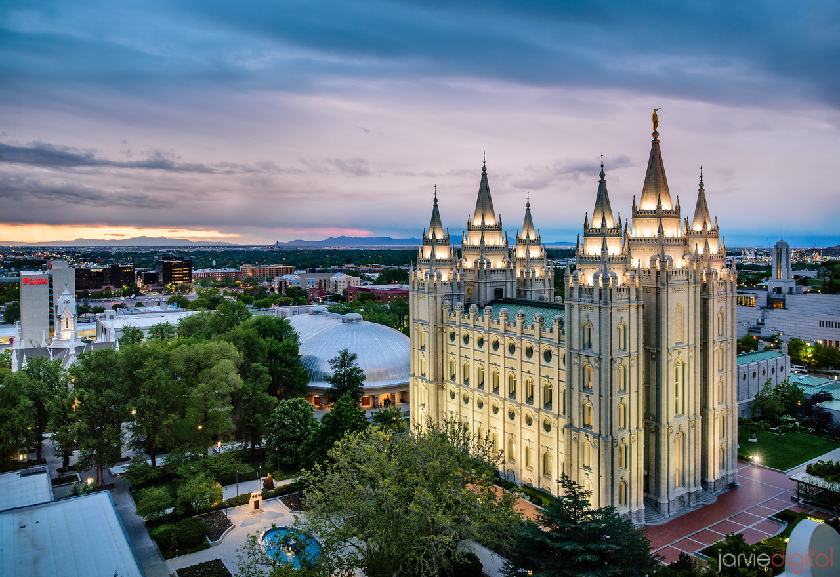
I believe in God’s structure for The Church

Slide 20

Church Leadership
Paul and Timothy, servants of Christ Jesus, To all the saints in Christ Jesus who are at Philippi, with the overseers and deacons
“As in all the churches of the saints,
the women should keep silent …and should be in submission…”
Local Church Leadership
No additional Oversight from Human authorities
Traditional Gendre Roles

Slide 21
The Job Of A Church
Hold on to what is good
Correct things that are wrong
…with all humility and gentleness, with patience, bearing with one another in love, eager to maintain the unity of the Spirit in the bond of peace.

