Slide 1
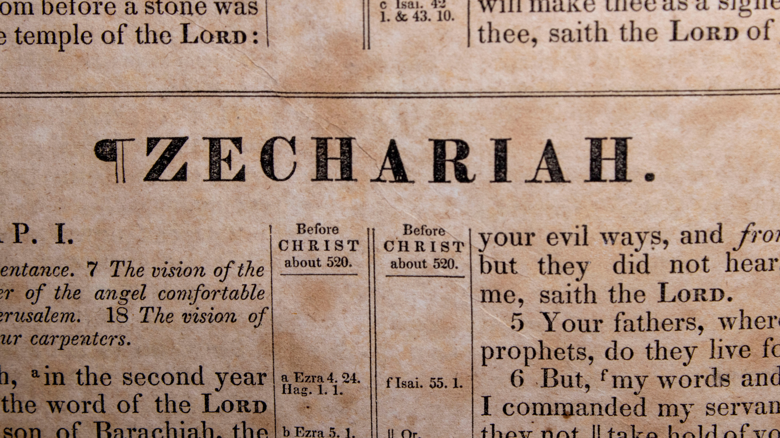

Slide 2
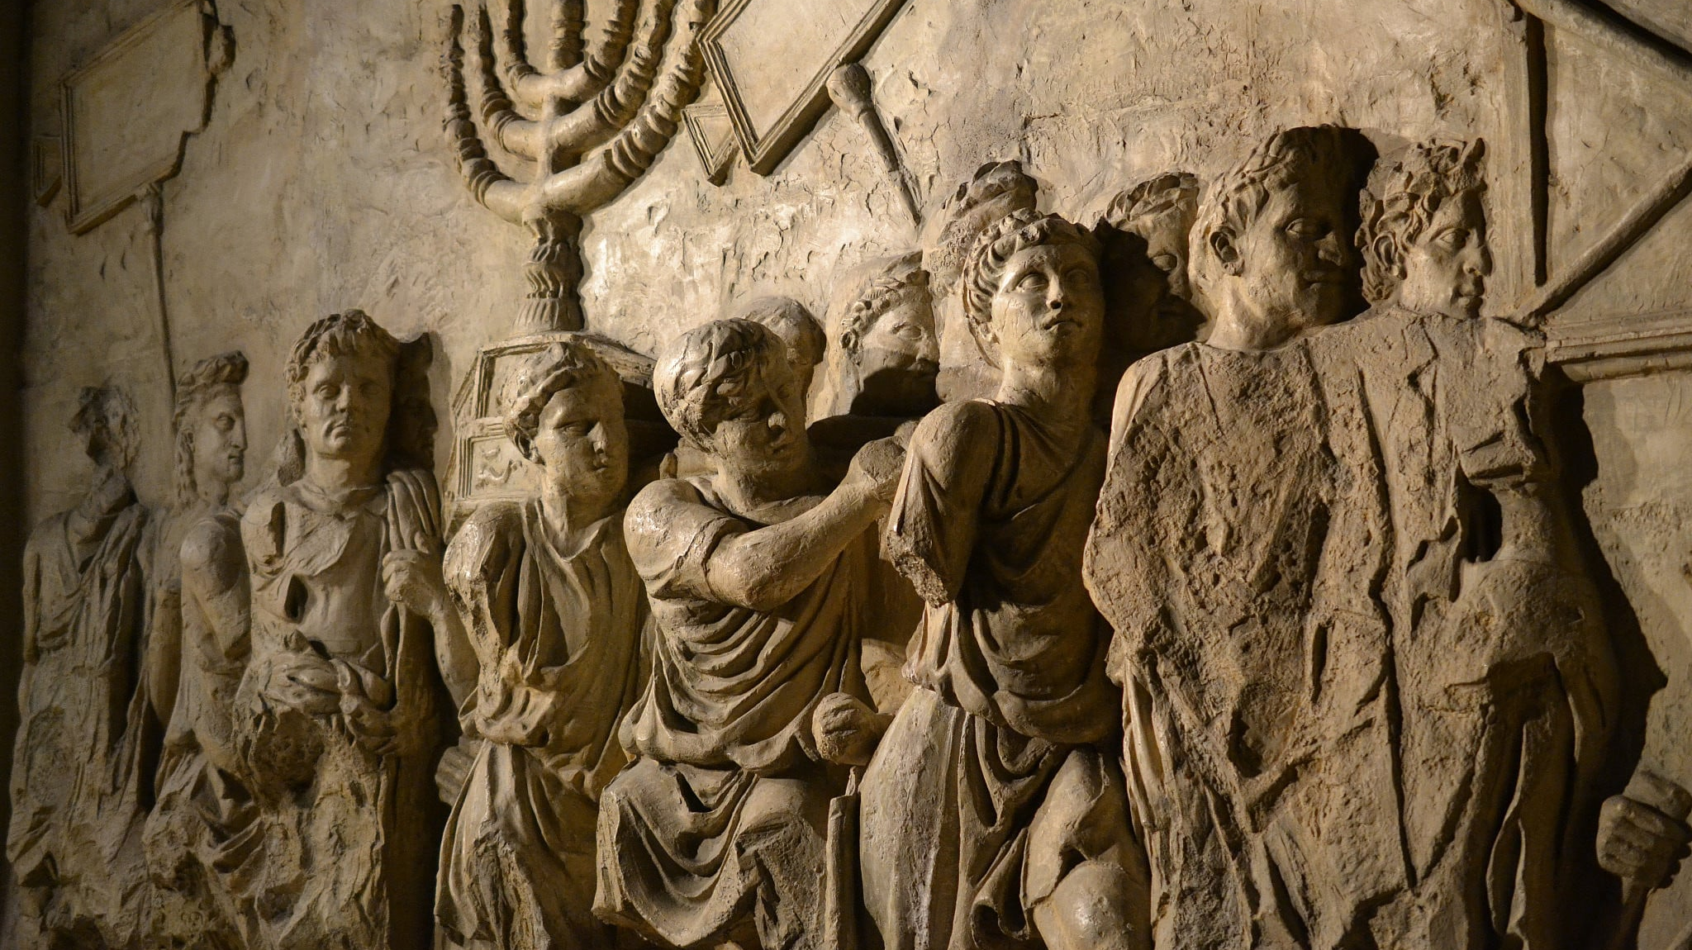

Slide 3
Timeline of the Major and Minor Prophets
Nahum
Jonah
Zephaniah
Haggai
Obadiah
Amos
Habakkuk
Joel
Zechariah
Jeremiah
900 B.C.
800 B.C.
700 B.C.
600 B.C.
500 B.C.
Micah
Daniel
Elijah
Isaiah
Ezekiel
Elisha
Malachi
Hosea
Captivity

Slide 4

“But many of the priests and Levites and heads of fathers' houses, old men who had seen the first house, wept with a loud voice when they saw the foundation of this house being laid, though many shouted aloud for joy…” (Ezra 3:12)

Slide 5
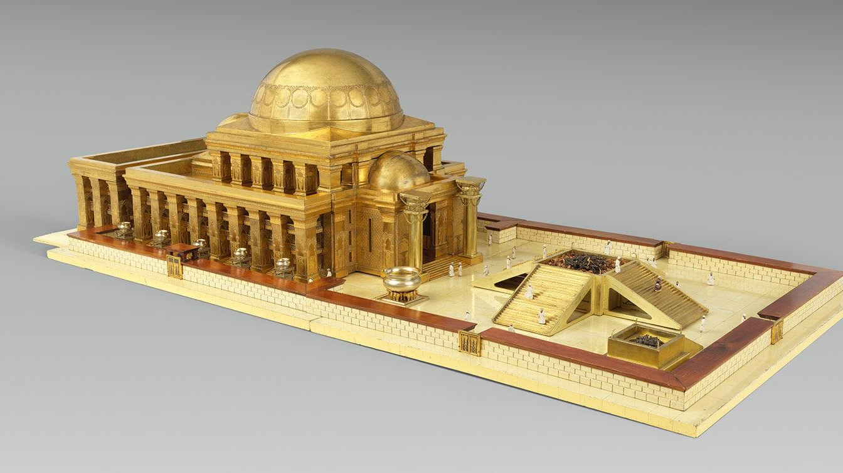

Slide 6
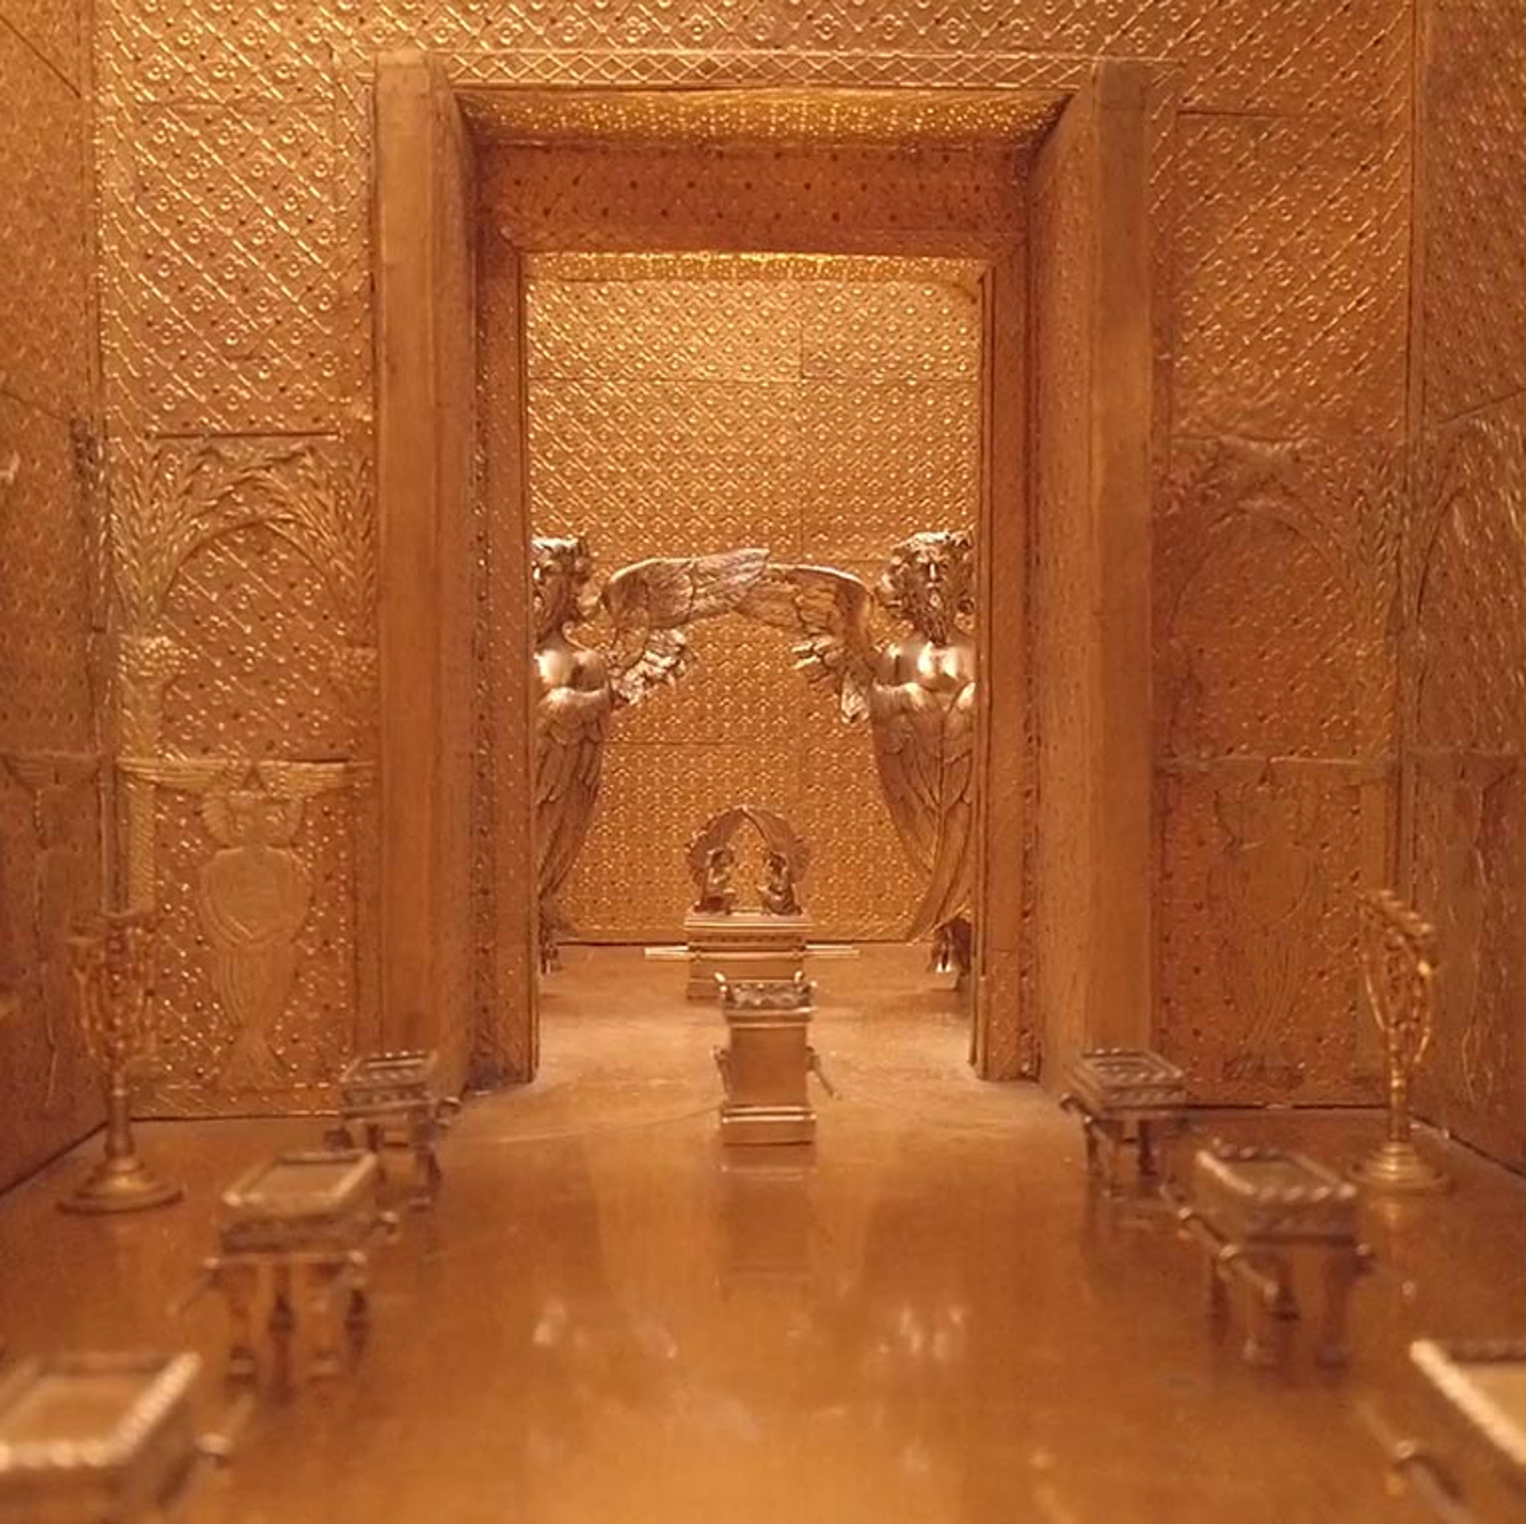

Slide 7
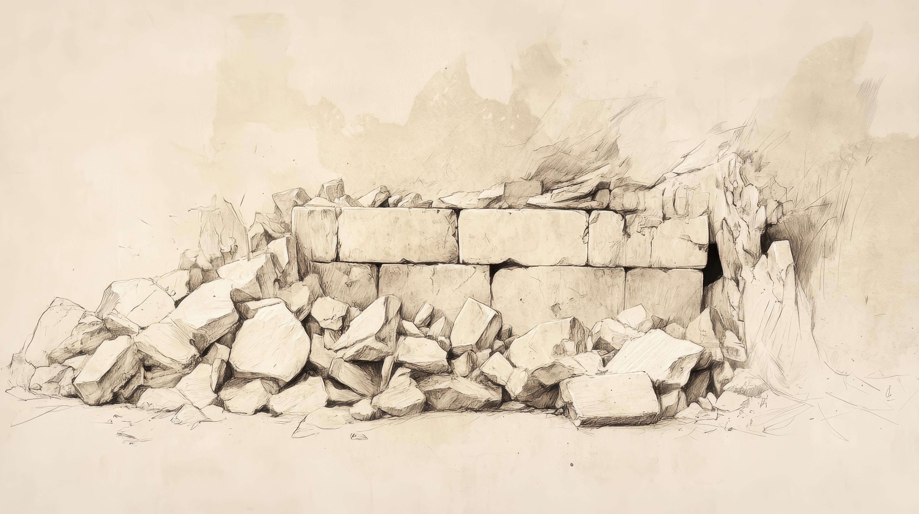
“Who is left among you who saw this house in its former glory? How do you see it now? Is it not as nothing in your eyes?”
(Haggai 2:3)

Slide 8
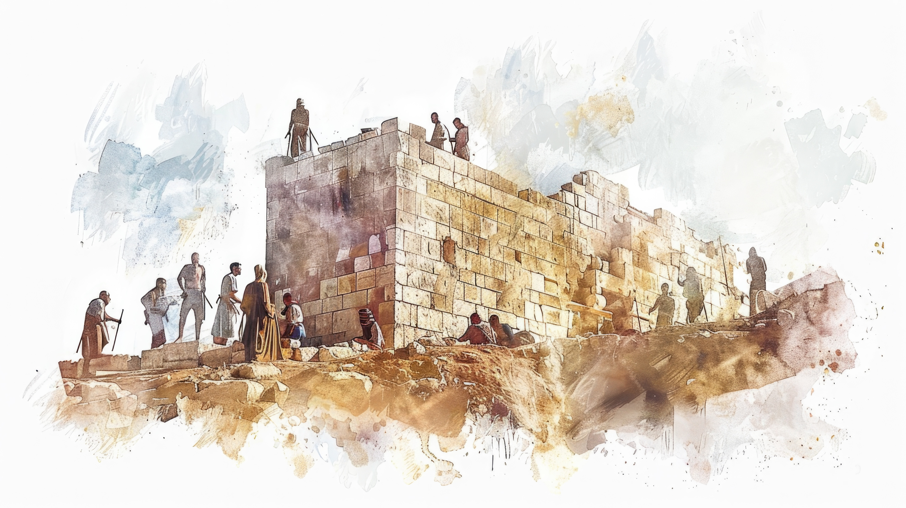
“The hands of Zerubbabel have laid the foundation of this house; his hands shall also complete it. Then you will know that the LORD of hosts has sent me to you.”
(Zechariah 4:9)

Slide 9
“For who has despised the day of small things? But these seven will be glad when they see the plumb line in the hand of Zerubbabel—these are the eyes of the LORD which range to and fro throughout the earth.” (Zechariah 4:10)

Slide 10

don’t despise the
Small Things.
Zechariah 4:10

Slide 11

1st Corinthians 1:26
“For consider your calling, brethren, that there were not many wise according to the flesh, not many mighty, not many noble…”
Small People

Slide 12

Small gestures
Acts 9:39
“…All the widows stood beside him weeping and showing tunics and other garments that Dorcas made while she was with them.”

Slide 13
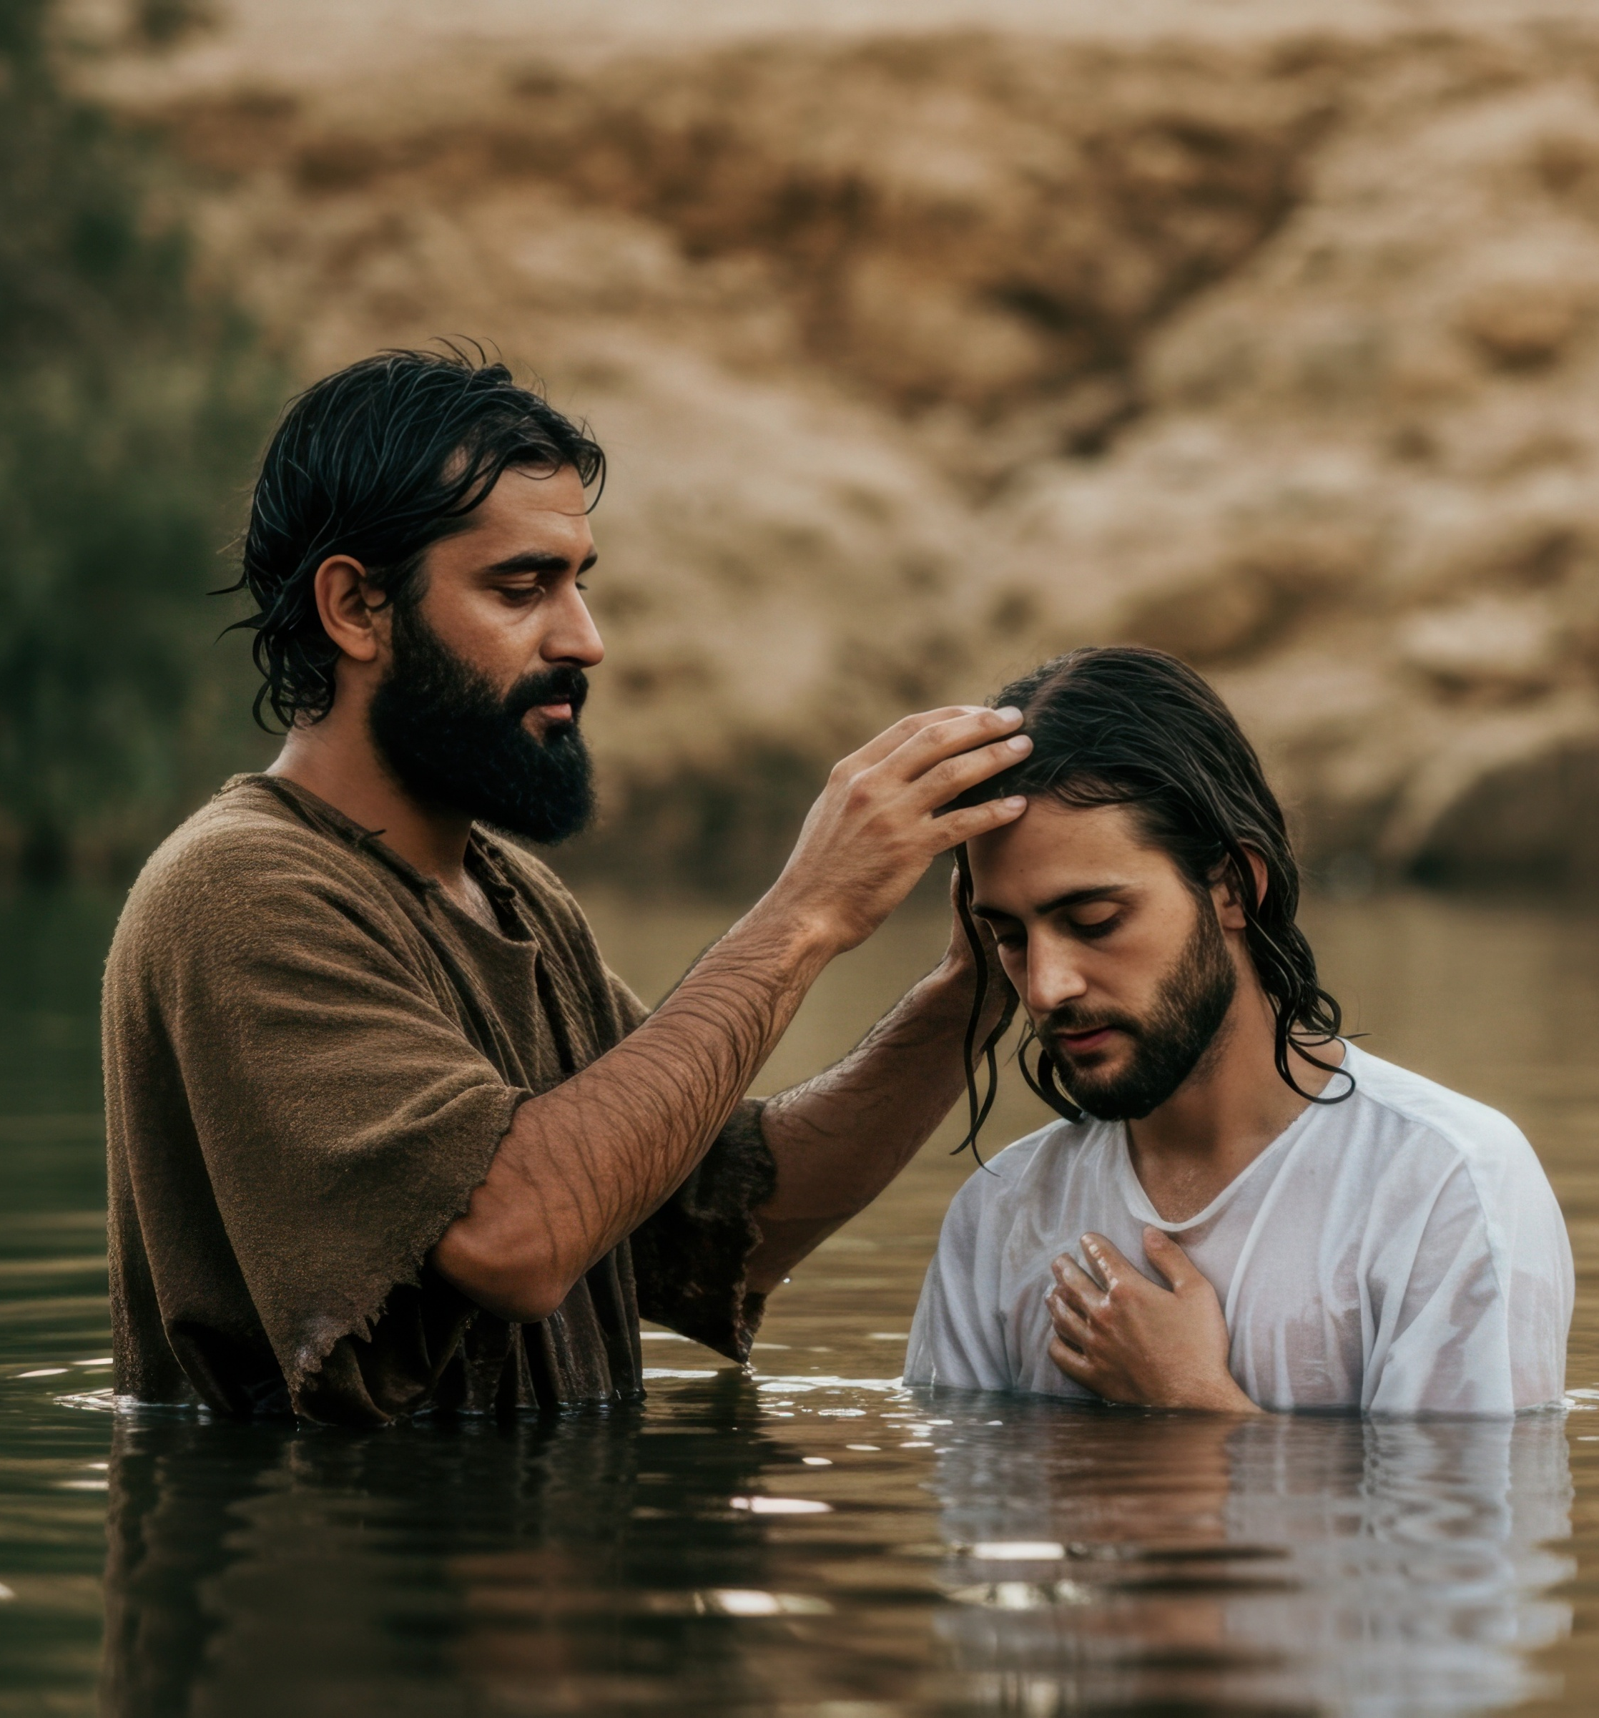
Acts 8:38
“And he ordered the chariot to stop; and they both went down into the water, Philip as well as the eunuch, and he baptized him.”
Small beginnings

Slide 14
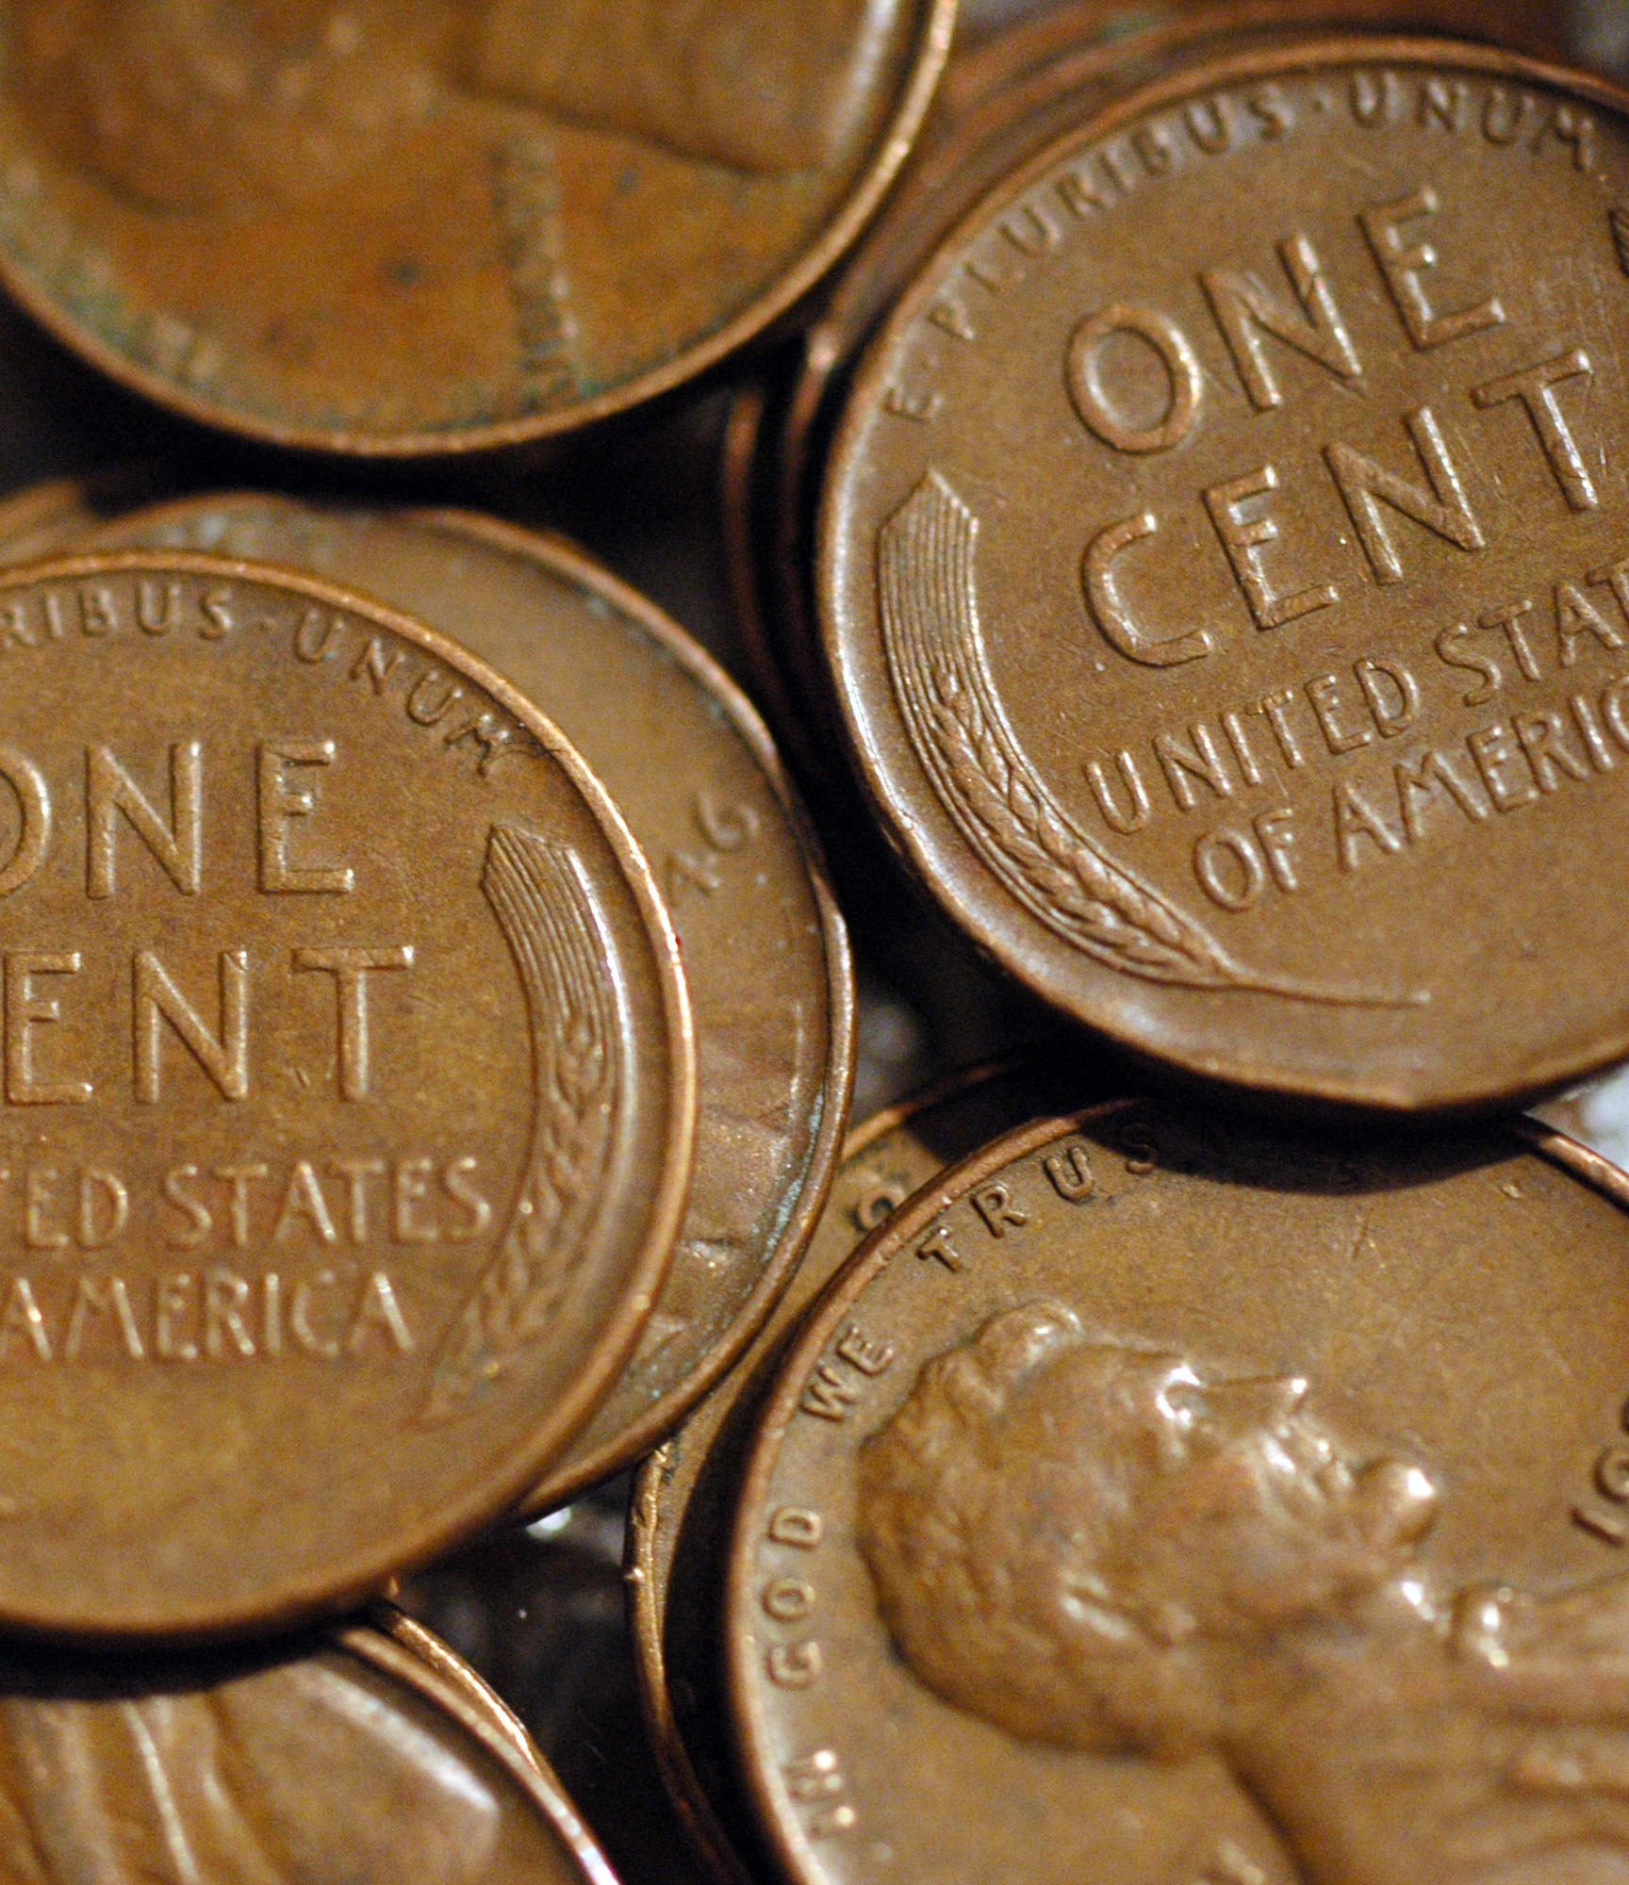
Luke 21:2-3
“…and he saw a poor widow put in two small copper coins.
And he said, “Truly, I tell you, this poor widow has put in more than all of them.”
Small sacrifices

Slide 15
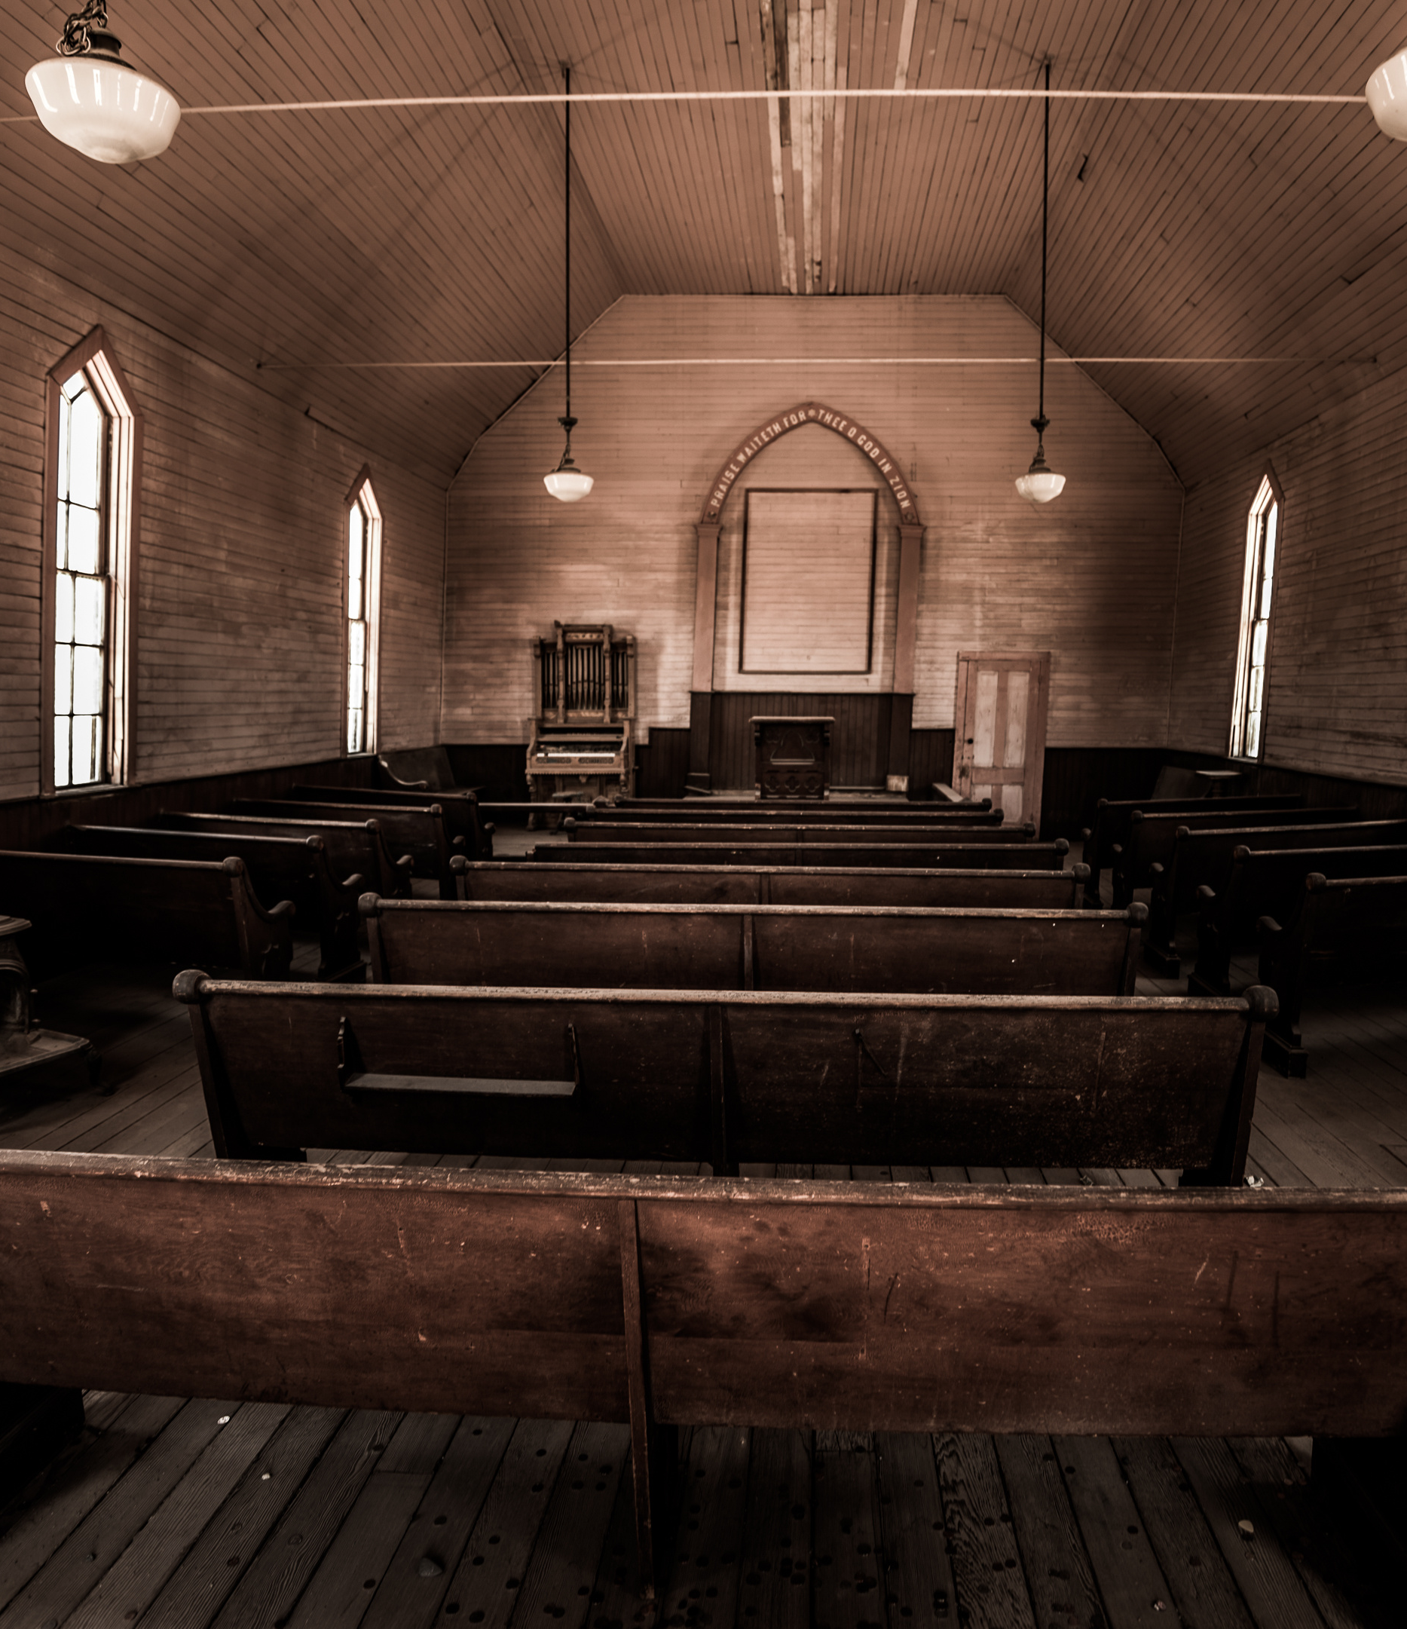
Hebrews 10:24-25
“And let us consider how to stir up one another to love and good works, not neglecting to meet together, as is the habit of some, but encouraging one another, and all the more as you see the Day drawing near.”
Small Expectations

Slide 16

Then the King will say to those on his right, ‘Come, you who are blessed by my Father, inherit the kingdom prepared for you from the foundation of the world. (Matthew 25:34)

