Slide 1
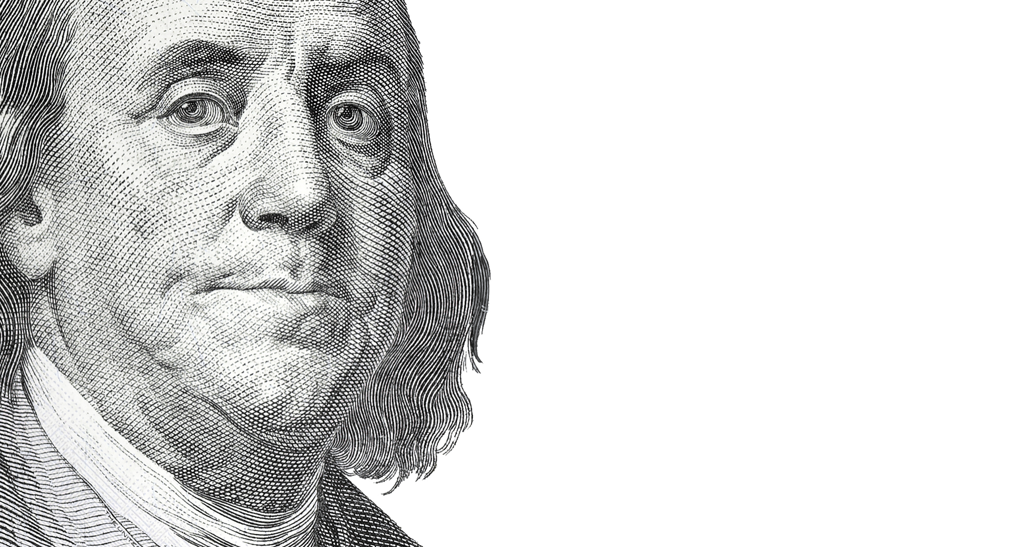

Slide 2


Slide 3

2nd Corinthians 5:19-20
“…in Christ, God was reconciling the world to himself, not counting their trespasses against them, and entrusting to us the message of reconciliation. Therefore, we are ambassadors for Christ, God making his appeal through us. We implore you on behalf of Christ, be reconciled to God.”

Slide 4

The Love OF Christ compels US

Slide 5

God… has given us the ministry of reconciliation

Slide 6
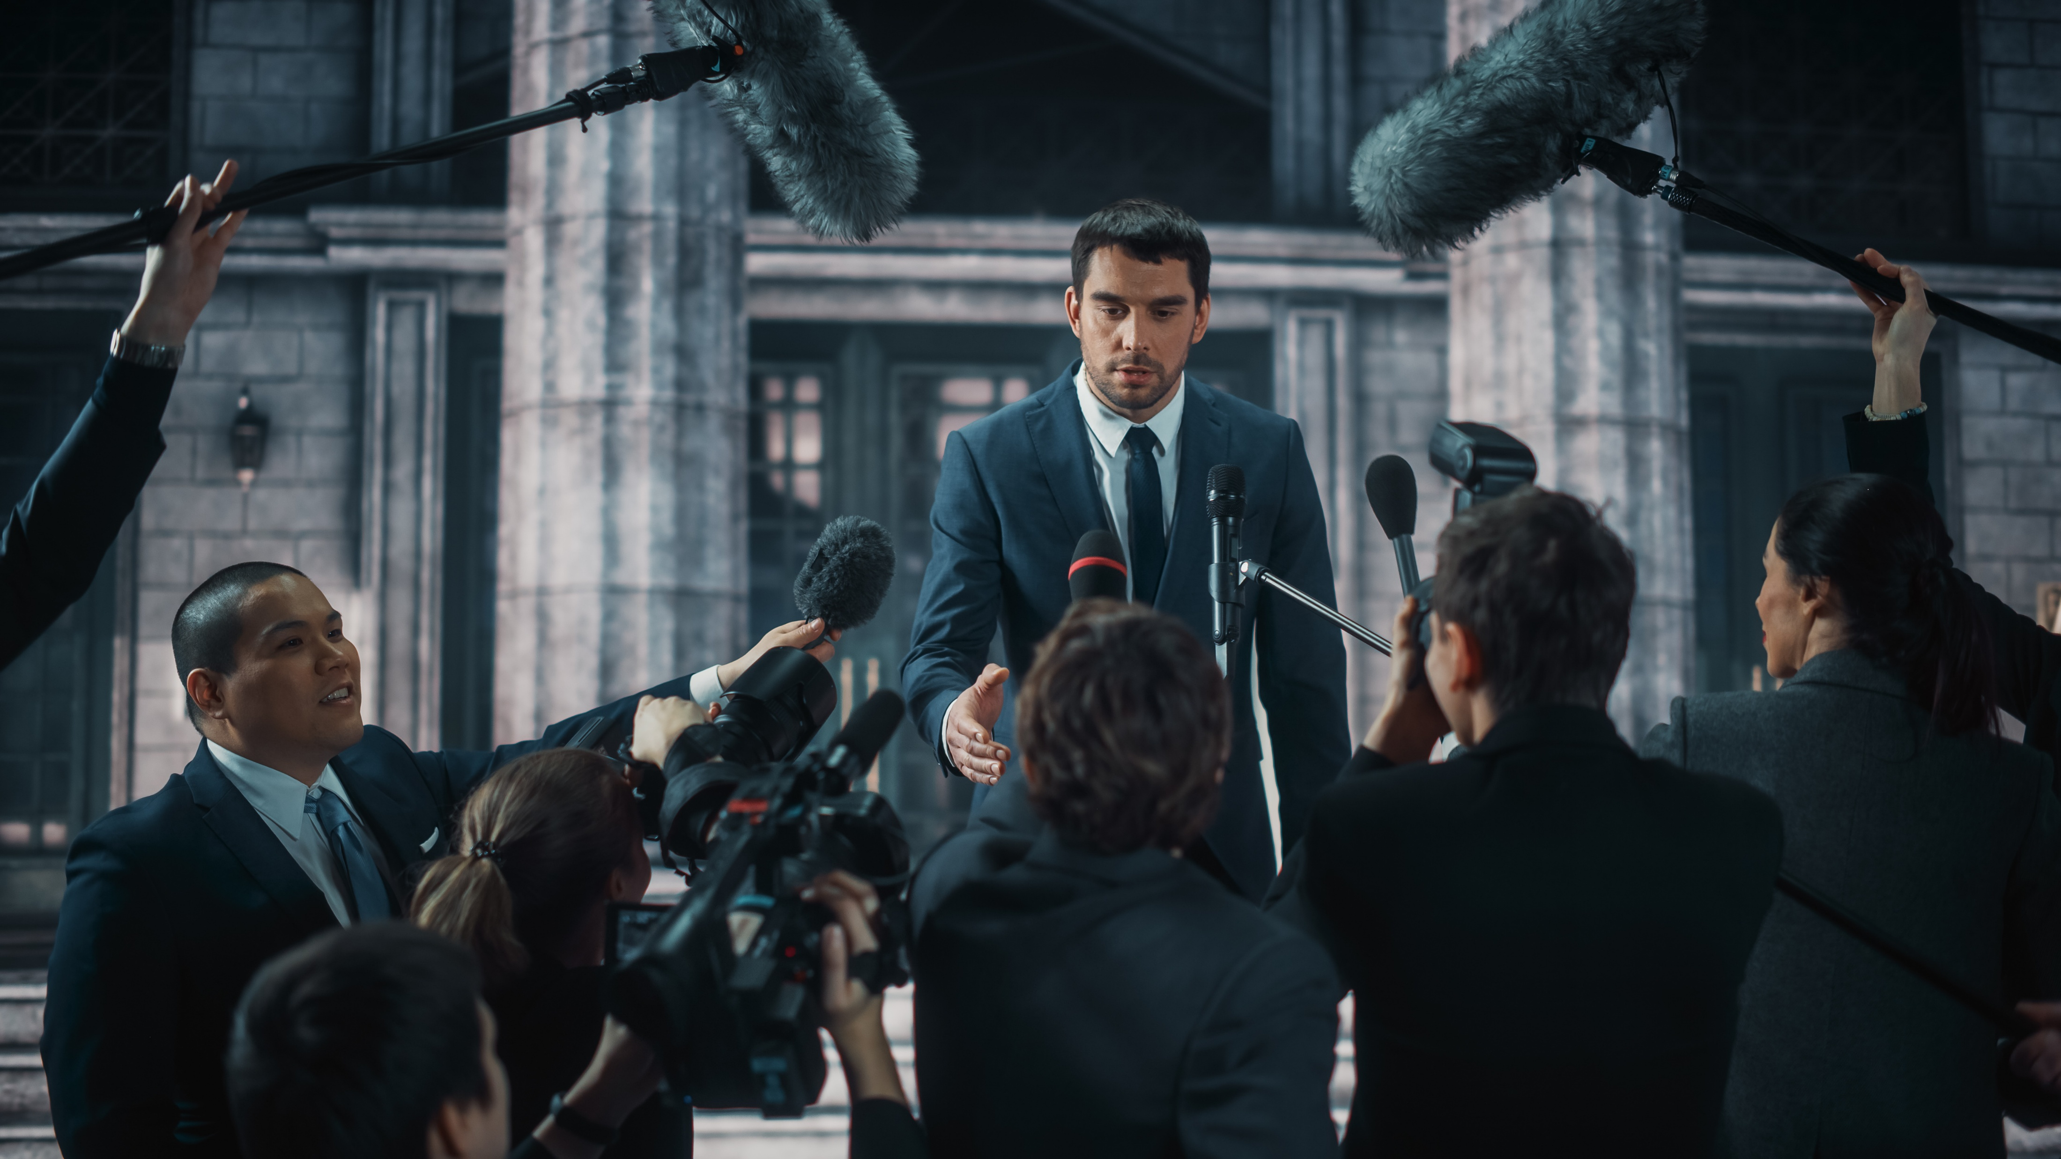
We are ambassadors on behalf of Christ

Slide 7

Ambassadors for Christ
There is conflict between the world and its creator
2nd Thessalonians 1:7-8

Slide 8

Ambassadors for Christ
Reconciliation to god is only possible through Jesus
Acts 16:31

Slide 9
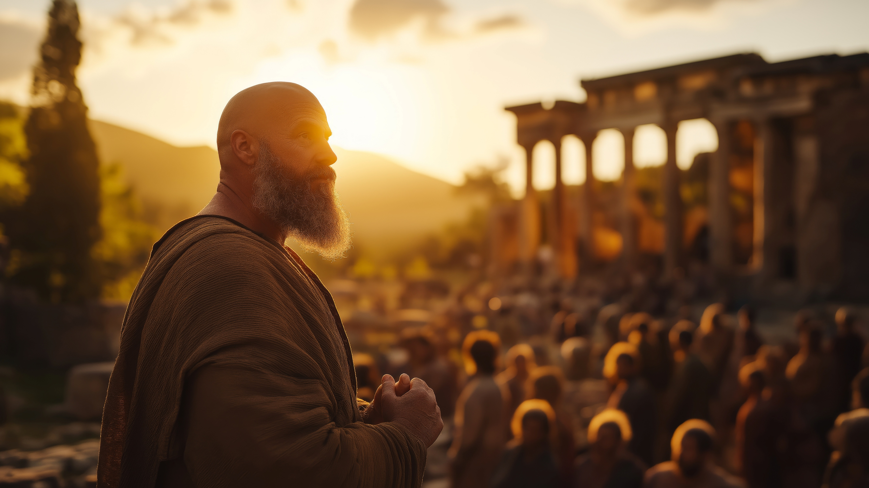
Ambassadors for Christ
God makes his appeal through me, so I must speak on his behalf
Ephesians 6:20

Slide 10

Why we struggle as Ambassadors
Potential Rejection
Unclear Expectations
Competing Priorities

Slide 11
Ambassadors for Christ
Pray
Behave
Speak
“pray also for us, that God may open to us a door for the word…”
“let your light shine before others, so that they may see your good works.”
“Many Samaritans from that town believed in him because of the woman's testimony”
John 4:39
Colossians 4:3
Matthew 5:16

