Slide 1
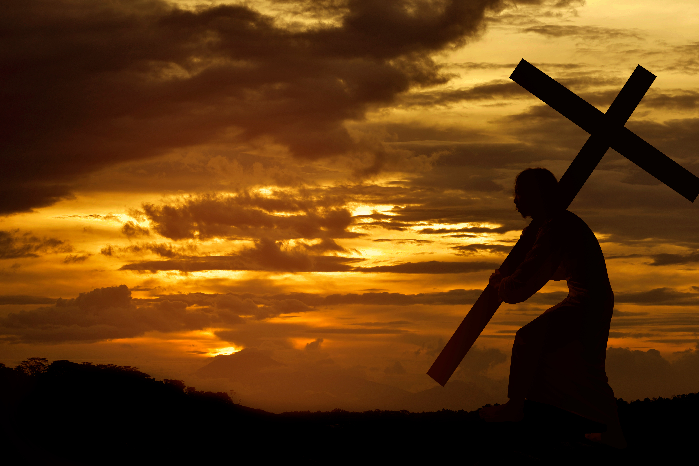
Happy Easter!

Slide 2
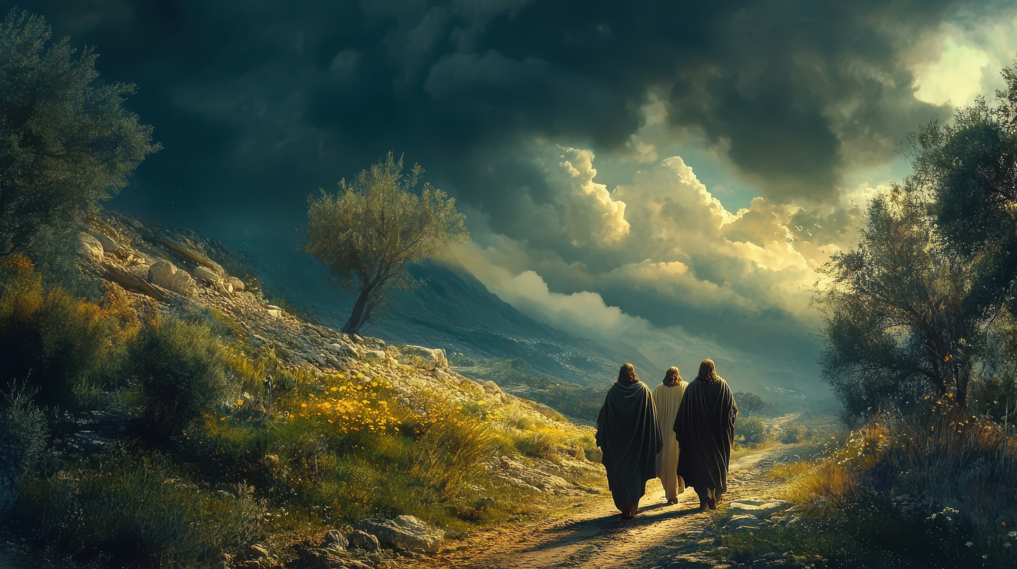
The Road to
Emmaus
Luke 24:13-35

Slide 4
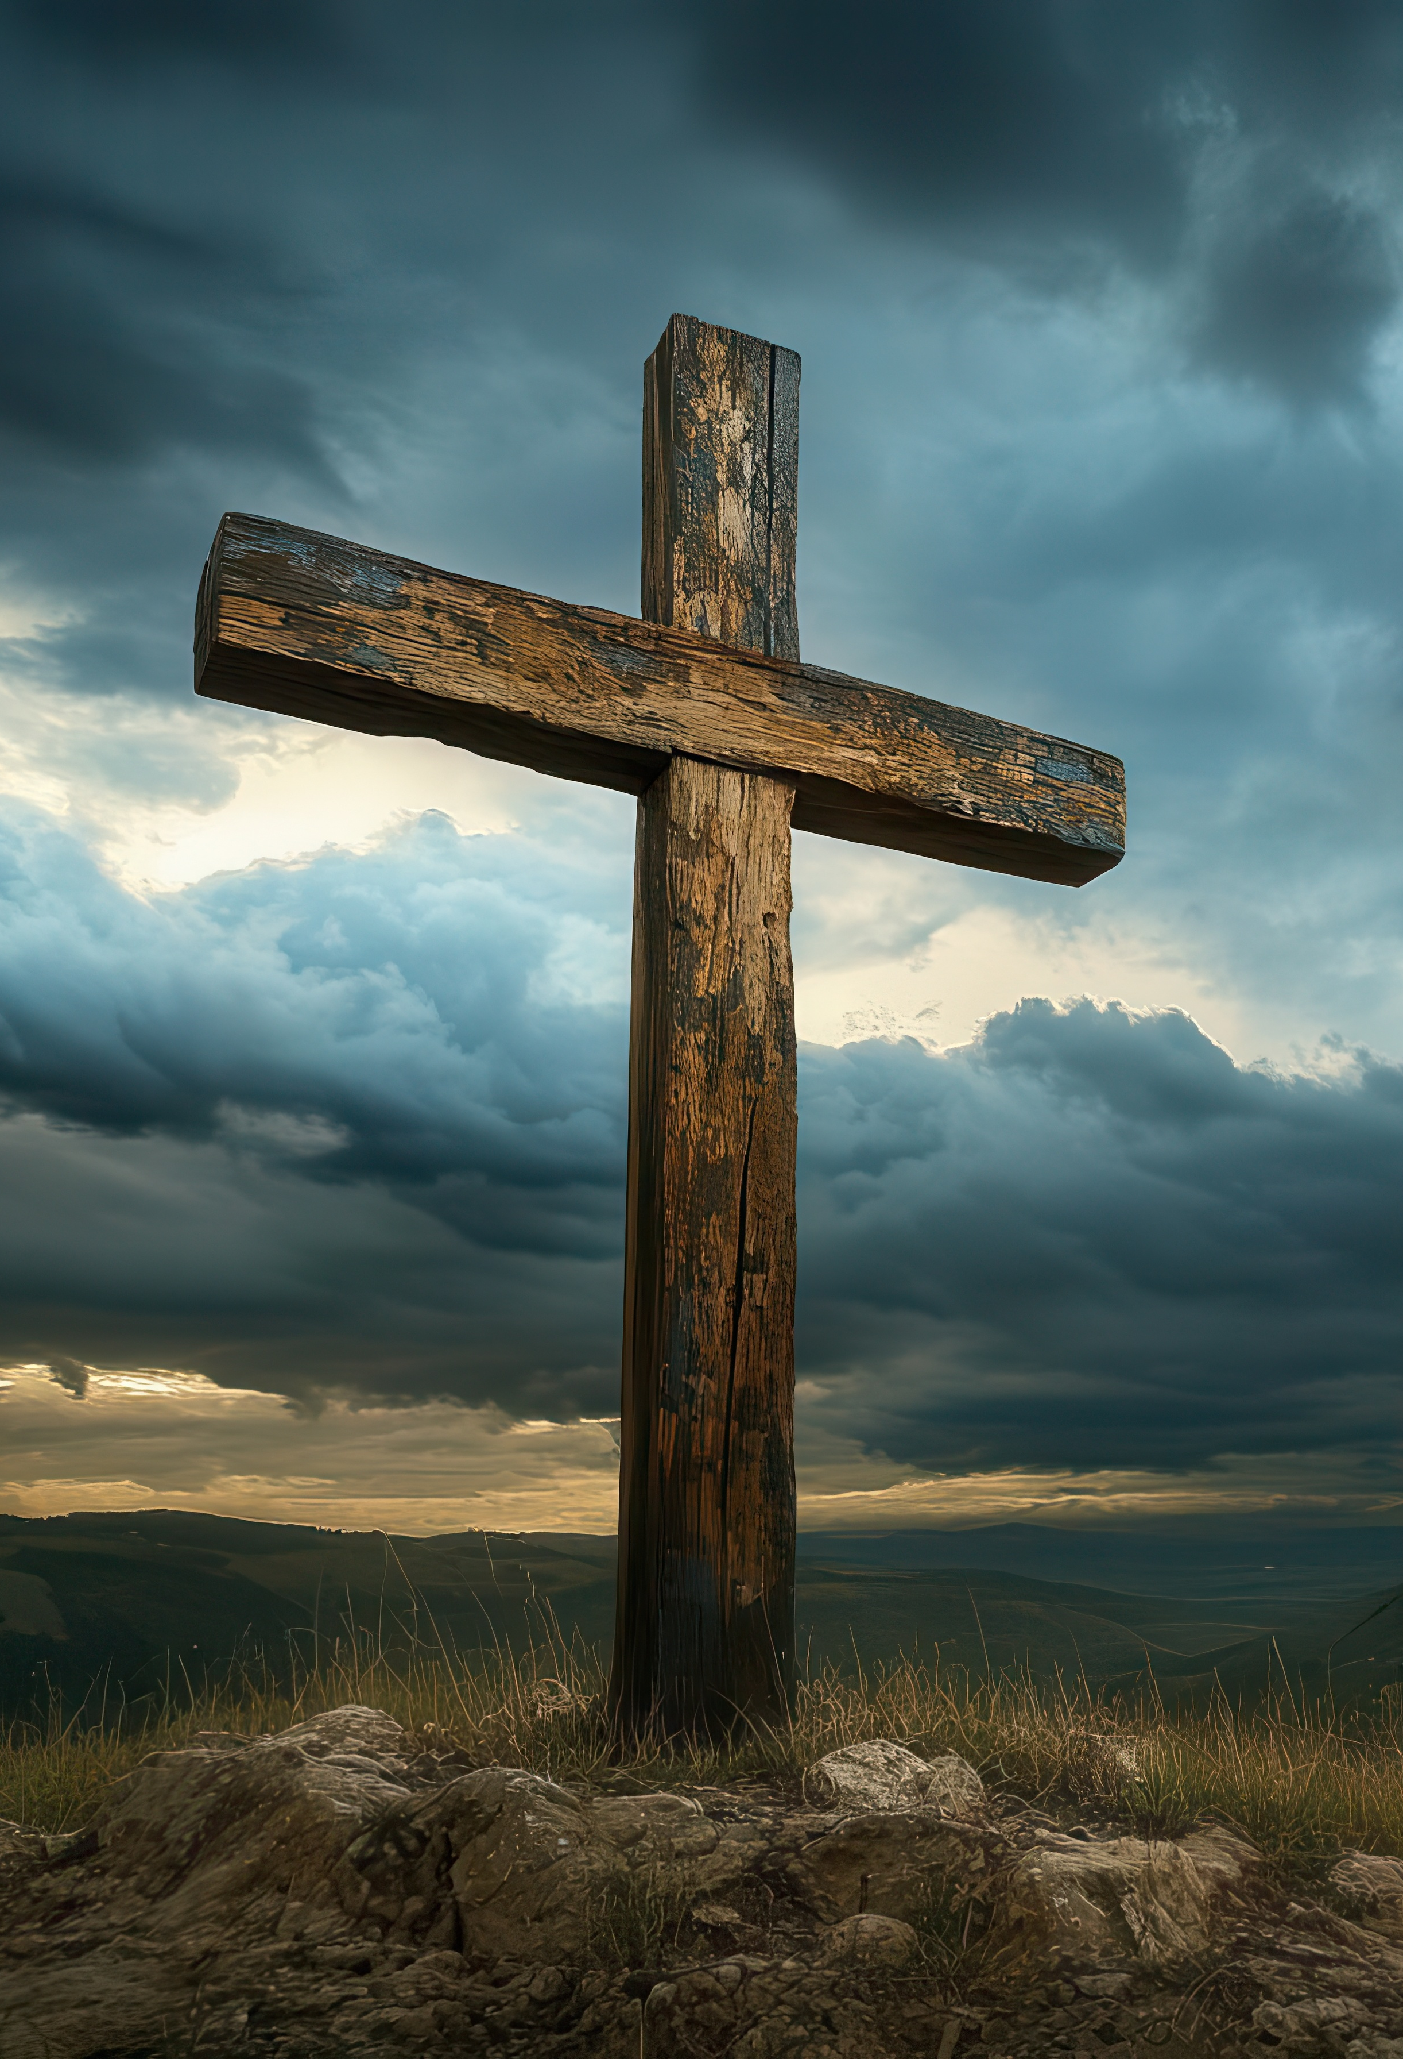
We Fail To See Jesus
1st Corinthians 10:4; Jude 5
How many go through life sad, not realizing that Jesus is right beside us?
At key moments in Israel’s history, Jesus is revealed to be present!
Because of our doubt and despair, we may even be prevented from seeing

Slide 5
John 1:46; John 7:1-5
We
Doubt
Jesus
People remain unsure what to think about Jesus
Was he a good person? Was he a prophet? A teacher? A fraud?
When we doubt who Jesus is or was, it leaves us confused

Slide 6
Mark 16:14; 7:18
Many of the people who listen to Jesus fail to understand his teachings
We Don’t Understand
Jesus
We don’t believe what others have told us about Him
We don’t know enough about what was written to even have an intelligent or informed opinion!

Slide 7


Slide 8
The Resurrection
2nd Peter 1:16; 1st Cor. 15:1-9
When we see the resurrected Jesus, we see Him as he really is – God!
Brings Awareness
The entire trajectory of their lives changed in that instant
They wanted to share with everyone else what they had seen and experienced

Slide 9
The Resurrection
Luke 24:6-8; John 2:19-22
Jesus doesn’t just want us to see Him, he wants us to learn from Him
Brings Insight
The resurrection makes sense of the Old Testament scriptures
He has gone before us to prepare a place for us, and has defeated our worst enemy in the process!

Slide 10
The Resurrection
John 21:9-14
Jesus wants to continue with us and have a relationship with us
Brings Communion
The moment of true fellowship comes in that communion meal
He is here now to sit and eat together with us!

Slide 11
1st Corinthians 15:50, 57
I tell you this, brothers: flesh and blood cannot inherit the kingdom of God, nor does the perishable inherit the imperishable… thanks be to God, who gives us the victory through our Lord Jesus Christ.

