Slide 1
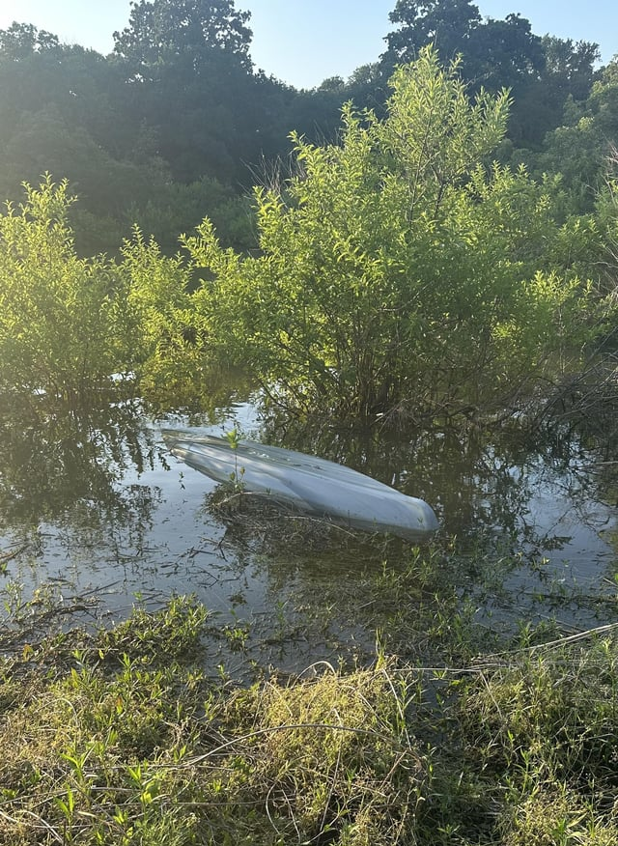
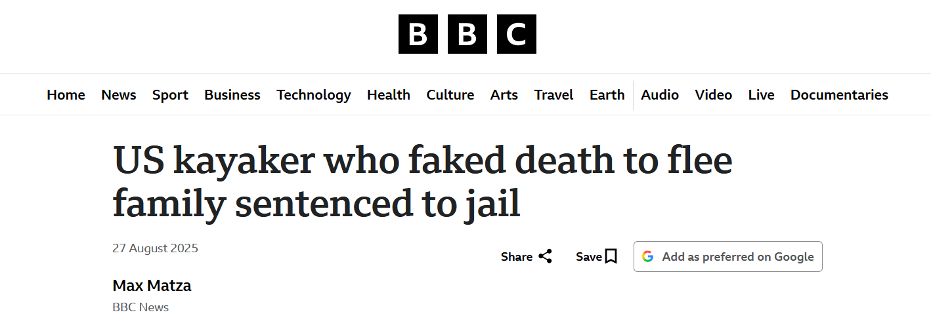
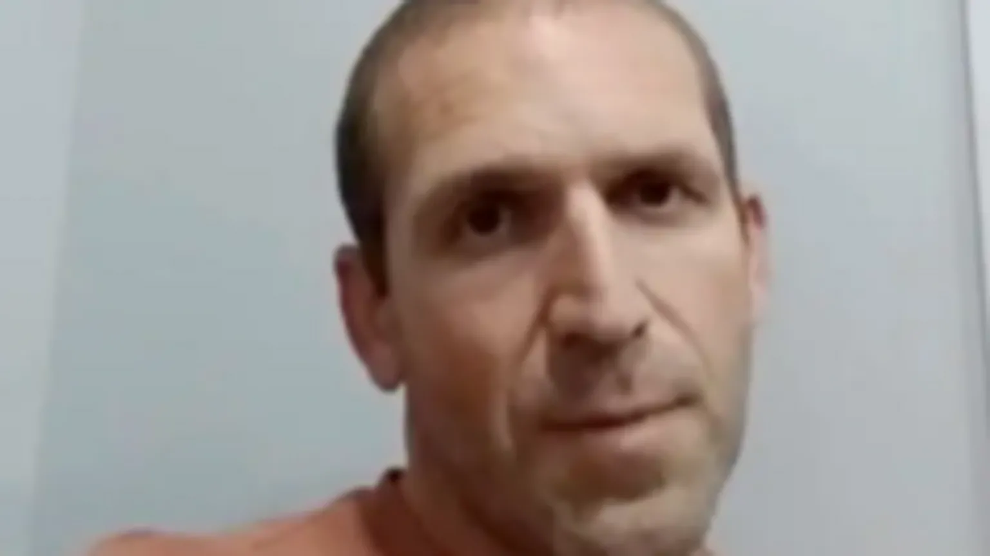
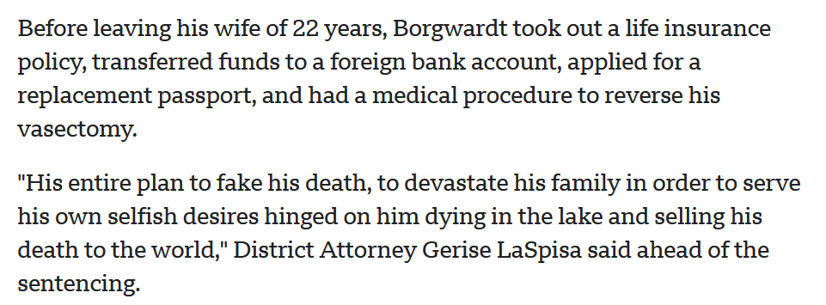

Slide 2

Colossians 3:1-3
Therefore, if you have been raised up with Christ, keep seeking the things above, where Christ is, seated at the right hand of God. Set your mind on the things above, not on the things that are on earth. For you have died and your life is hidden with Christ in God.

Slide 3
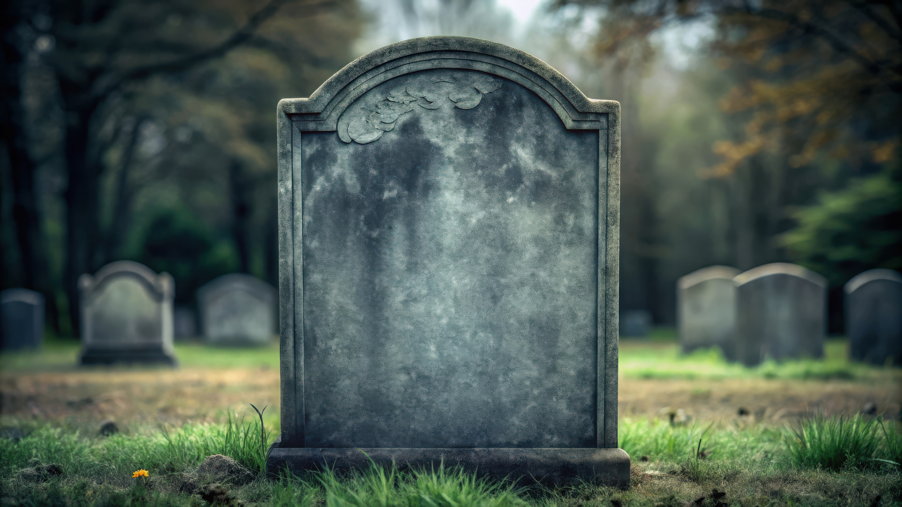
You Have
Died
Colossians 3:3

Slide 4


Slide 5
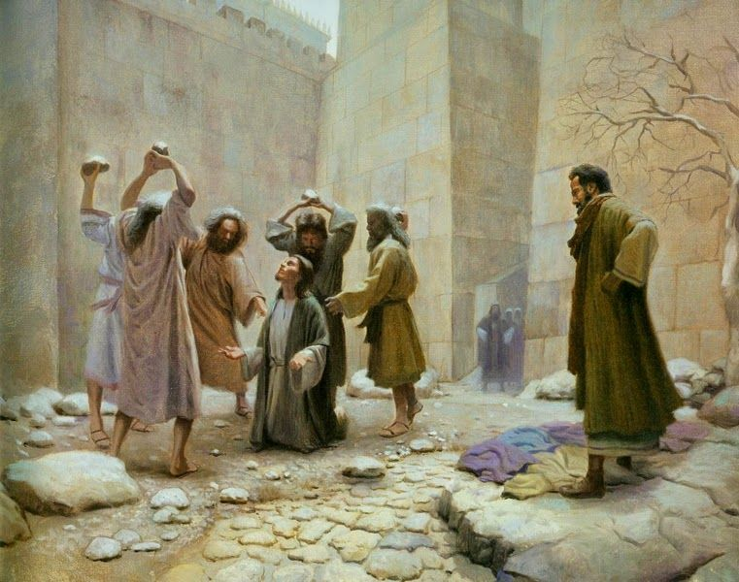
Acts 22:4-5
I persecuted this Way to the death, binding and delivering to prison both men and women,
as the high priest and the whole council of elders can bear me witness.

Slide 6
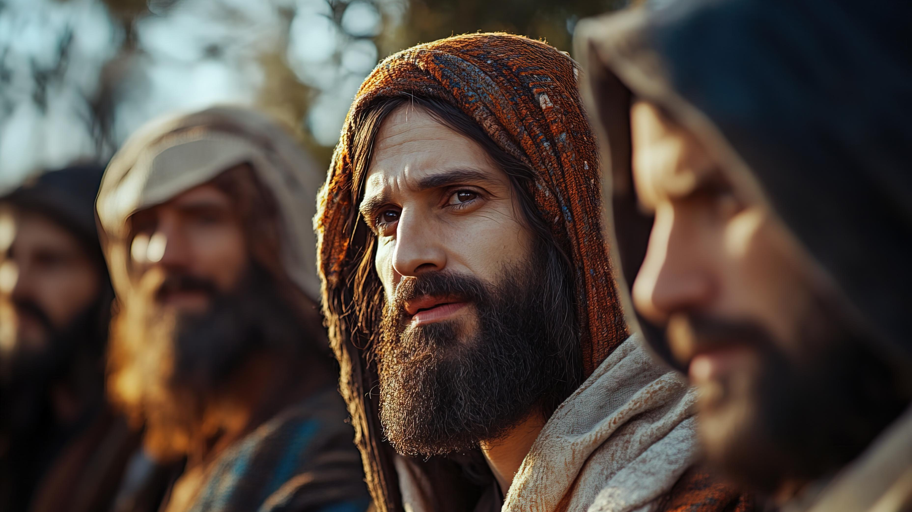
If anyone else thinks he has reason for confidence in the flesh, I have more: circumcised on the eighth day, of the people of Israel, of the tribe of Benjamin, a Hebrew of Hebrews; as to the law, a Pharisee; as to zeal, a persecutor of the church; as to righteousness under the law, blameless. (Philippians 3:4-6)

Slide 7
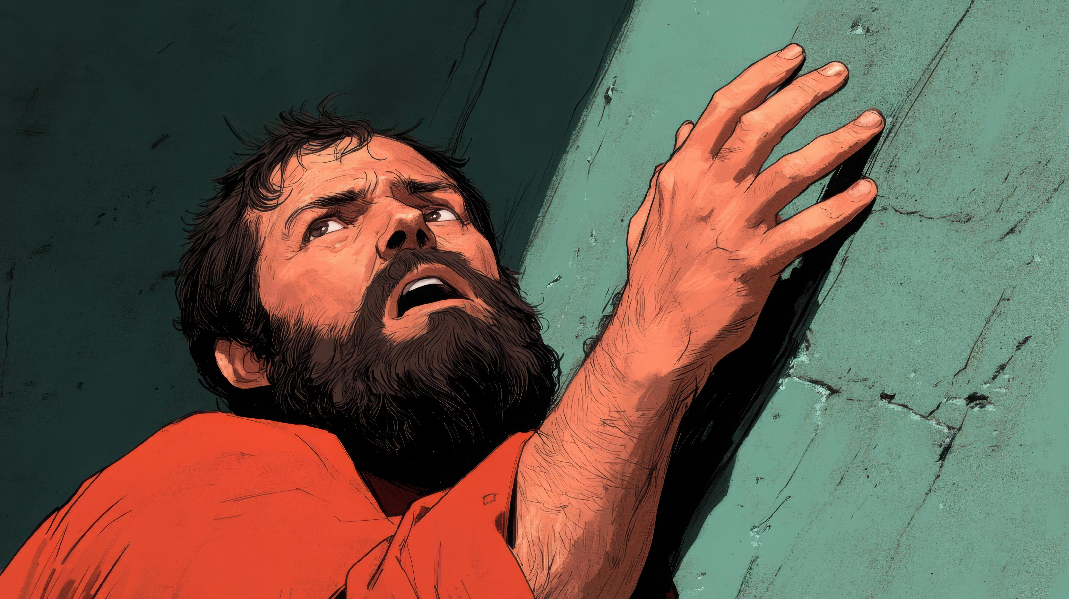
And I fell to the ground and heard a voice saying to me, ‘Saul, Saul, why are you persecuting me?’

Slide 8
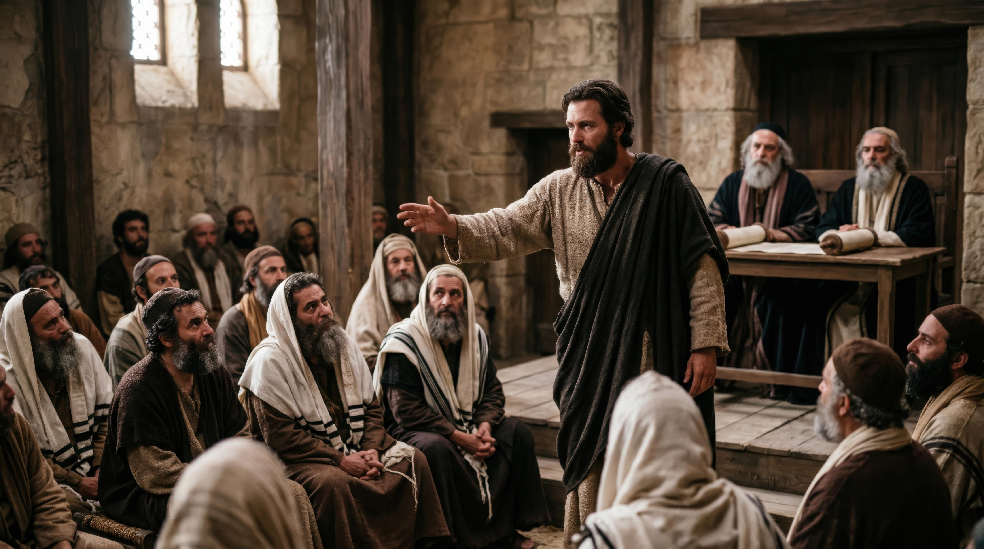
And when they had carried out all that was written of him, they took him down from the tree and laid him in a tomb. But God raised him from the dead, and for many days he appeared to those who had come up with him from Galilee to Jerusalem, who are now his witnesses to the people. (Acts 13:29-31)

Slide 9
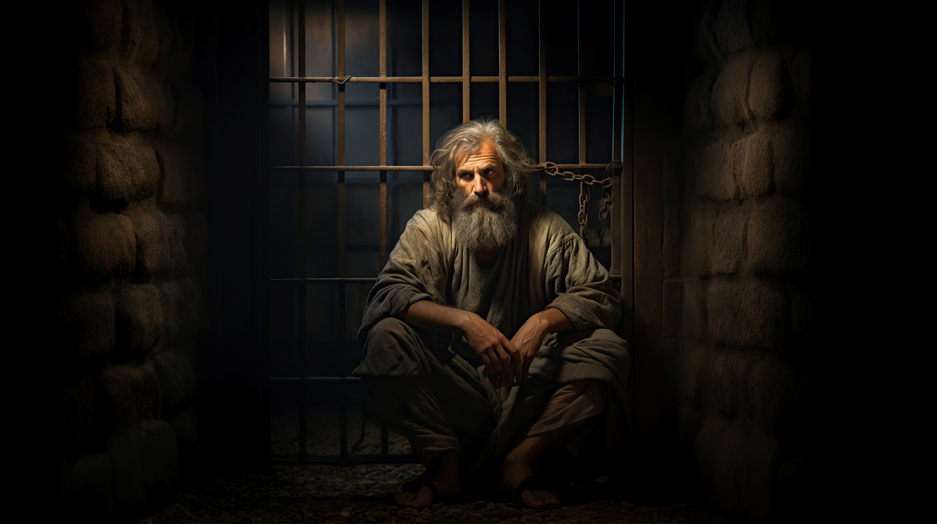
“…For his sake I have suffered the loss of all things…”

Slide 10
“…Remember Jesus Christ, risen from the dead, the offspring of David, as preached in my gospel, for which I am suffering, bound with chains as a criminal.”

Slide 11
“If we have died with him, we will also live with him…”

Slide 12
Have You
Died?

Slide 13
Uh… how do I die, without dying?

Slide 14
Colossians 3:5-9
Put to death therefore what is earthly in you: sexual immorality, impurity, passion, evil desire, and covetousness, which is idolatry. On account of these the wrath of God is coming. In these you too once walked, when you were living in them. But now you must put them all away: anger, wrath, malice, slander, and obscene talk from your mouth.

Slide 15
We die by removing the parts of our character that are offensive to God.

Slide 16
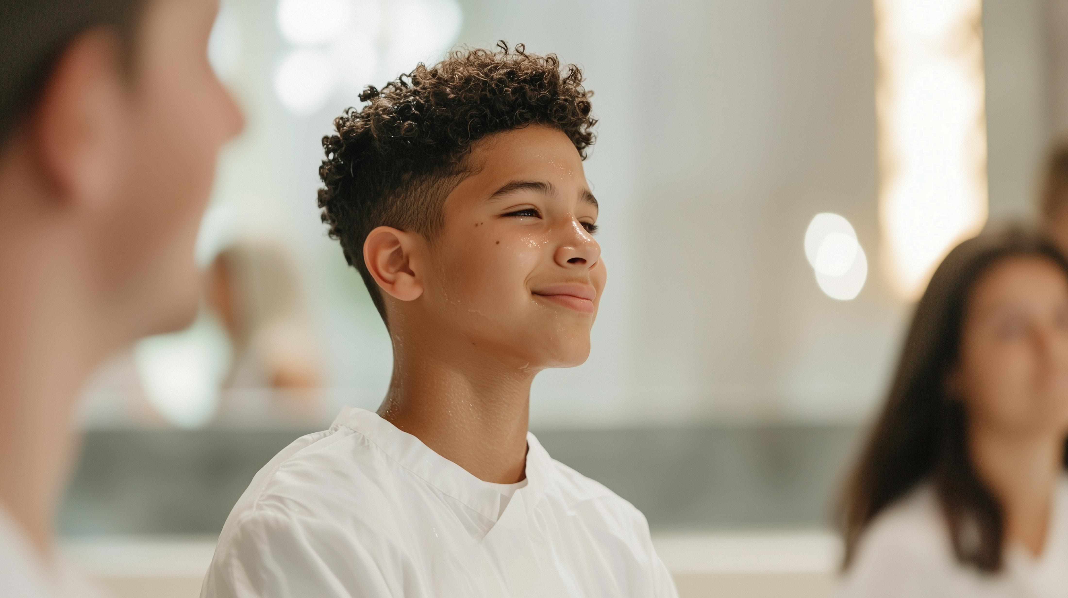
We have to continue to die.

Slide 17
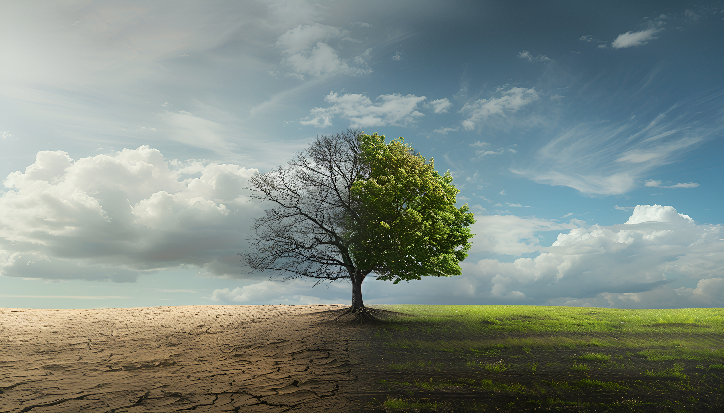
“bear fruits worthy of repentance”

Slide 18
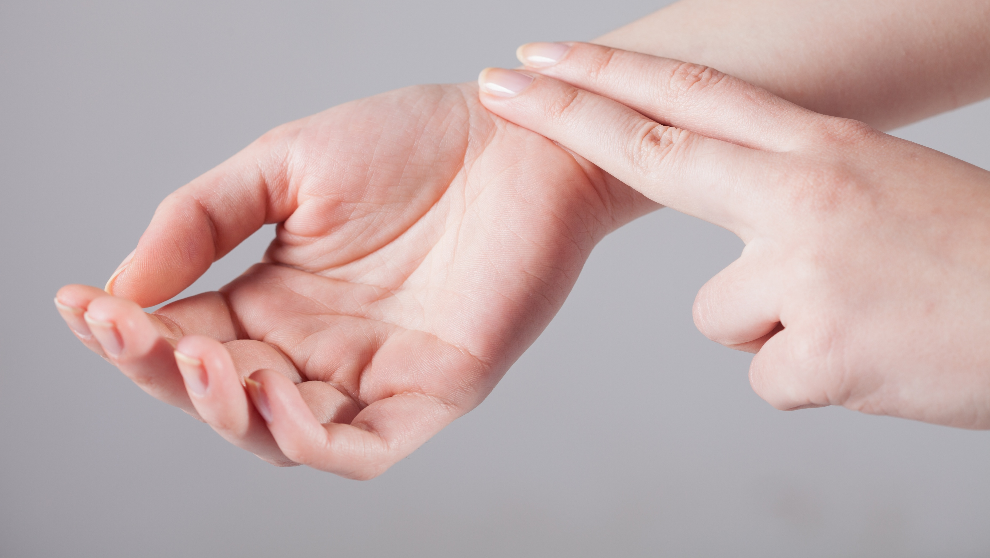
Pulse check!
What you say
What you want
What you do

Slide 19
We were buried therefore with him by baptism into death, in order that, just as Christ was raised from the dead by the glory of the Father, we too might walk in newness of life.

