Slide 1

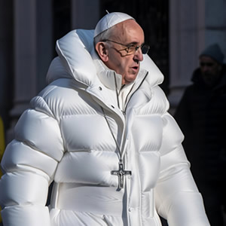

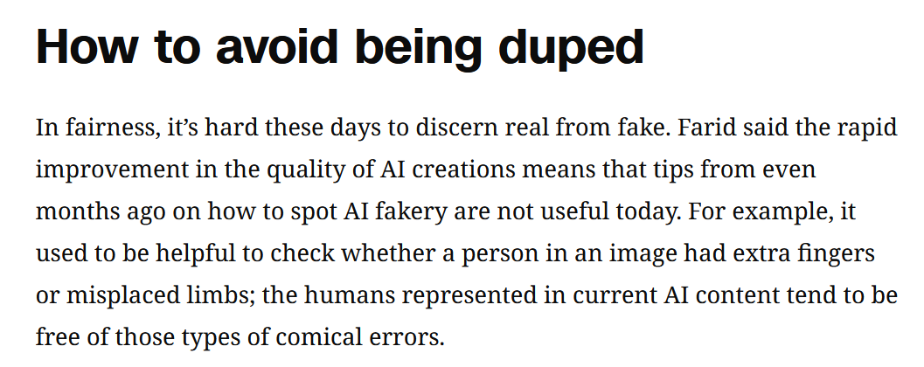

Slide 2

Philip found Nathanael and said to him, “We have found him of whom Moses in the Law and also the prophets wrote, Jesus of Nazareth, the son of Joseph.”
Nathanael said to him, “Can anything good come out of Nazareth?” Philip said to him, “Come and see.”
(John 1:45-46)

Slide 3
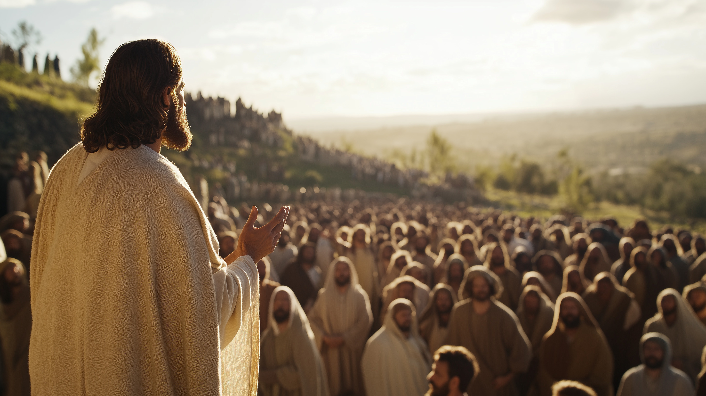
Are You The Christ?
How To Wrestle With Doubts About Your Faith

Slide 4
Doubt is easy.
It demands irrefutable evidence but offers none of its own.

Slide 5

Matthew 11:1-3
“When Jesus had finished giving instructions to His twelve disciples, He departed from there to teach and preach in their cities. Now when John, while imprisoned, heard of the works of Christ, he sent word by his disciples and said to Him, “Are You the Expected One, or shall we look for someone else?”

Slide 6
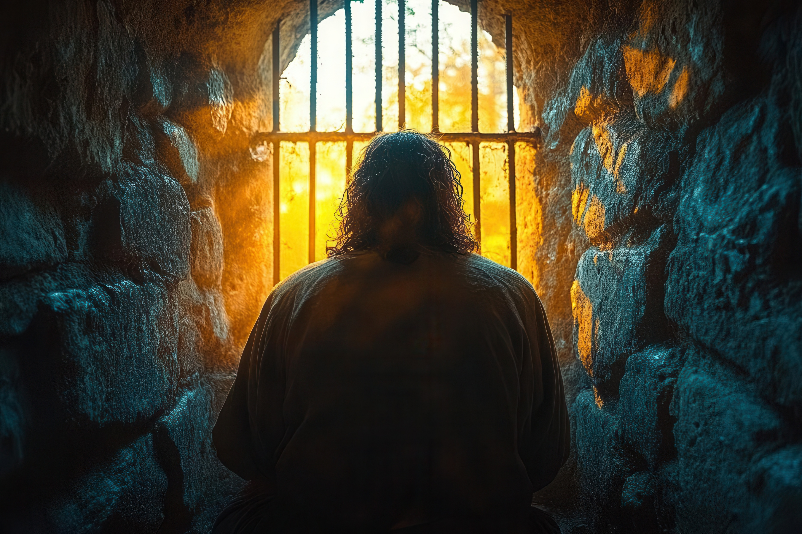
What Happened to John?
John was an outspoken messenger of the Kingdom of God
His teaching brought conflict
He recognized Jesus as the Lamb of God, and Baptized him
John ended up in prison for preaching against a ruler’s infidelity
It seems John became unsure about the direction of the mission

Slide 7

The Tools of Doubt – Negative Circumstances
Satan believes that if things weren’t easy in your life, you would curse God
Matthew 11:2
“Now when John heard in prison…”
The loss of a loved one, a breakup, health problems… they all put pressure on your faith in God
High level bible characters were put to this same test, like Peter and Job

Slide 8
The Tools of Doubt – Misunderstanding God
Matthew 11:2
People walked away from Jesus because they didn’t understand His mission
“Now when John, while imprisoned, heard of the works of Christ, he sent word by his disciples and said to Him, “Are You the Expected One, or shall we look for someone else?”
We have expectations for God, and if he doesn’t live up to those, then our belief is non-existent
“If God was loving, He would do this and that and never let anyone hurt!”

Slide 9
The Tools of Doubt – Never Enough Evidence
John 7:3
The people that refused to believe in Jesus always acted like they would believe if there was just a little more
“So his brothers said to him, “Leave here and go to Judea, that your disciples also may see the works you are doing!”
And yet there was plenty of evidence for people to see and believe
The condition of our heart can set an insurmountable bar for belief

Slide 10
The Tools of Doubt – Ridicule
John 7:47
The Pharisees acted like belief in Jesus was absurd
“The Pharisees answered them, “Have you also been deceived?”
No one wants to feel like a fool!

Slide 11
The Tools of Doubt – Groupthink/Arrogance
John 7:48-49
No one with any sense believes any of this! Look at all the smart people who are atheists!
“Have any of the authorities or the Pharisees believed in him? But this crowd that does not know the law is accursed.”
You are made to feel like only idiots or unintelligent people believe in Jesus.

Slide 12
The Tools of Doubt – Groupthink/Arrogance
John 7:48-49
No one with any sense believes any of this! Look at all the smart people who are atheists!
“Have any of the authorities or the Pharisees believed in him? But this crowd that does not know the law is accursed.”
You are made to feel like only idiots or unintelligent people believe in Jesus.

Slide 13

How can anyone fight against this onslaught to our faith?

Slide 14
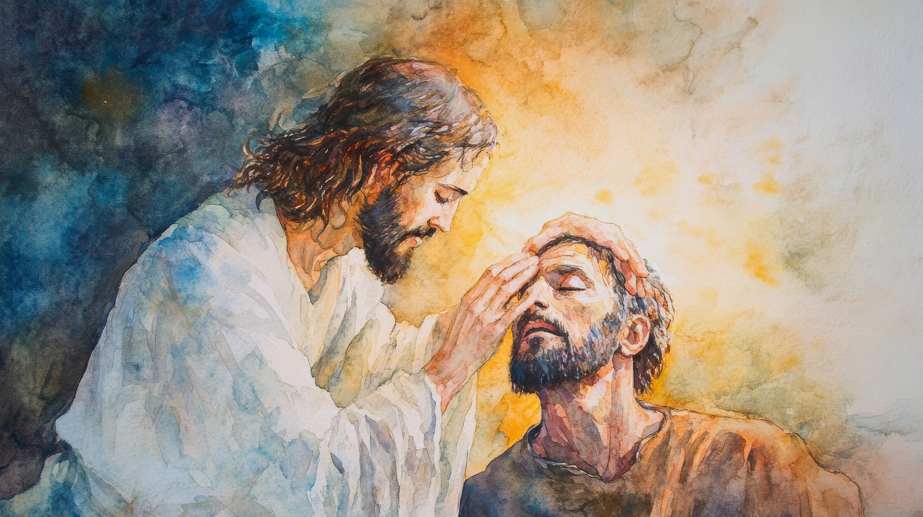
When Your Faith Is Shaken,
Go to Jesus
Jesus answered and said to them, “Go and report to John what you hear and see: the blind receive sight and the lame walk, the lepers are cleansed and the deaf hear, the dead are raised up, and the poor have the gospel preached to them. “And blessed is he who does not take offense at Me.”

Slide 15

“Truly, this was the son of god”

