Slide 1


Slide 2

Choosing Your
CHURCH
Facts to guide our feelings

Slide 3
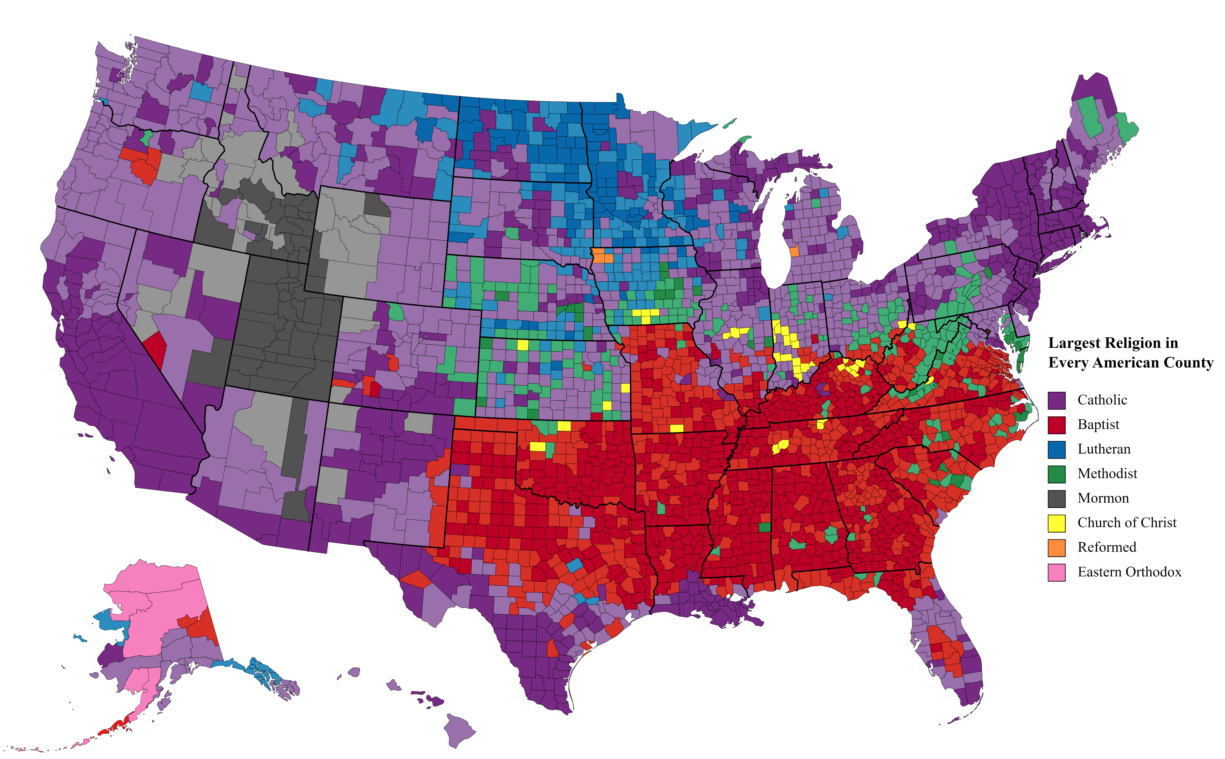

Slide 4

Ephesians 4:3-6
“…eager to maintain the unity of the Spirit in the bond of peace. There is one body and one Spirit—just as you were called to the one hope that belongs to your call— one Lord, one faith, one baptism, one God and Father of all, who is over all and through all and in all.”

Slide 5

A Different Church for Everyone
My Favorite!
God is HERE!
This is it!

Slide 6
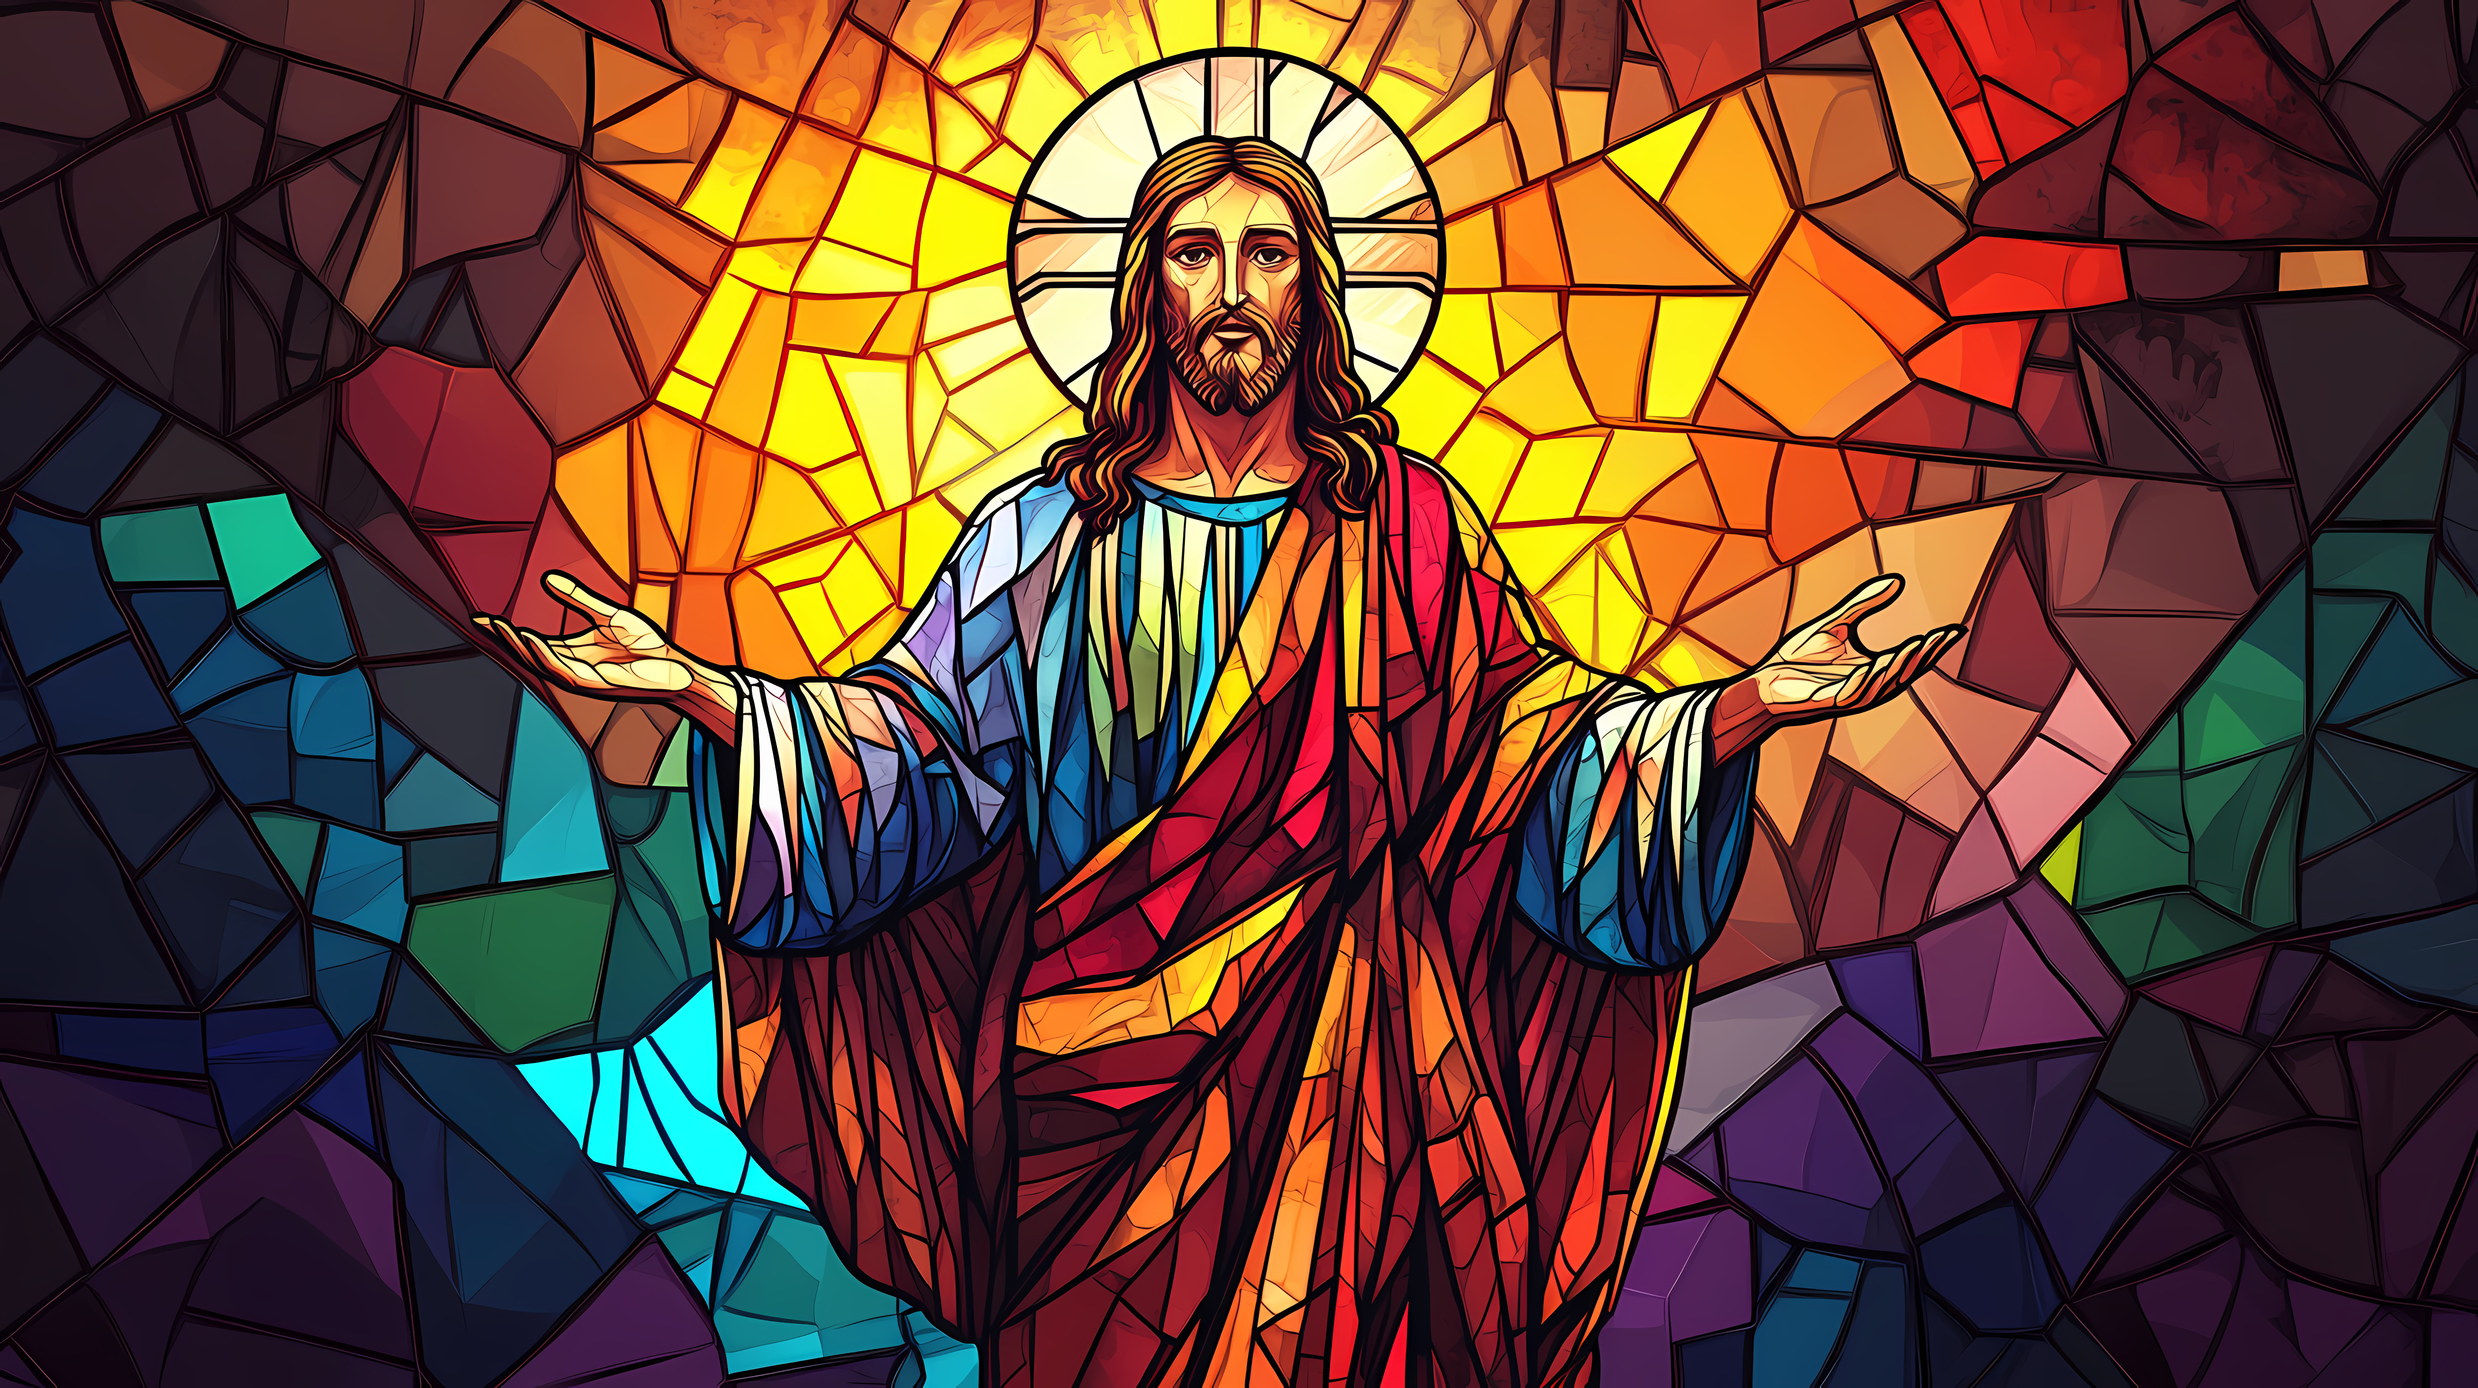
holding fast to the Head
from whom the whole body, nourished and knit together through its joints and ligaments, grows with a growth that is from God.
Colossians 2:19

Slide 7
And thE Lord Added
To The church Daily those Who Were Being Saved
Acts 2:47

Slide 8
1ST John 2:19
They went out from us, but they were not of us; for if they had been of us, they would have continued with us…

Slide 9


Ways Churches In The New Testament
WERE THE SAME
Ways Churches In The New Testament
WERE Different
Worship
Leadership
Practices
Beliefs
Locations
Problems
Circumstances

Slide 10
1st Corinthians 4:15-17
“…For though you have countless guides in Christ, you do not have many fathers. For I became your father in Christ Jesus through the gospel. I urge you, then, be imitators of me. That is why I sent you Timothy, my beloved and faithful child in the Lord, to remind you of my ways in Christ, as I teach them everywhere in every church.”

Slide 11
1st Timothy 3:14-15
“I hope to come to you soon, but I am writing these things to you so that, if I delay, you may know how one ought to behave in the household of God, which is the church of the living God, a pillar and buttress of the truth.”

Slide 12
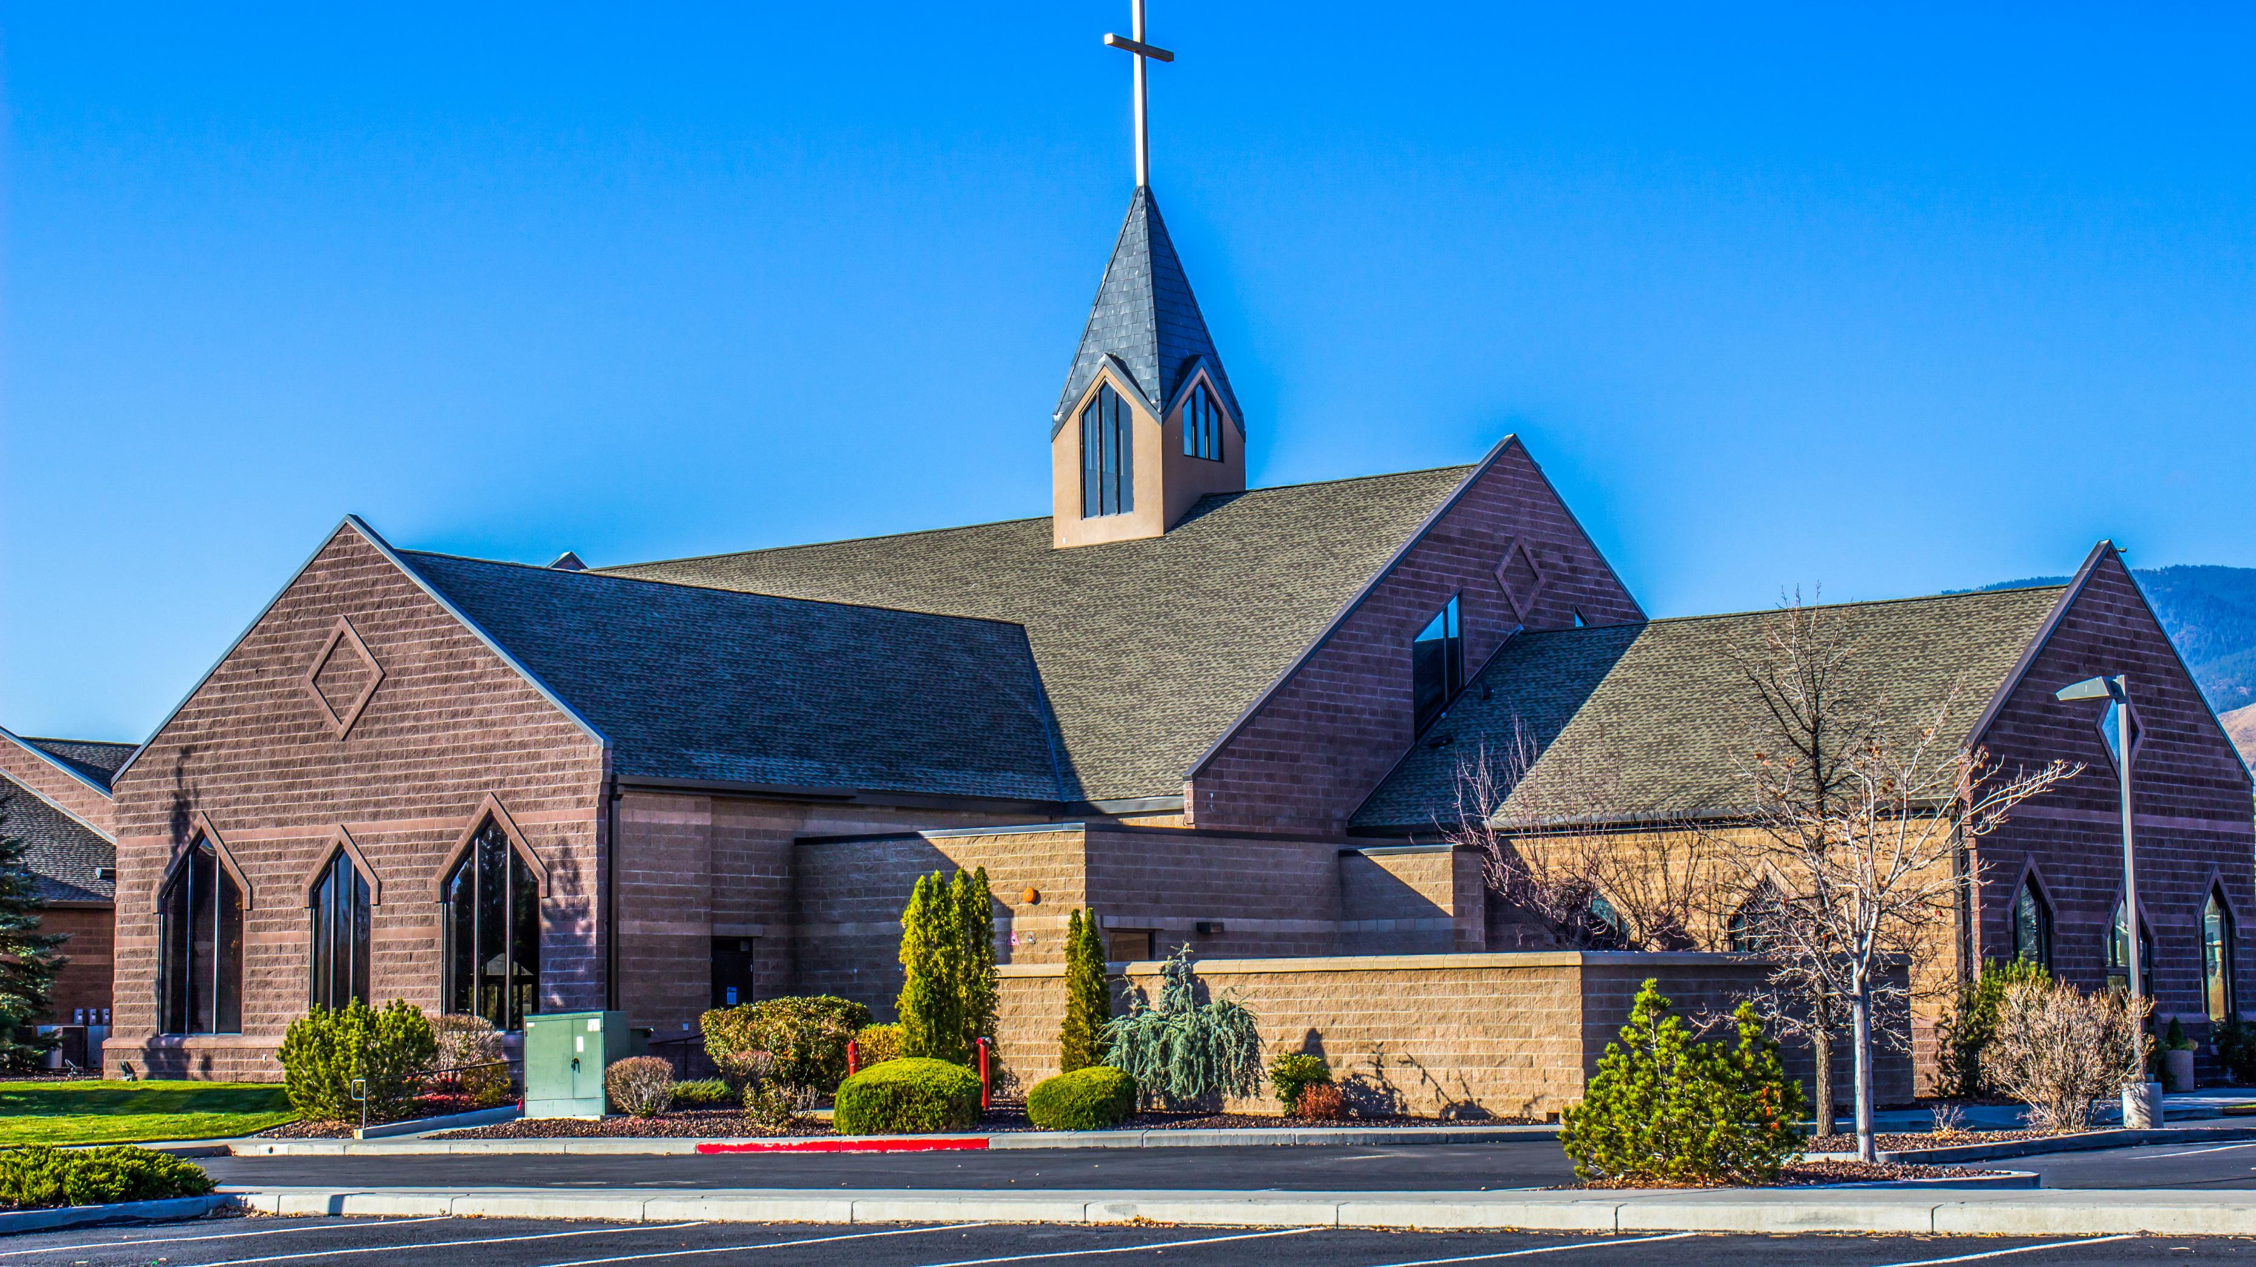
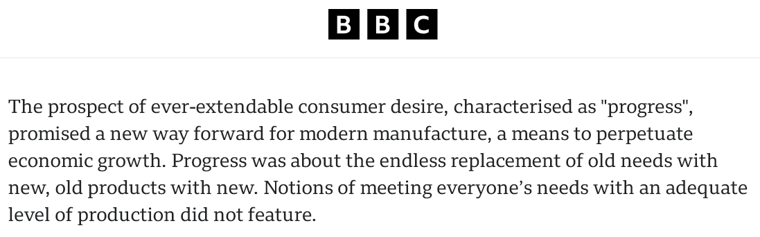

Slide 13
When local churches started appealing to consumers, it undermined the very concept of what a local church was intended to become.

Slide 14
1
2
3
4
Instruction
Discipline
Leadership
Engagement
If you put these things before the brothers, you will be a good servant of Christ Jesus, being trained in the words of the faith and of the good doctrine that you have followed.
Now we command you, brothers…that you keep away from any brother who is walking in idleness and not in accord with the tradition that you received from us.
Obey your leaders and submit to them, for they are keeping watch over your souls, as those who will have to give an account.
And we urge you, brothers, admonish the idle, encourage the fainthearted, help the weak, be patient with them all.

Slide 15
1st Kings 3:7
We Need to use Great Wisdom when Selecting A Church
“And now, O LORD my God, you have made your servant king in place of David my father, although I am but a little child. I do not know how to go out or come in.”

Slide 16
Is My Heart In The Right Place?

Slide 17
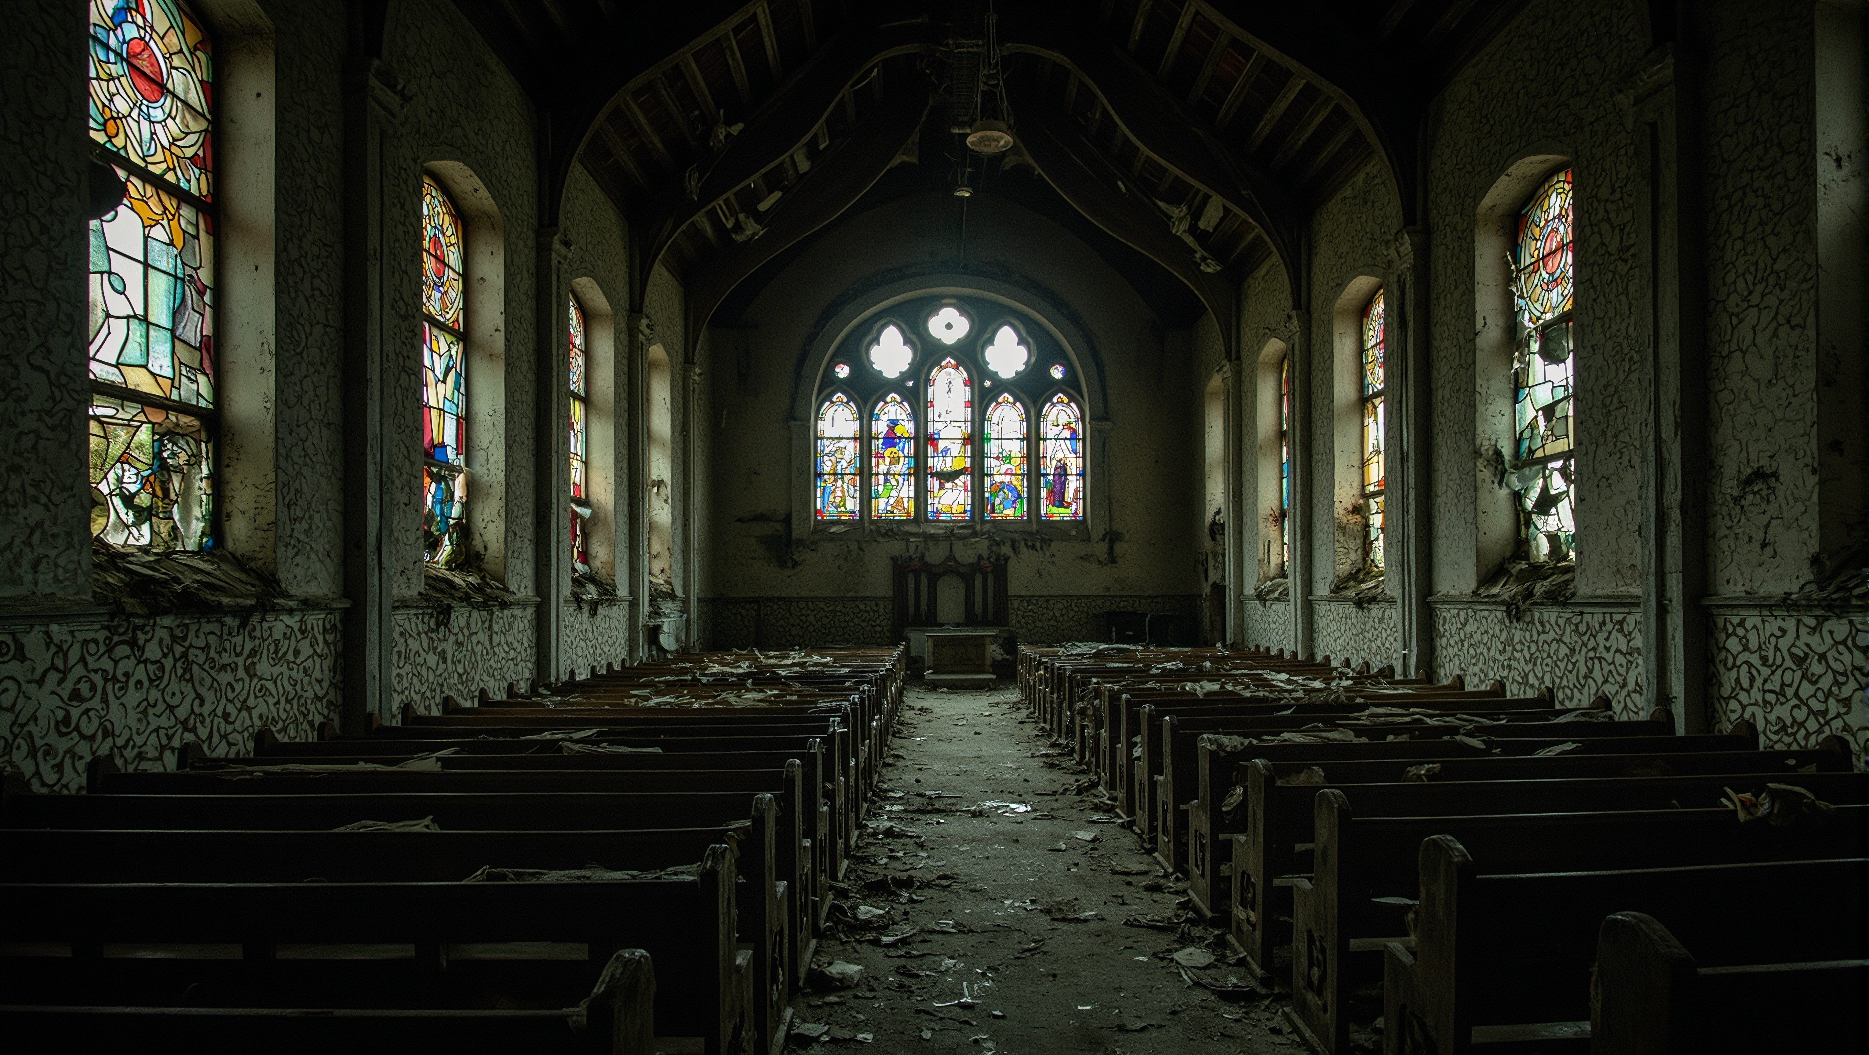
There is no perfect “church” on this earth

Slide 18
Our goal should be to get as close as we can to what God wants

Slide 19
For this reason I left you in Crete, that you should set in order the things that are lacking…
Titus 1:5

Slide 20
1. The church is the body of Christ, and all members are added to it when they are saved
2. Our local churches are physical representations of that
3. Churches in the Bible were started with expected consistency in organization, beliefs and practices
4. We may not like some things about the church, and the world provides options to meet our desires
5. Christians should try to learn what God’s will is for his church on this earth

