Slide 1

“Please recognize, you are still dumb”

Slide 2
“And David the king said to all the assembly, “Solomon my son, whom alone God has chosen, is young and inexperienced, and the work is great, for the palace will not be for man but for the LORD God.” – 1st Chronicles 29:1

Slide 3
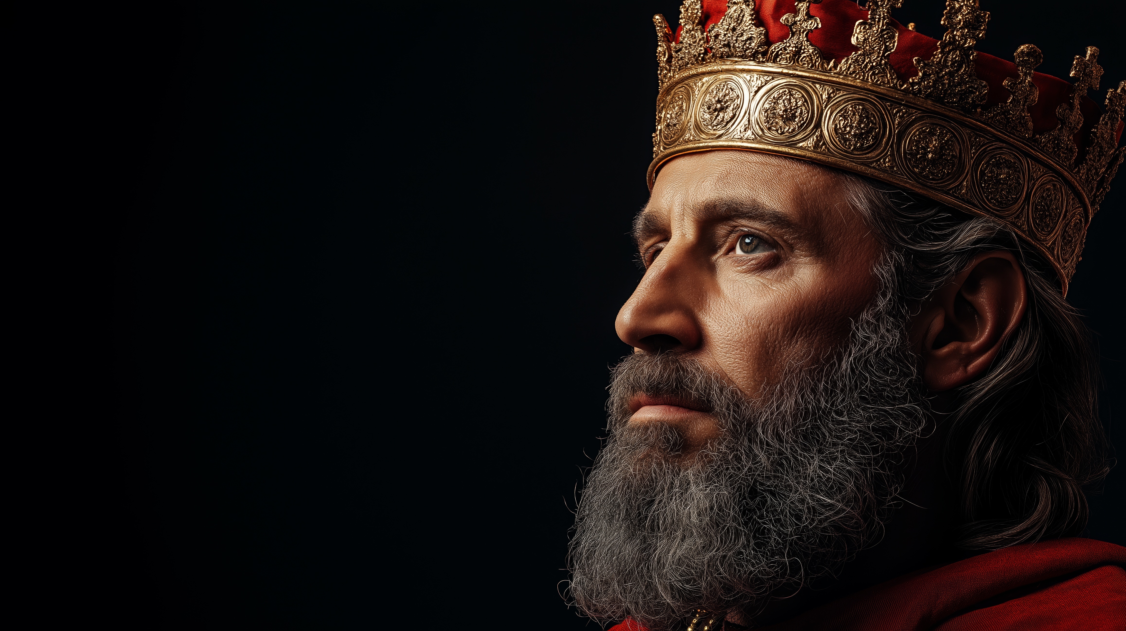
Advice
for a
Son
1st Chronicles 28

Slide 4
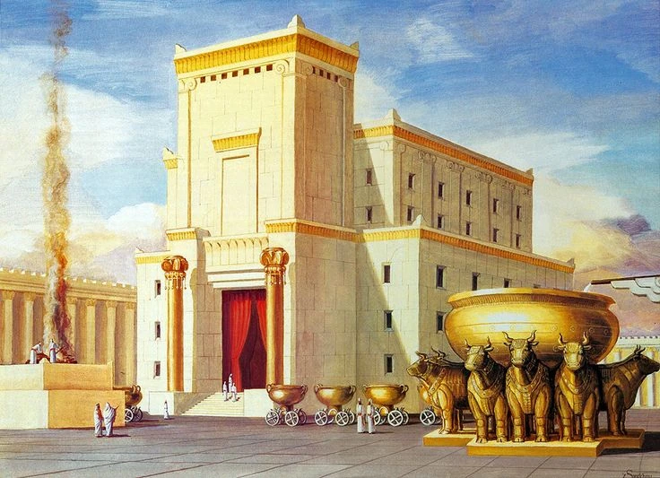

Slide 5
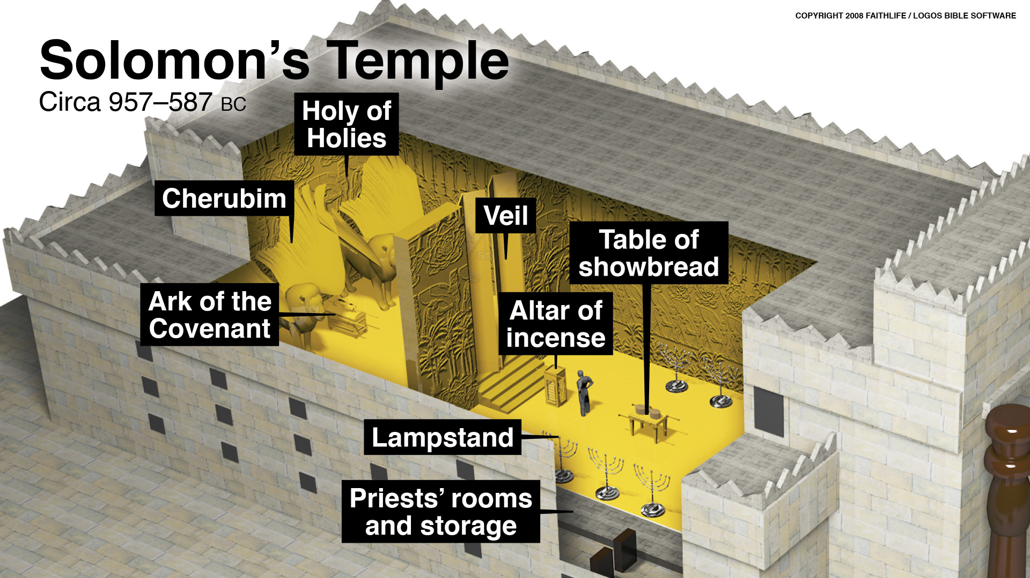

Slide 6
King David
8 Different Wives
20 Named Children
Unknown Number of Concubines
4 Sons Fighting
1 Eventual King

Slide 7
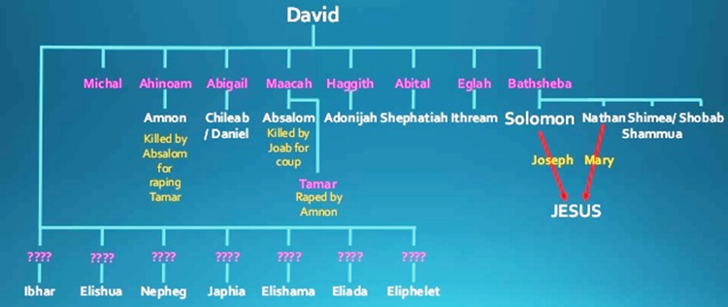

Slide 8
1st Chronicles 22:7-10
David said to Solomon, “My son, I had it in my heart to build a house to the name of the LORD my God. But the word of the LORD came to me, saying, ‘You have shed much blood and have waged great wars. You shall not build a house to my name, because you have shed so much blood before me on the earth. Behold, a son shall be born to you who shall be a man of rest. I will give him rest from all his surrounding enemies. For his name shall be Solomon, and I will give peace and quiet to Israel in his days. He shall build a house for my name. He shall be my son, and I will be his father, and I will establish his royal throne in Israel forever.’

Slide 9
A Willing Heart
1st Chronicles 28:9
Our greatest undertaking in life is to learn about the God of heaven
And you, Solomon my son, know the God of your father and serve him with a whole heart and with a willing mind, for the LORD searches all hearts and understands every plan and thought. If you seek him, he will be found by you, but if you forsake him, he will cast you off forever.
David’s desire is for his son to have the right spirit and attitude toward religion
Mal. 1:12-13; Exo. 35:29; 1st Chr. 29:9, 19
Our children need to develop a desire to do right

Slide 10
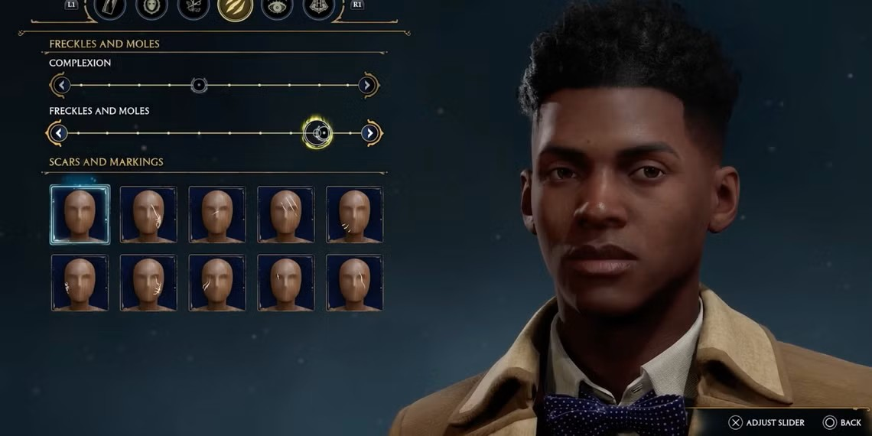
1. what kind of person you are trying to be?

Slide 11
2. Know your choices have
consequences

Slide 12
Faithfulness to god
1st Kings 2:2-3
Youth presents many specific perils for people following God
I am about to go the way of all the earth. Be strong, and show yourself a man, and keep the charge of the LORD your God, walking in his ways and keeping his statutes, his commandments, his rules, and his testimonies, as it is written in the Law of Moses, that you may prosper in all that you do and wherever you turn,
The worst thing that can happen to a parent is to have godless children
1st Samuel 2:22-24; Prov. 17:25. 15:20
Our desire is for complete submission to the will of God

Slide 13
Work Ethic
1st Chronicles 28:20
Ultimately, our desire will lead to knowledge which leads to action
Then David said to Solomon his son, “Be strong and courageous and do it. Do not be afraid and do not be dismayed, for the LORD God, even my God, is with you. He will not leave you or forsake you, until all the work for the service of the house of the LORD is finished.
Kingdom work is a big job, and we need boys that will MAN UP and DO IT!
1st Chronicles 22:16-19
God can strengthen us and sustain us to do His will

Slide 14
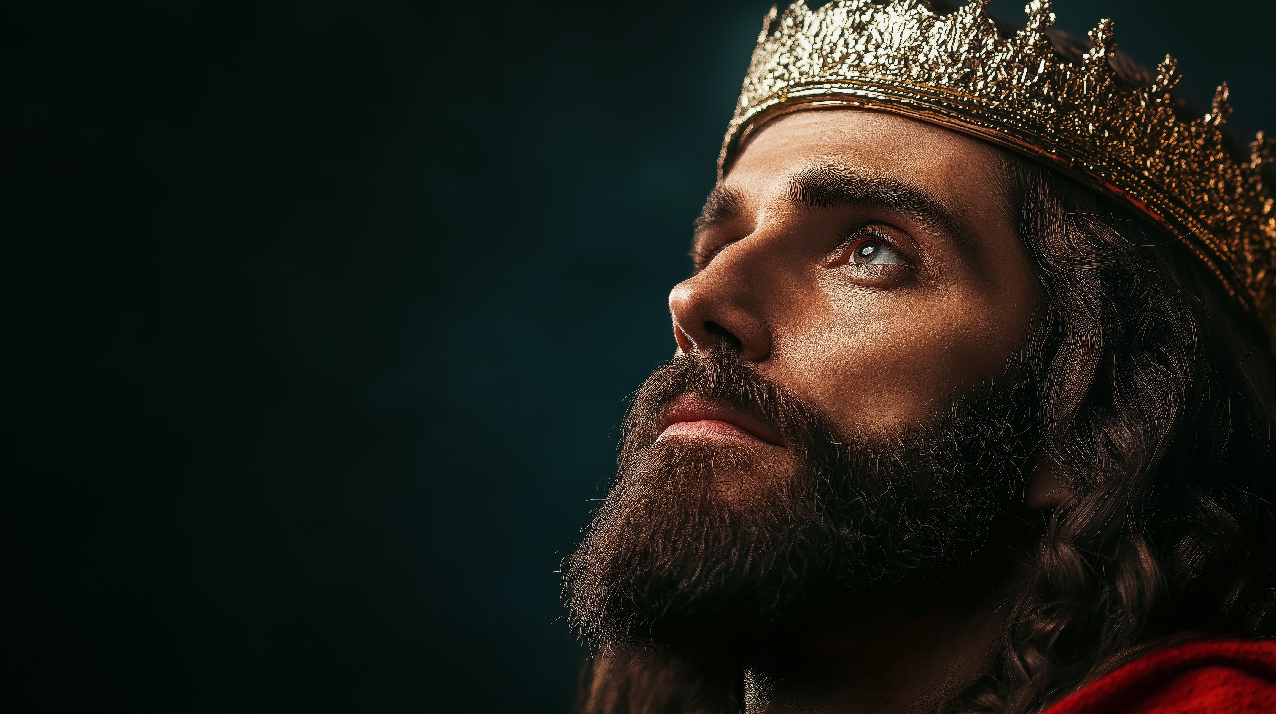
Uh what about everything else in life?

Slide 15
God answered Solomon, “Because this was in your heart, and you have not asked for possessions, wealth, honor, or the life of those who hate you, and have not even asked for long life, but have asked for wisdom and knowledge for yourself that you may govern my people over whom I have made you king…

Slide 16
Matthew 6:33
But seek first the kingdom of God and his righteousness, and all these things will be added to you.

