Slide 2


ETERNITY
IN THE BALANCE
Matthew 25

Slide 3
Think about the idea of eternity.

Slide 4
Think about the idea of being punished for an eternity.

Slide 5
Is God going to send someone to Hell lightly?

Slide 6
What does the Bible say about who will suffer the fate of eternal punishment?
1st Corinthians 6:9-10
Galatians 5:19-21
Revelation 21:8
2nd Thessalonians 1:6-10
Others?

Slide 7
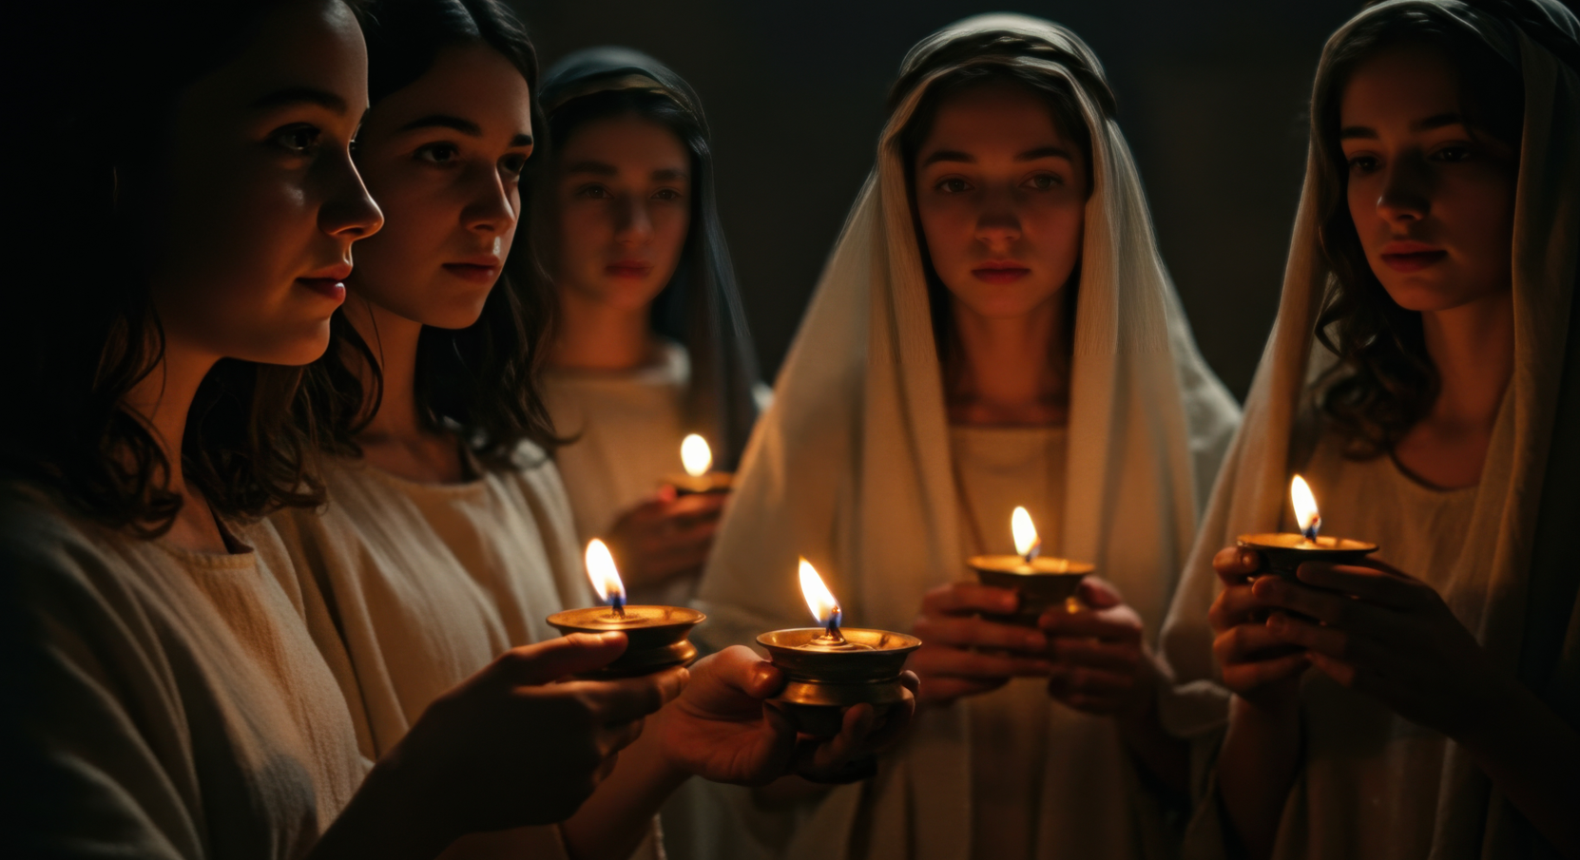
Matthew 25:1-13

Slide 8
“And while they were going away to make the purchase, the bridegroom came, and those who were ready went in with him to the wedding feast; and the door was shut.” v10
Matthew 25:1-13

Slide 9
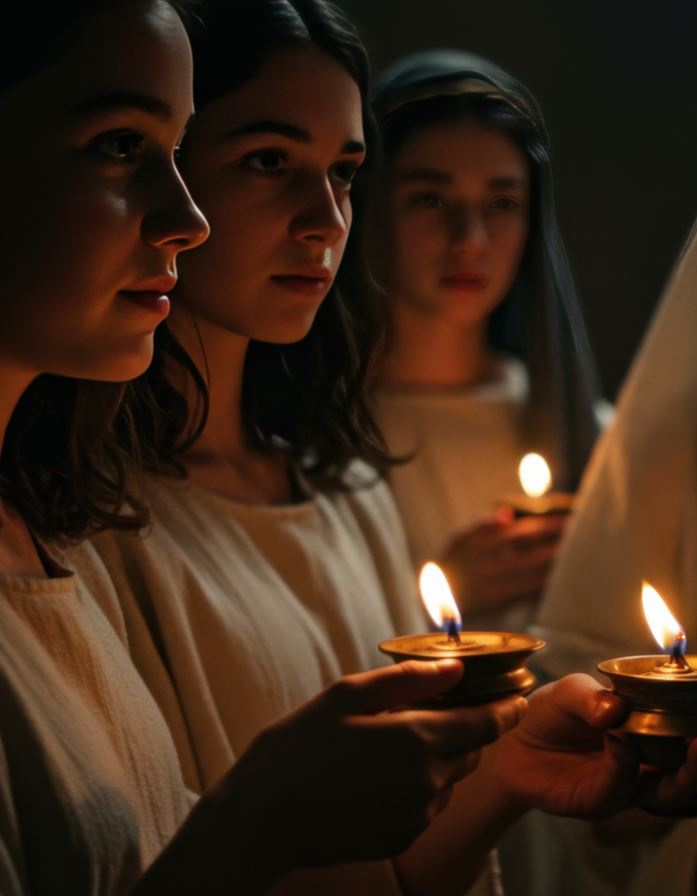
Hardship
We need to have a constant awareness of Jesus’ return.
Procrastination is not your friend.
Live like you were dying!
If you know of something you need to do or say…
Some failed to
Be ready!
Matthew 25:1-13

Slide 10
Notice the language
“Later the other virgins also came, saying, ‘Lord, lord, open up for us.’ But he answered, ‘Truly I say to you, I do not know you.’” v11-12
Matthew 25:1-13

Slide 11
“Be on the alert then, for you do not know the day nor the hour.” v13
Matthew 25:1-13

Slide 12
What I say to you I say to all, ‘Be on the alert!’
Jesus, Mark 13:37

Slide 13
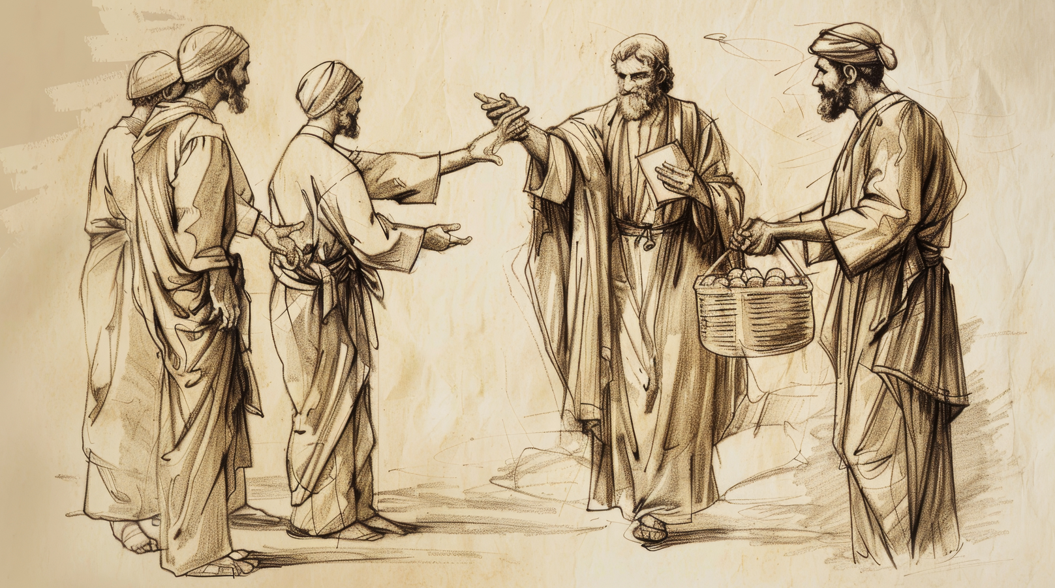
Matthew 25:14-30

Slide 14

“But he who received the one talent went away, and dug a hole in the ground and hid his master’s money.” v18
Matthew 25:14-30

Slide 15

Don’t let fear of failure paralyze you in this kingdom!
Try something for Jesus!
Don’t waste your life solely chasing secular work or hobbies.
God want’s a return on His investment!
Some failed to
Take action!
Matthew 25:14-30

Slide 16

Notice the language
“‘You wicked, lazy slave, you knew that I reap where I did not sow and gather where I scattered no seed... you ought to have put my money in the bank, and… I would have received my money back with interest.”
Matthew 25:26-27

Slide 17
Notice the language
“Throw out the worthless slave into the outer darkness; in that place there will be weeping and gnashing of teeth.”
Matthew 25:30

Slide 18

Matthew 25:31-46

Slide 19

What is the essence of Christianity?
Jesus tells is to give, help, serve, visit, share…
Some failed to
Be generous!
Matthew 25:31-46

Slide 20
“I was a stranger,
and you invited Me in.”
Matthew 25:35
Don’t let a stranger be a stranger for very long

Slide 21
What is the essence of Christianity?
Jesus tells is to give, help, serve, visit, share…
And to do it for a specific group… the least of these.
See the face of Jesus when you look at people!
Be generous to the least
Matthew 25:31-46

Slide 22
Notice the language
“Depart from Me, accursed ones, into the eternal fire which has been prepared for the devil and his angels; for I was hungry…”
Matthew 25:41-42

Slide 23
The main thing is to make the main thing the main thing.
Jesus is the main thing!
Luke 10:42

Slide 24
ETERNITY
IN THE BALANCE
Matthew 25

