Slide 1

Choosing Your
CHURCH
Facts to guide our feelings

Slide 2
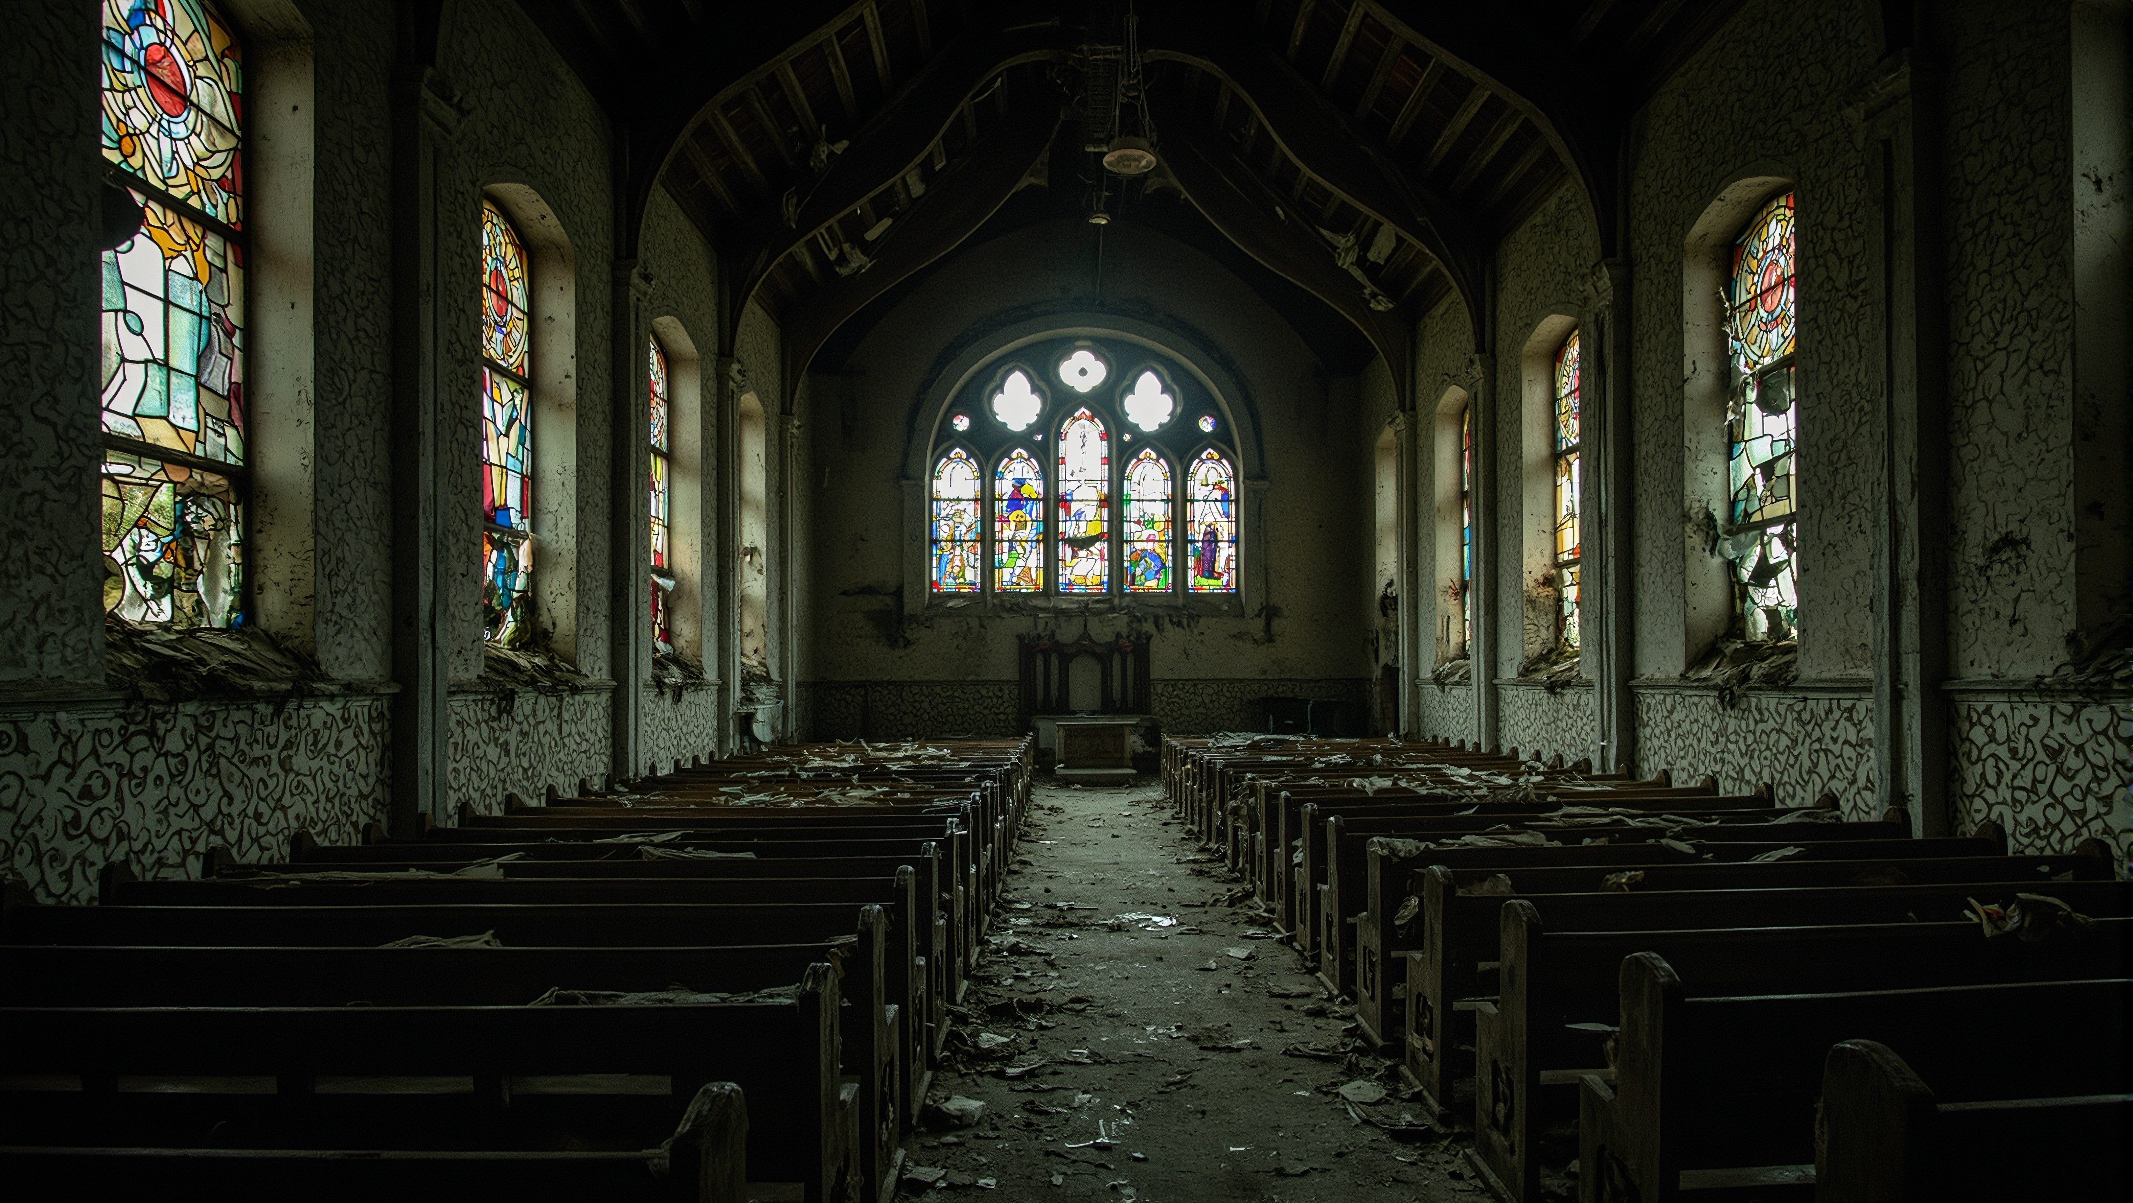
There is no perfect “church” on this earth
Our goal should be to get as close as we can to what God wants

Slide 3
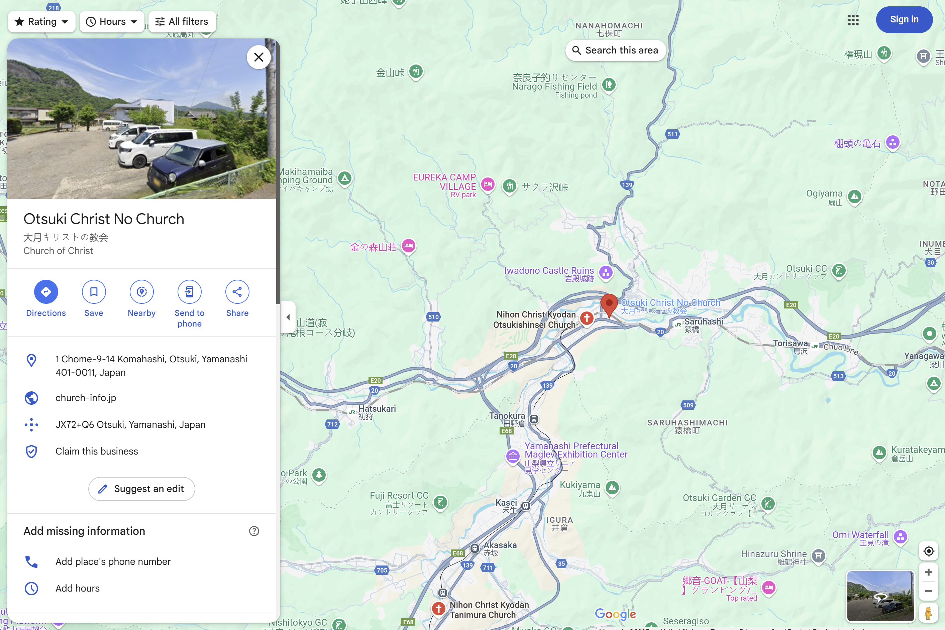
For many people, choosing where to worship is not even an option

Slide 4
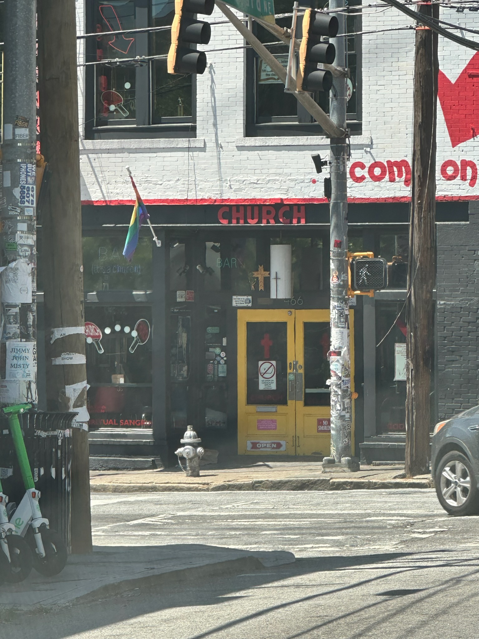
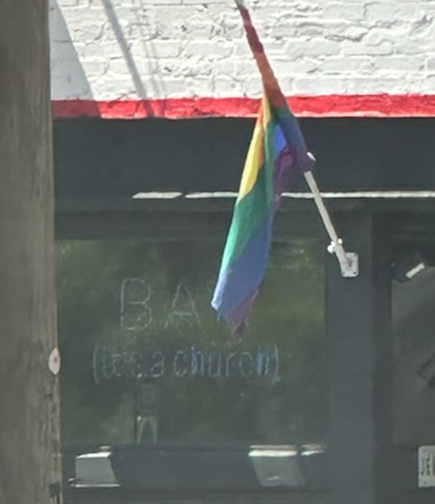


Slide 5

Slapping the word “Church” above a door doesn’t sanction anything

Slide 6

The people are the church

Slide 7

LOVE
So what’s the most important thing a church can possess?

Slide 8

1st Corinthians 13
If I speak in the tongues of men and of angels, but have not love, I am a noisy gong or a clanging cymbal. And if I have prophetic powers, and understand all mysteries and all knowledge, and if I have all faith, so as to remove mountains, but have not love, I am nothing. If I give away all I have, and if I deliver up my body to be burned, but have not love, I gain nothing.

Slide 9
Application
If my church has great lessons, but has not love, it is nothing.
If my church understands the bible perfectly, but doesn’t have love, it is nothing.
If my church uses its money right, but doesn’t have love, it has gained nothing.

Slide 10
Revelation 2:4-5
“But I have this against you, that you have abandoned the love you had at first. Remember therefore from where you have fallen; repent, and do the works you did at first. If not, I will come to you and remove your lampstand from its place, unless you repent.”

Slide 11
1st Timothy 1:4-5
“…nor to devote themselves to myths and endless genealogies, which promote speculations rather than the stewardship from God that is by faith.
The aim of our charge is love that issues from a pure heart and a good conscience and a sincere faith.

Slide 12
1st Thess. 4:9-10
“Now concerning brotherly love you have no need for anyone to write to you, for you yourselves have been taught by God to love one another,
for that indeed is what you are doing to all the brothers throughout Macedonia…”

Slide 13
Colossians 2:1-2
“For I want you to know how great a struggle I have for you and for those at Laodicea and for all who have not seen me face to face, that their hearts may be encouraged, being knit together in love, to reach all the riches of full assurance of understanding and the knowledge of God's mystery, which is Christ.”

Slide 14
Philippians 2:1-2
“So if there is any encouragement in Christ, any comfort from love, any participation in the Spirit, any affection and sympathy, complete my joy by being of the same mind, having the same love, being in full accord and of one mind.”

Slide 15
Ephesians 5:1-2
“Therefore be imitators of God, as beloved children. And walk in love, as Christ loved us and gave himself up for us, a fragrant offering and sacrifice to God.”

Slide 16
Galatians 5:13-14
“For you were called to freedom, brothers. Only do not use your freedom as an opportunity for the flesh, but through love serve one another. For the whole law is fulfilled in one word: “You shall love your neighbor as yourself.”

Slide 17
1st Corinthians 16:14
“Let all that you do be done in love.”

Slide 18

Communion
Music
Just because something isn’t as easy to see, doesn’t mean its less important.
leadership
Money
Love?????

Slide 19

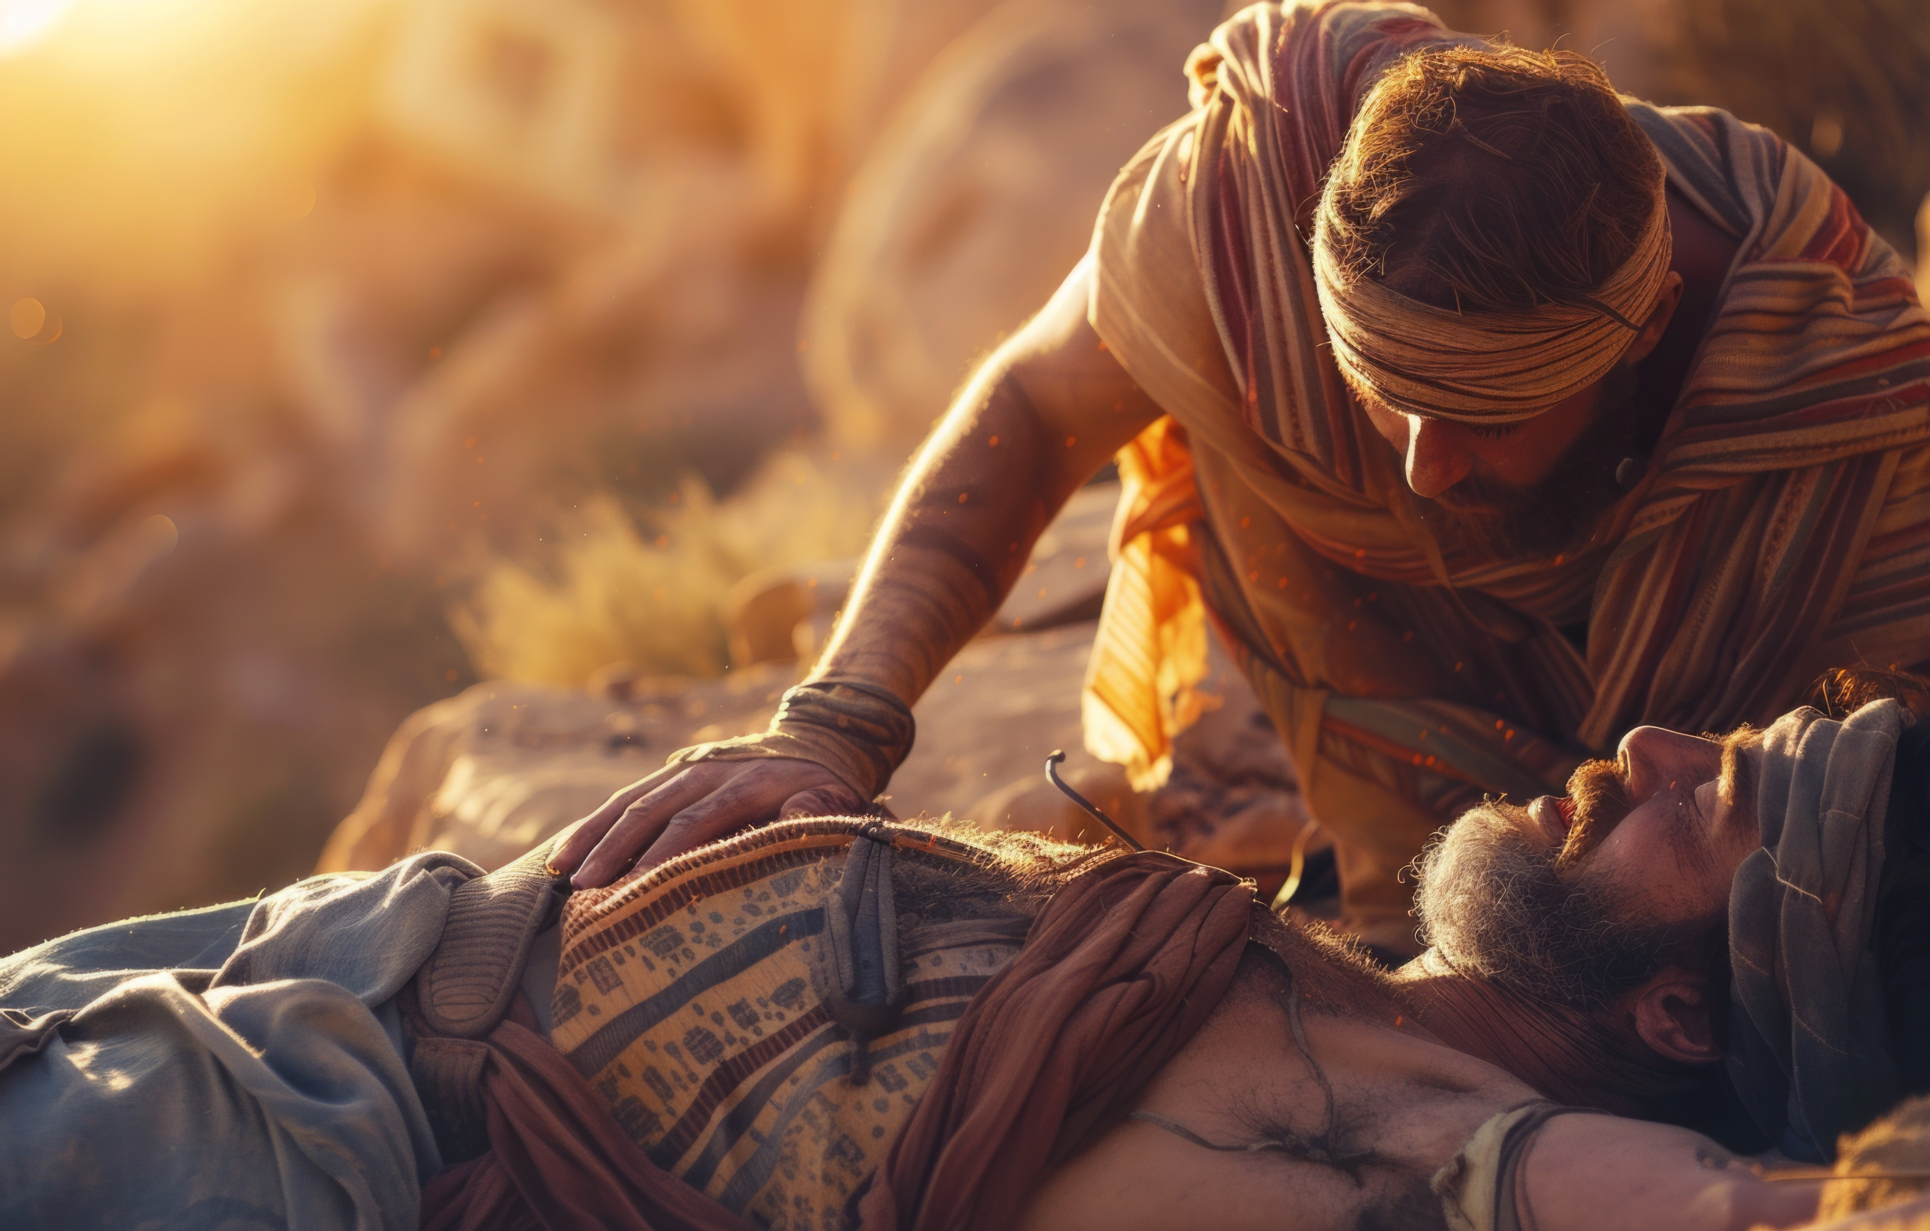
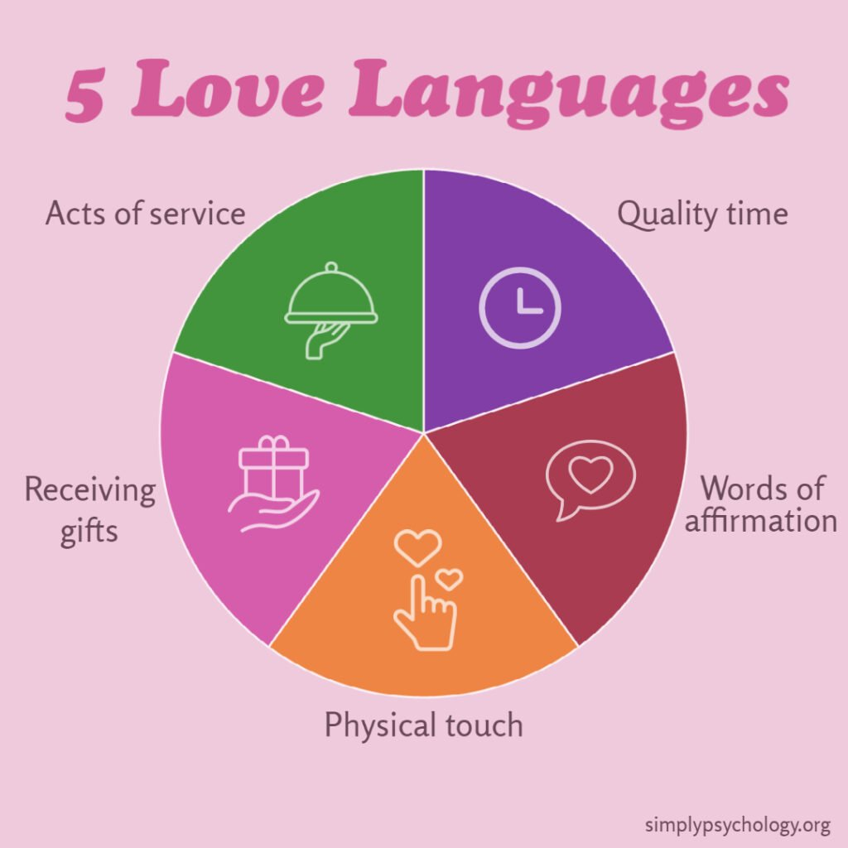
He let him ride on his own animal
He spent time overnight looking after him
He promised to pay for whatever was needed
He bound his wounds
He bought a room at the inn

Slide 20

Do people spend time together away from services?
Are there real conversations going on?
Can you see familiarity and affection between members?
Is there hospitality and generosity?
Do the members willingly engage in service to each other?

Slide 21
I understand why people leave a church where they don’t see love.

