Slide 1
Isaiah 2:5
O house of Jacob, come, let us walk in the light of the LORD!

Slide 2


Slide 3
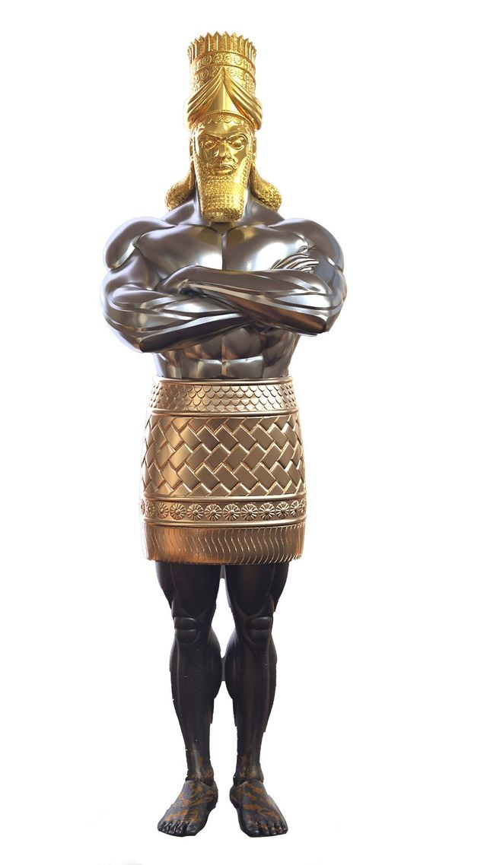
Daniel 2:44
“And in the days of those kings the God of heaven will set up a kingdom that shall never be destroyed, nor shall the kingdom be left to another people. It shall break in pieces all these kingdoms and bring them to an end, and it shall stand forever…”

Slide 4
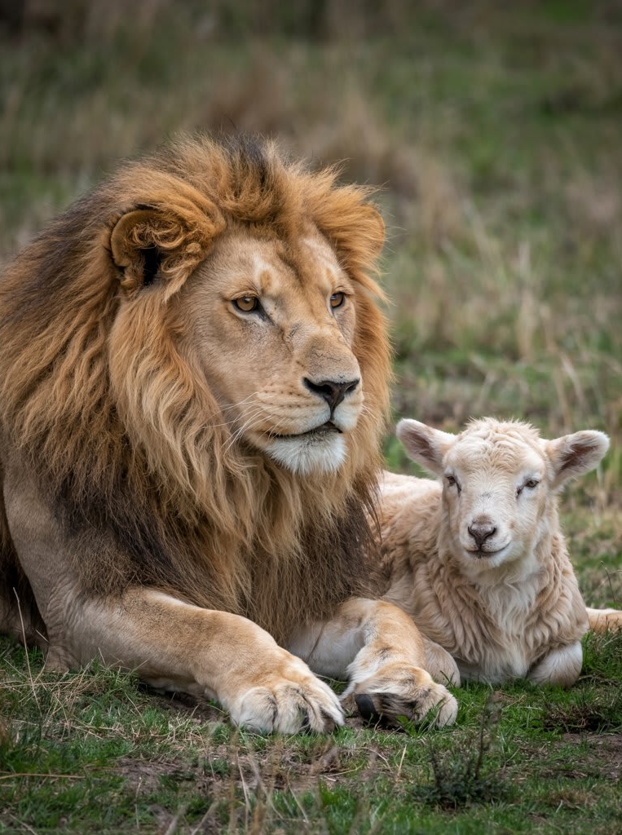
Isaiah 11:9-10
“They shall not hurt or destroy in all my holy mountain; for the earth shall be full of the knowledge of the LORD as the waters cover the sea. In that day the root of Jesse, who shall stand as a signal for the peoples—of him shall the nations inquire, and his resting place shall be glorious.”

Slide 5
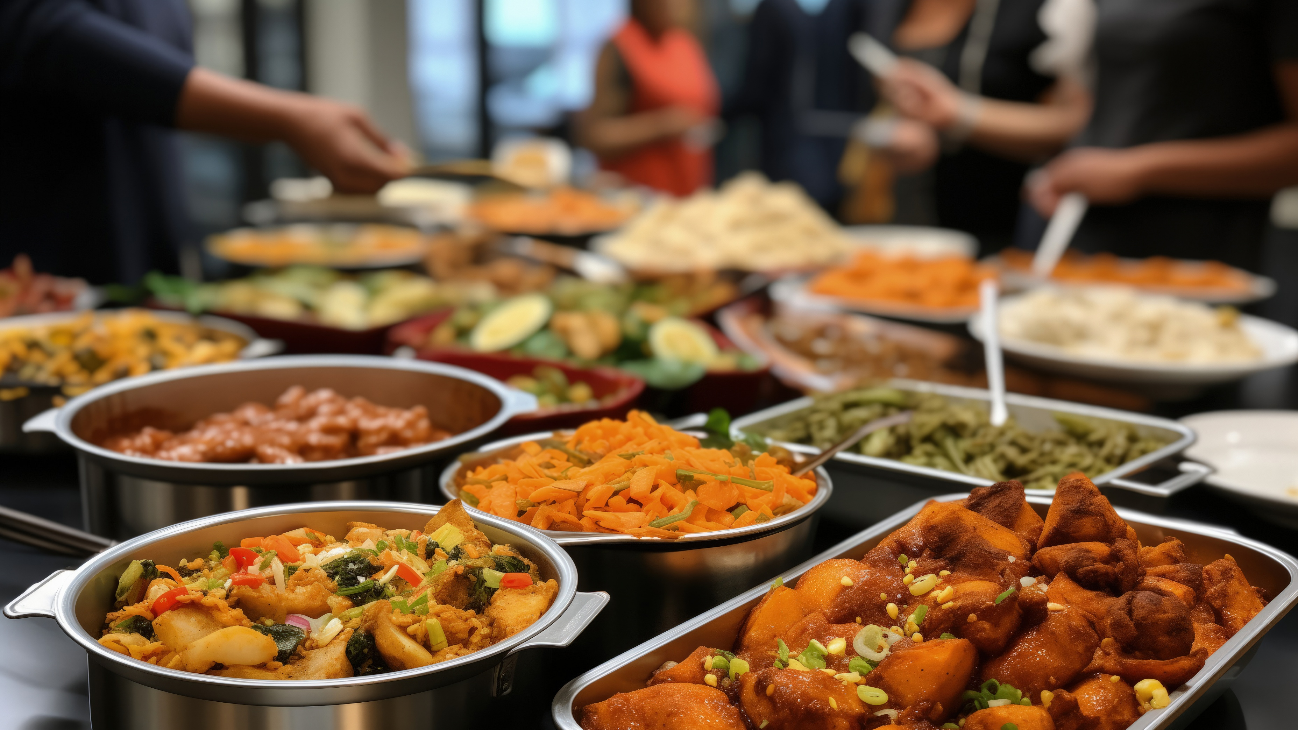
Acts 2:45-46
“And they were selling their possessions and belongings and distributing the proceeds to all, as any had need.
And day by day, attending the temple together and breaking bread in their homes, they received their food with glad and generous hearts…”

Slide 6
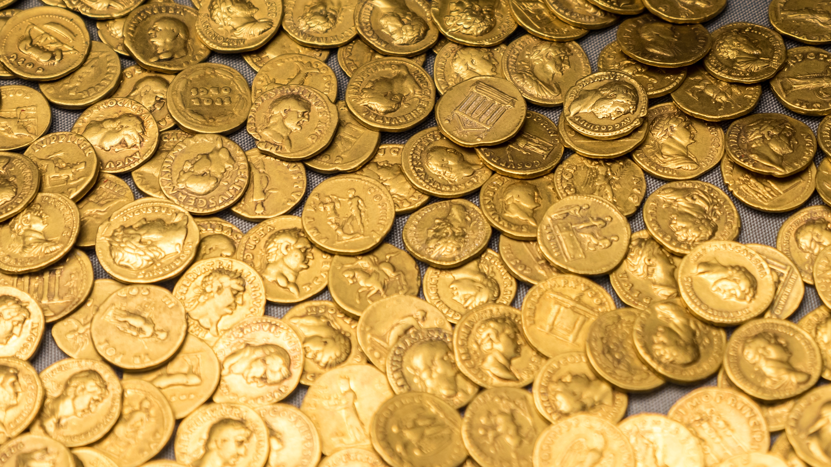
Acts 4:34-35
“There was not a needy person among them, for as many as were owners of lands or houses sold them and brought the proceeds of what was sold and laid it at the apostles' feet, and it was distributed to each as any had need.”

Slide 7

the shocking deaths of
Ananias and Sapphira

Slide 8
Luke 1:1-4
“Inasmuch as many have undertaken to compile an account of the things accomplished among us, just as they were handed down to us by those who from the beginning were eyewitnesses and servants of the word, it seemed fitting for me as well, having investigated everything carefully from the beginning, to write it out for you in consecutive order, most excellent Theophilus; so that you may know the exact truth about the things you have been taught.”

Slide 9
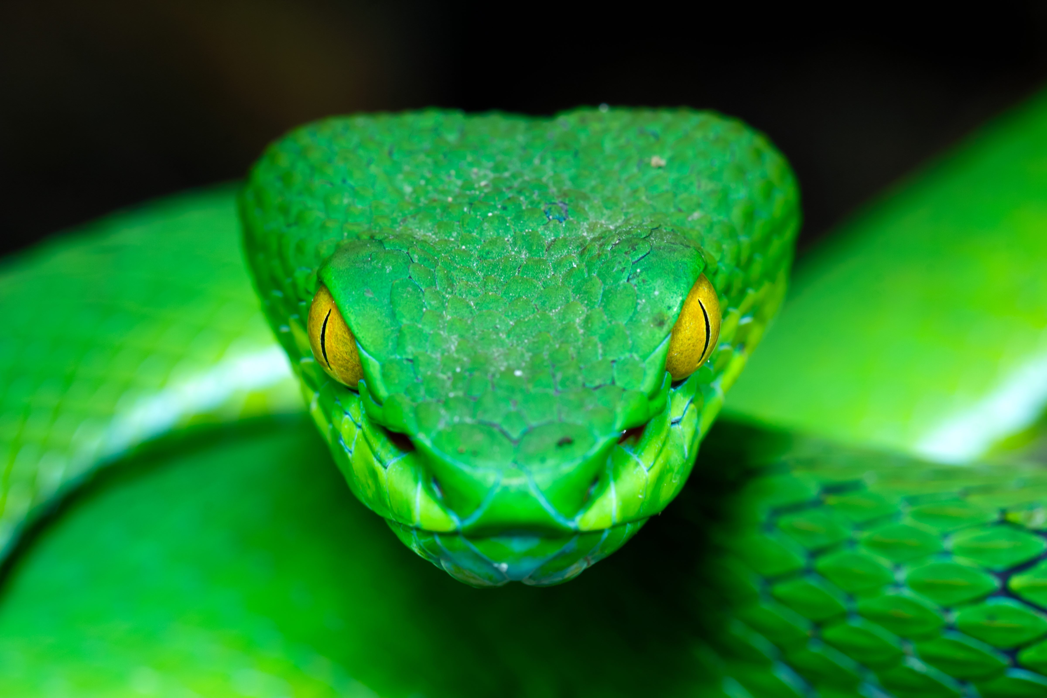
Acts 5:3
“But Peter said, “Ananias, why has Satan filled your heart to lie to the Holy Spirit and to keep back for yourself part of the proceeds of the land?

Slide 10
We Can Be Filled By Satan
1st Peter 5:8
Be of sober spirit, be on the alert. Your adversary, the devil, prowls around like a roaring lion, seeking someone to devour.
We all have the potential to be influenced, for good or for evil
Satan wants us to yield to the flesh: pride, dishonesty, hypocrisy, anger, etc.
He uses our vices and our weaknesses to exploit us to do his bidding (2nd Tim. 2:26)
Despite his influence, we are ultimately held accountable for our actions

Slide 11
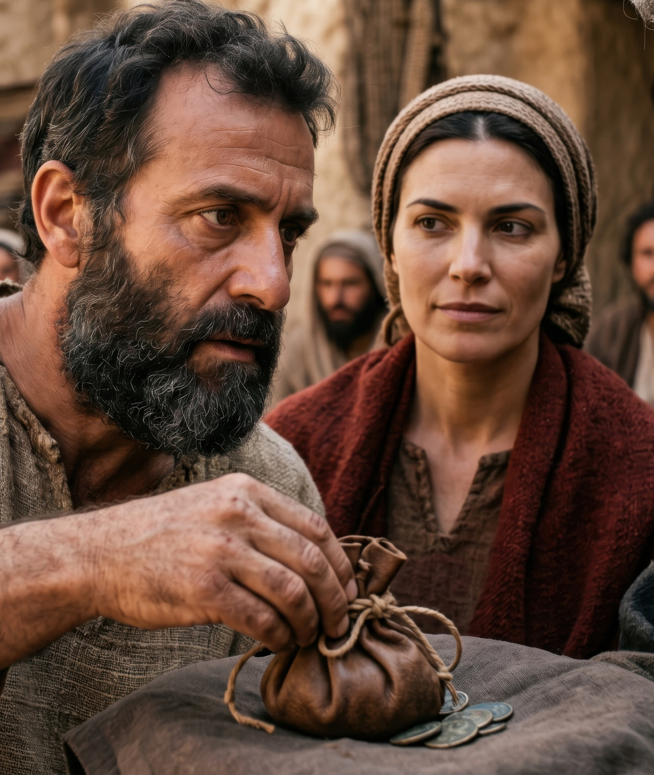
Acts 5:1-2
But a man named Ananias, with his wife Sapphira, sold a piece of property, and kept back some of the price for himself, with his wife’s full knowledge, and bringing a portion of it, he laid it at the apostles’ feet.

Slide 12
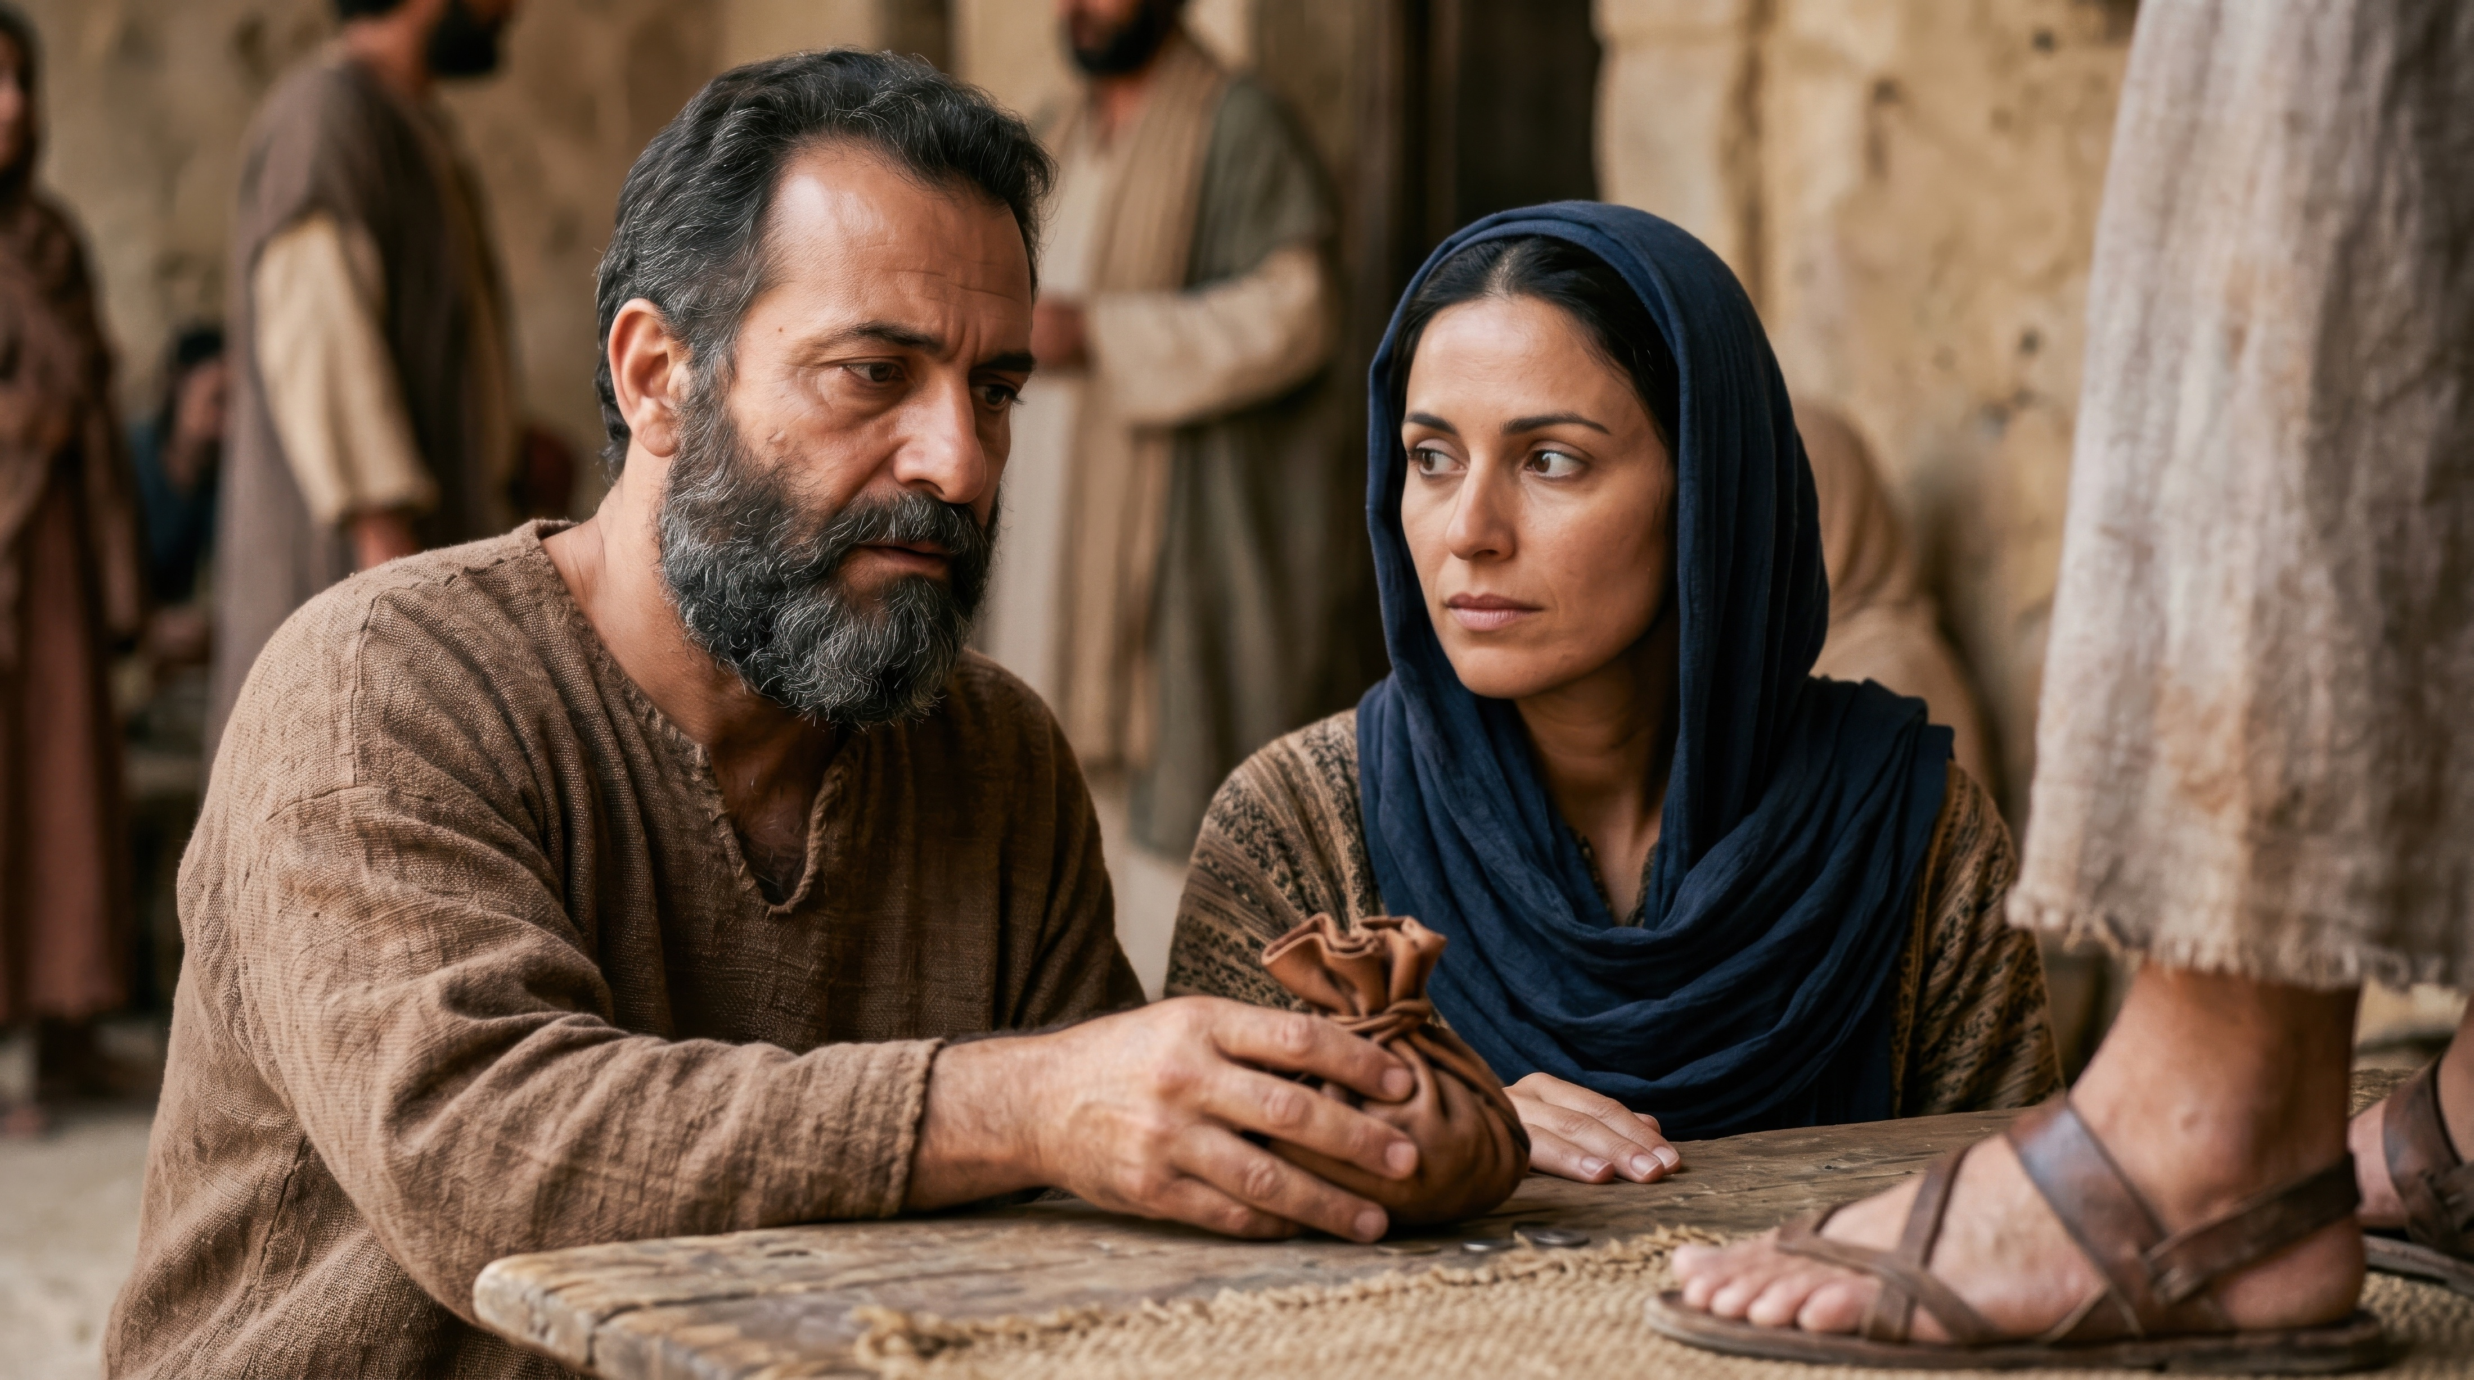
We Are Reminded of how god views sin
Acts 8:24
But Simon answered and said, “Pray to the Lord for me yourselves, so that nothing of what you have said may come upon me.”
We as humans view sin differently than God
God shows us how He views even perceived “minor offenses” (Num 15:32)
God reminds us that He sees even secretive or hidden behaviors (2nd Kings 5:26)
We learn from this event the serious consequences of sin
Hebrews 10:26-29

Slide 13
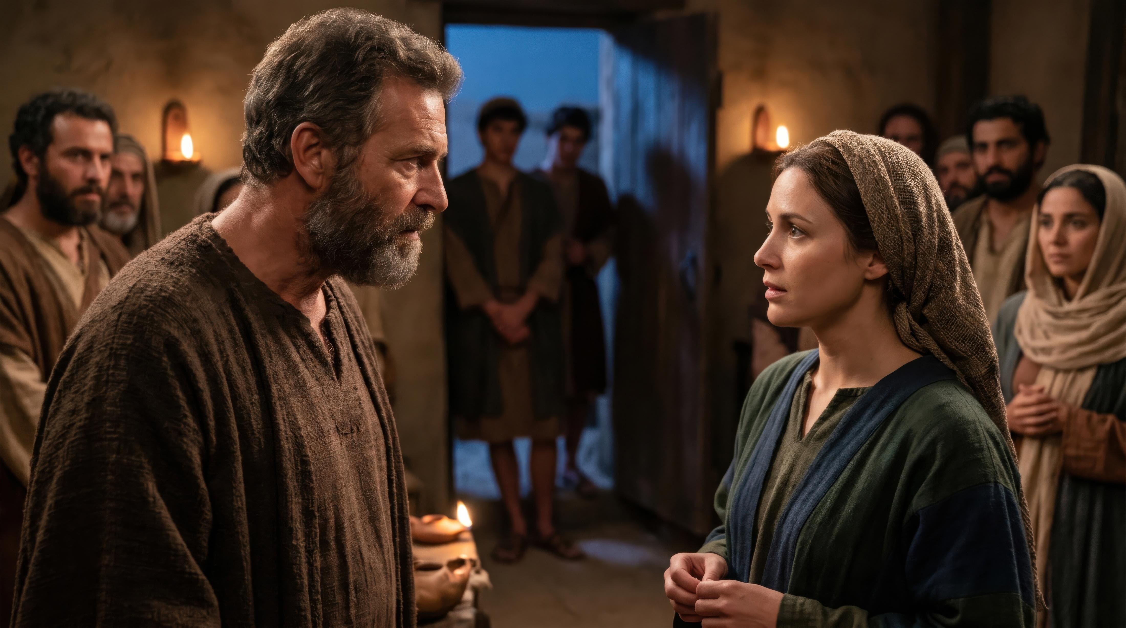
Acts 5:7
Now there elapsed an interval of about three hours, and his wife came in, not knowing what had happened. And Peter responded to her, “Tell me whether you sold the land for such and such a price?” And she said, “Yes, that was the price.”

Slide 14
God May Give You An Opportunity to change
2nd Kings 5:25
But he went in and stood before his master. And Elisha said to him, “Where have you been, Gehazi?” And he said, “Your servant went nowhere.”
God is longsuffering, gracious and merciful
Every sin deserves punishment, and His patience can be misconstrued as ignorance
Today is our opportunity to change our behavior – we never know when His forbearance with us has reached its end
Regardless of physical punishment, the spiritual separation is far worse
Amos 4:12

Slide 15
Acts 5:11
“And great fear came over the whole church, and over all who heard of these things.”

