Slide 1


Slide 2


Slide 3


Slide 4

Romans 12:1-2
“Therefore I urge you, brethren, by the mercies of God, to present your bodies a living and holy sacrifice.. And do not be conformed to this world, but be transformed by the renewing of your mind, so that you may prove what the will of God is, that which is good and acceptable and perfect.” (NASB)

Slide 5
Colossians 3:15
“So, as those who have been chosen of God, holy and beloved, put on a heart of compassion, kindness, humility, gentleness and patience; bearing with one another, and forgiving each other, whoever has a complaint against anyone; just as the Lord forgave you, so also should you. Beyond all these things put on love, which is the perfect bond of unity. Let the peace of Christ rule in your hearts, to which indeed you were called in one body; and be thankful.”

Slide 6

Transformed
PEOPLE OF PEACE

Slide 7

The Peace of Christ

Slide 8
Isaiah 9:6
For a child will be born to us, a son will be given to us; And the government will rest on His shoulders; And His name will be called Wonderful Counselor, Mighty God, Eternal Father, Prince of Peace.

Slide 9
Isaiah 11:6,9
And the wolf will dwell with the lamb, And the leopard will lie down with the young goat, And the calf and the young lion and the fatling together; And a little boy will lead them… They will not hurt or destroy in all My holy mountain, For the earth will be full of the knowledge of the LORD As the waters cover the sea.”

Slide 10
John 14:27
Peace I leave with you; my peace I give to you. Not as the world gives do I give to you. Let not your hearts be troubled, neither let them be afraid.

Slide 11
The peace that Jesus gives us is real, powerful, and personal. It should profoundly affect our outlook on life – and by virtue – everyone we come in contact with.

Slide 12
Romans 14:17
For the kingdom of God is not a matter of eating and drinking but of righteousness and peace and joy in the Holy Spirit.

Slide 13
2nd Corinthians 13:11
Finally, brothers, rejoice. Aim for restoration, comfort one another, agree with one another, live in peace; and the God of love and peace will be with you.

Slide 14
2nd Peter 3:14
Therefore, beloved, since you are waiting for these, be diligent to be found by him without spot or blemish, and at peace.

Slide 15
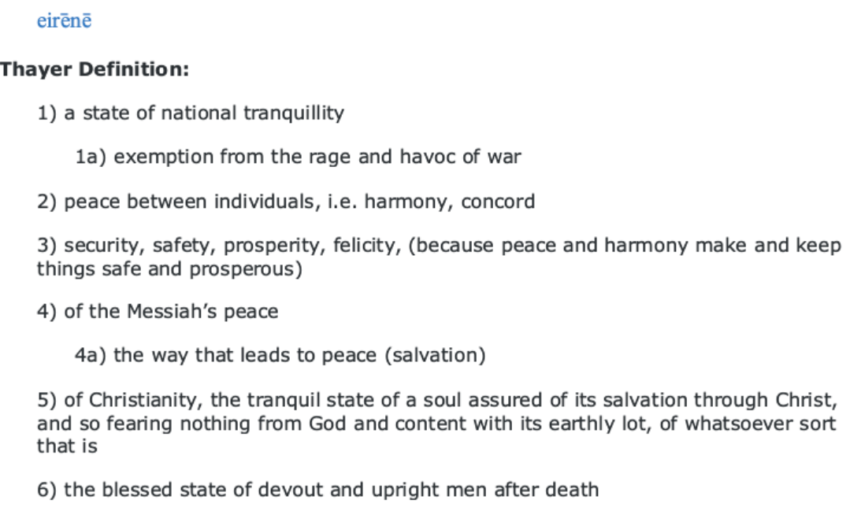

Slide 16
Colossians 3:15
“So, as those who have been chosen of God, holy and beloved, put on a heart of compassion, kindness, humility, gentleness and patience; bearing with one another, and forgiving each other, whoever has a complaint against anyone; just as the Lord forgave you, so also should you. Beyond all these things put on love, which is the perfect bond of unity. Let the peace of Christ rule in your hearts, to which indeed you were called in one body; and be thankful.”

Slide 17

What Rules In Your Heart?

Slide 18
Worry

Slide 19
anger

Slide 20
passions

Slide 21
envy

Slide 22
How Can I Let Peace Rule?
1. Constantly remind yourself of the peace you have with God.
May the God of hope fill you with all joy and peace in believing, so that by the power of the Holy Spirit you may abound in hope.
-Romans 15:13

Slide 23
How Can I Let Peace Rule?
2. Be someone who resolves problems instead of creating them.
Blessed are the peacemakers, for they shall be called sons of God.
-Matthew 5:9

Slide 24
How Can I Let Peace Rule?
3. Fight against the things that want to rob you of peace.
Strive for peace with everyone, and for the holiness without which no one will see the Lord.
-Hebrews 12:14

