Slide 1

Choosing Your
CHURCH
Facts to guide our feelings

Slide 2

LOVE
So what’s the most important thing a church can possess?

Slide 3

1st Corinthians 13
If I speak in the tongues of men and of angels, but have not love, I am a noisy gong or a clanging cymbal. And if I have prophetic powers, and understand all mysteries and all knowledge, and if I have all faith, so as to remove mountains, but have not love, I am nothing. If I give away all I have, and if I deliver up my body to be burned, but have not love, I gain nothing.

Slide 4
Application
If my church has great lessons, but has not love, it is nothing.
If my church understands the bible perfectly, but doesn’t have love, it is nothing.
If my church uses its money right, but doesn’t have love, it has gained nothing.

Slide 5
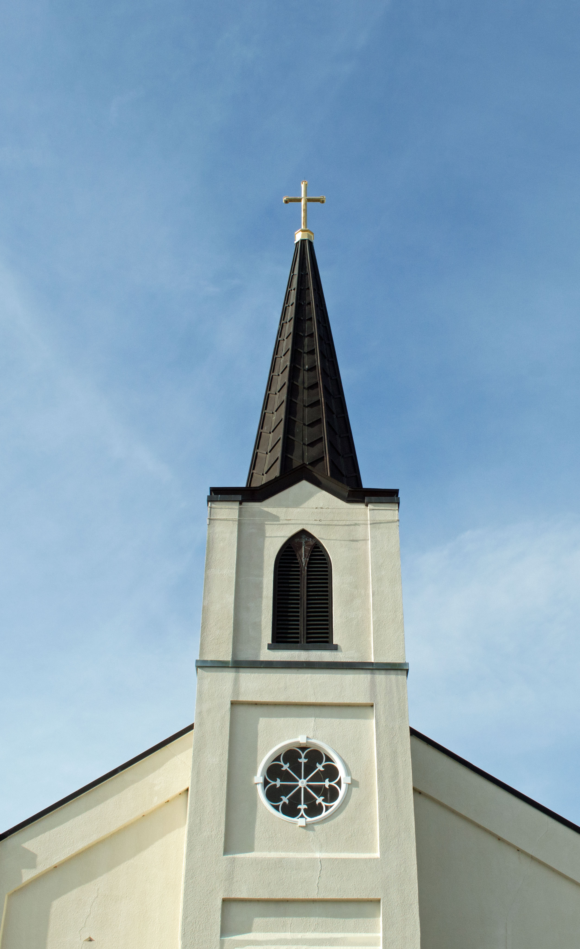
Do people spend time together away from services?
Are there real conversations going on?
Can you see familiarity and affection between members?
Is there hospitality and generosity?
Do the members willingly engage in service to each other?

Slide 6
I get it, love is critical.
But is there anything else to consider?

Slide 7
Revelation 2:14-16
“But I have a few things against you: you have some there who hold the teaching of Balaam, who taught Balak to put a stumbling block before the sons of Israel, so that they might eat food sacrificed to idols and practice sexual immorality. So also you have some who hold the teaching of the Nicolaitans. Therefore repent…”

Slide 8
2nd Peter 2:1-2
“But false prophets also arose among the people, just as there will be false teachers among you, who will secretly bring in destructive heresies, even denying the Master who bought them, bringing upon themselves swift destruction. And many will follow their sensuality, and because of them the way of truth will be blasphemed.”

Slide 9
Matthew 7:15-16
“Beware of false prophets, who come to you in sheep's clothing but inwardly are ravenous wolves.
You will recognize them by their fruits. Are grapes gathered from thornbushes, or figs from thistles?”

Slide 10
1st John 4:1
“Beloved, do not believe every spirit, but test the spirits to see whether they are from God, for many false prophets have gone out into the world.”

Slide 11
1st Timothy 4:6
“If you put these things before the brothers, you will be a good servant of Christ Jesus, being trained in the words of the faith and of the good doctrine that you have followed.”

Slide 12

What A Church teaches matters to god

Slide 13
Areas of Doctrine
Conversion
The nature of Jesus
Morality
Church Leadership
Public Worship
Food and Drink
Communion
Money and Wealth

Slide 14


Slide 15
“It ALL matters!”
CRAZY!
CHURCH DOCTRINE
“Nothing matters!”
CRAZY!

Slide 16
Me and My Church
Please come visit us!

Slide 17

God Is The Judge

Slide 18
Genesis 18:24-25
“Suppose there are fifty righteous within the city. Will you then sweep away the place and not spare it for the fifty righteous who are in it? Far be it from you to do such a thing, to put the righteous to death with the wicked, so that the righteous fare as the wicked! Far be that from you! Shall not the Judge of all the earth do what is right?”

Slide 19
2nd Peter 2:7-9
“and if he rescued righteous Lot, greatly distressed by the sensual conduct of the wicked…then the Lord knows how to rescue the godly from trials, and to keep the unrighteous under punishment until the day of judgment…”

Slide 20
2nd Timothy 2:19
“But God's firm foundation stands, bearing this seal: “The Lord knows those who are his,” and, “Let everyone who names the name of the Lord depart from iniquity.”

Slide 21
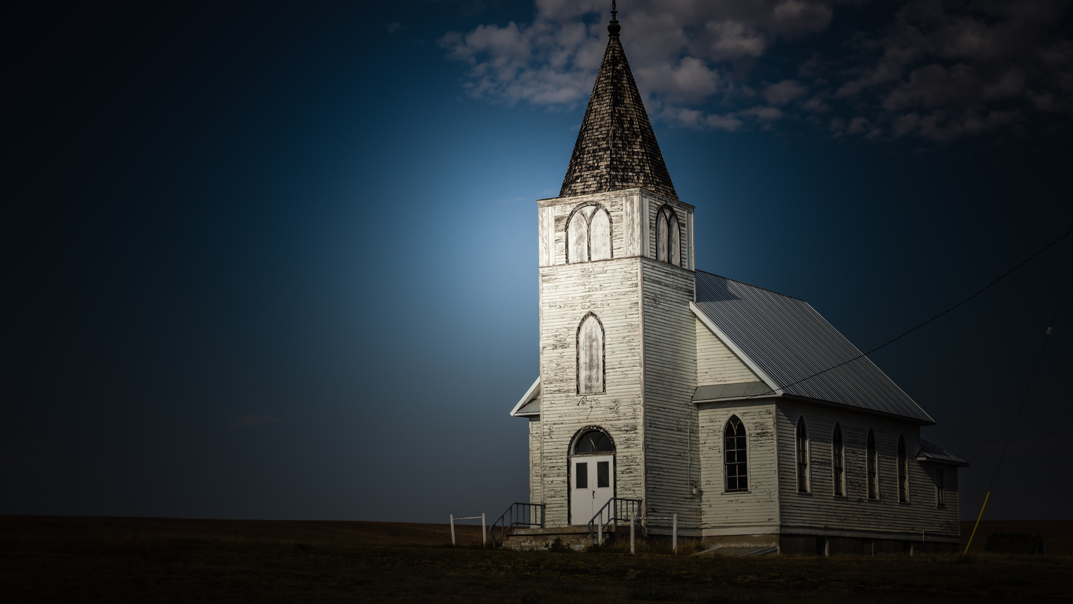
Good People Can Be In Bad Churches

Slide 22
James 3:1
“Let not many of you become teachers, my brethren, knowing that as such we will incur a stricter judgment.”

Slide 23
Hebrews 13:17
“Obey your leaders and submit to them, for they are keeping watch over your souls, as those who will have to give an account. Let them do this with joy and not with groaning, for that would be of no advantage to you.

Slide 24
Revelation 3:1-4
‘I know your works. You have the reputation of being alive, but you are dead…I have not found your works complete in the sight of my God…Yet you have still a few names in Sardis, people who have not soiled their garments, and they will walk with me in white, for they are worthy.”

Slide 25

Allow Room For Growth

Slide 26
1st Peter 2:1-2
“Like newborn infants, long for the pure spiritual milk, that by it you may grow up into salvation— if indeed you have tasted that the Lord is good.”

Slide 27
1st Peter 2:1-2
“…until we all attain to the unity of the faith and of the knowledge of the Son of God, to mature manhood, to the measure of the stature of the fullness of Christ…”

Slide 28
Choose A Church That is committed to the teachings of god, but with a spirit of humility that gives grace as much as it expects to receive it.

