Slide 1


Slide 2
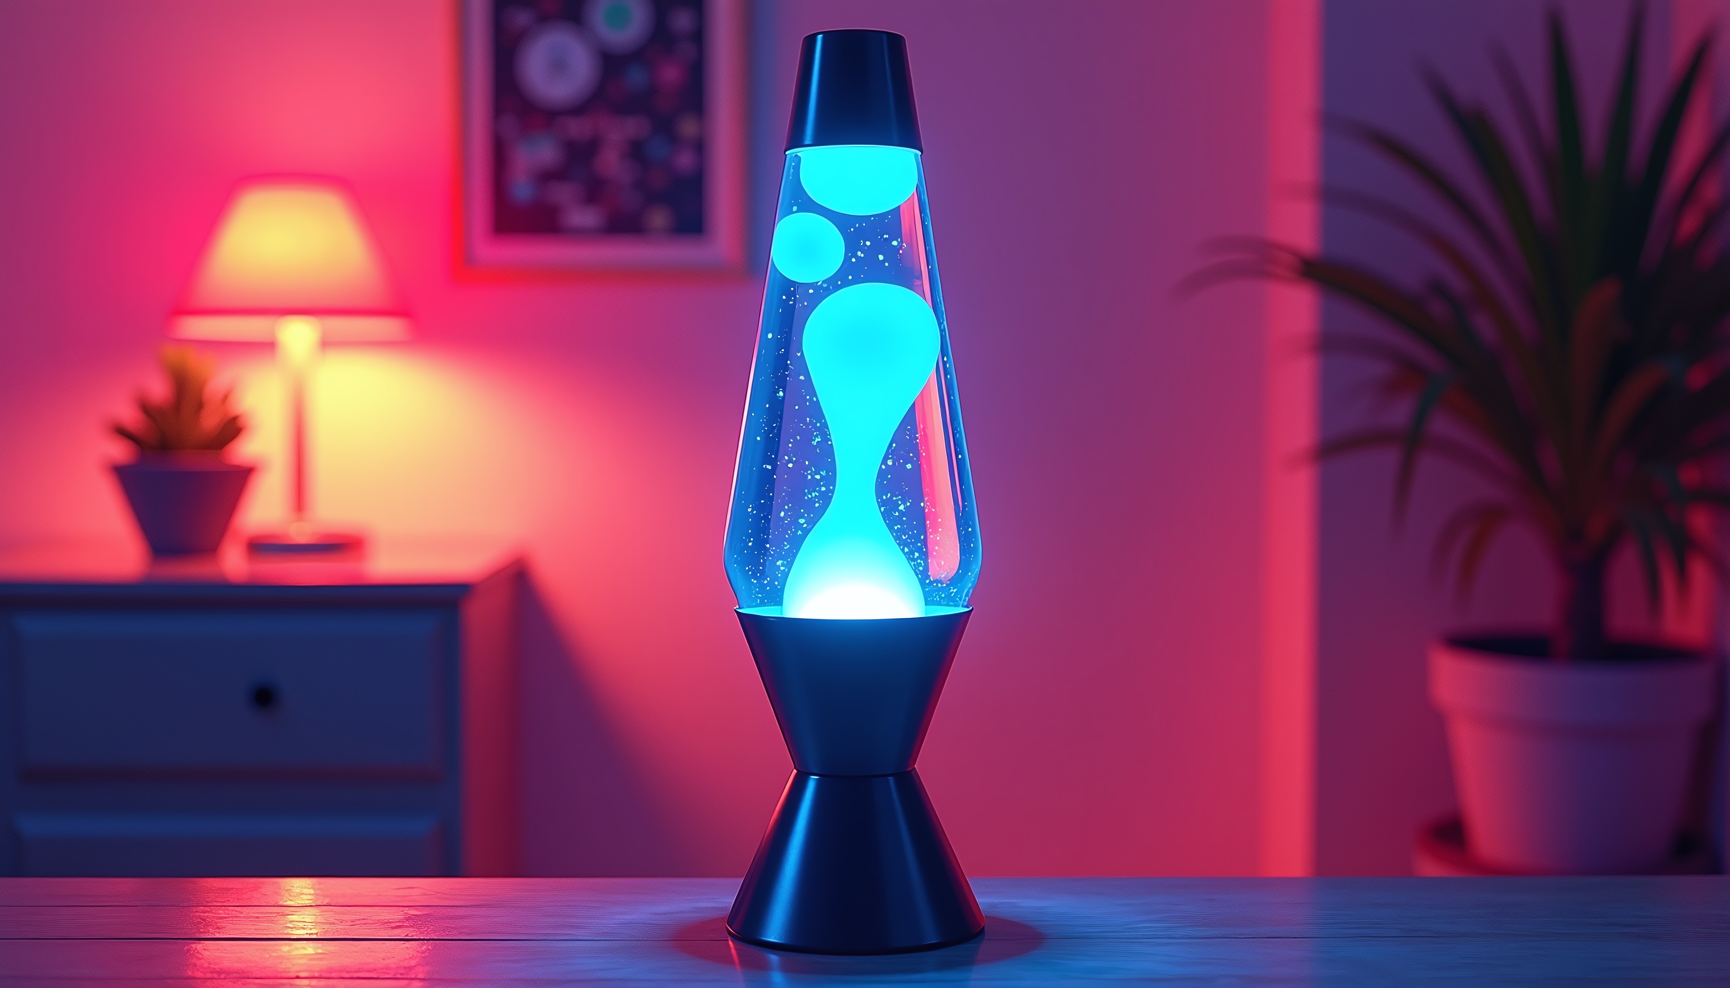

Slide 3
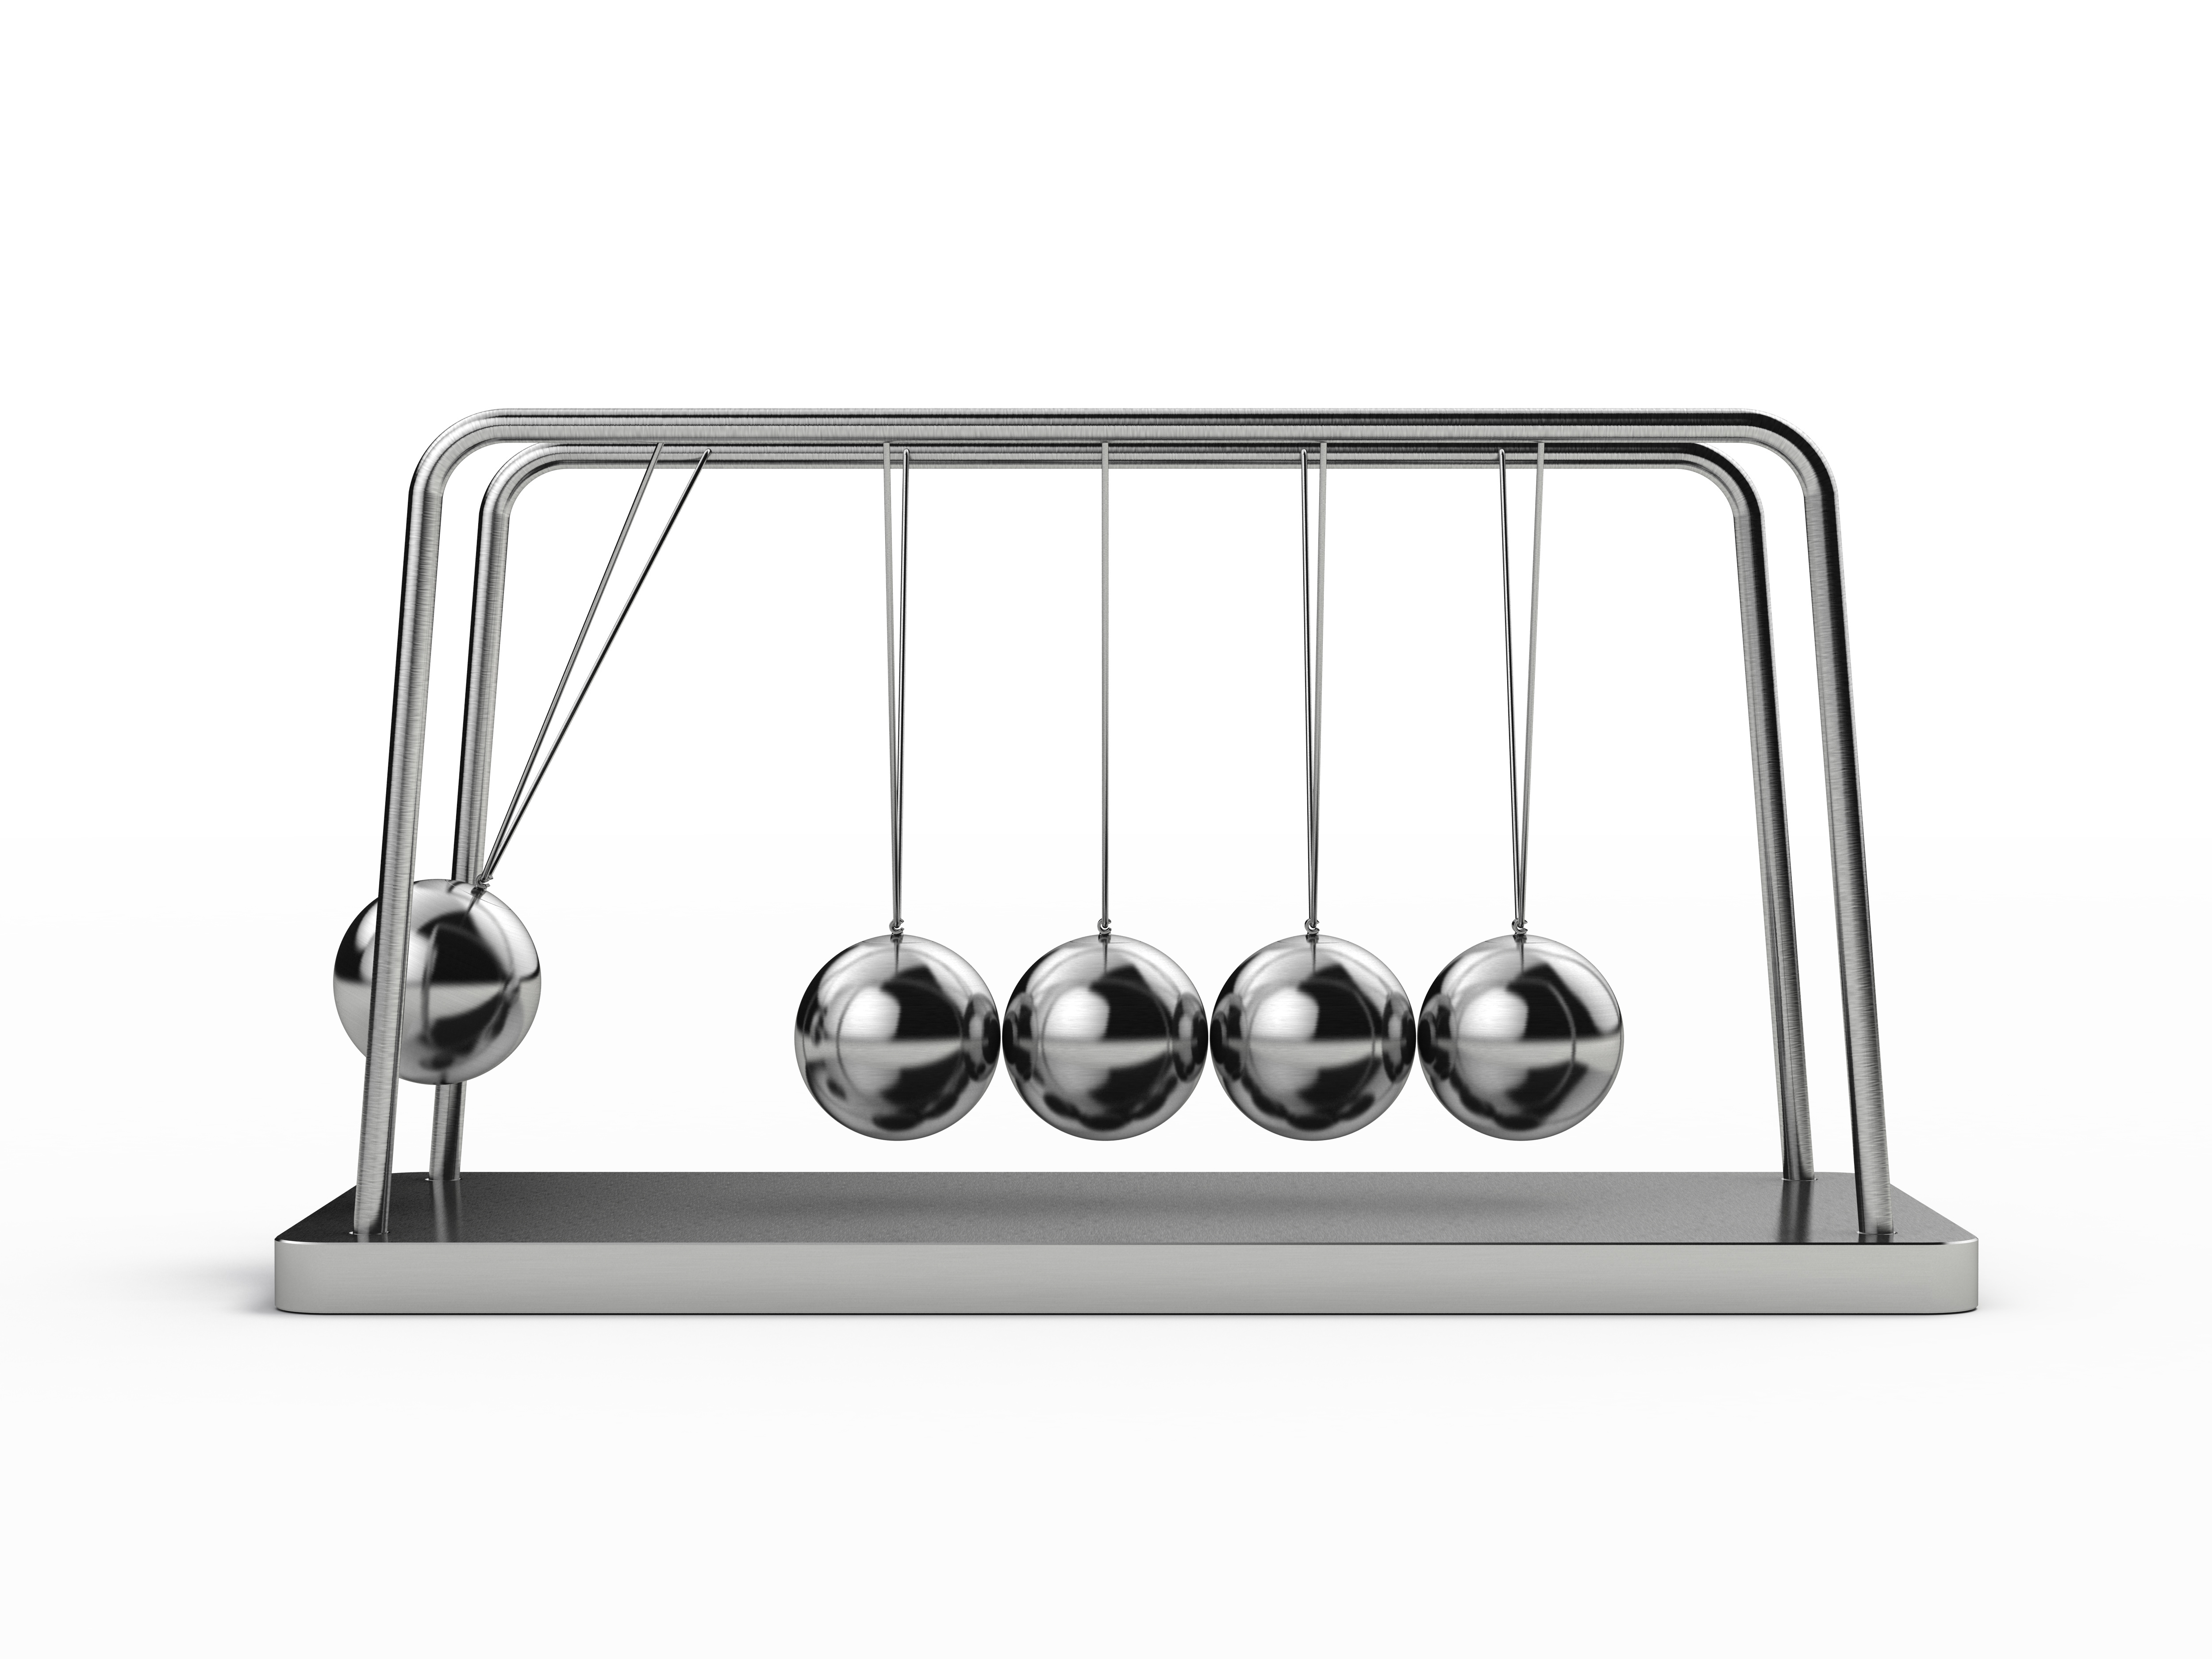

Slide 4

The Cause
Are you responsible for other people’s sins?

Slide 5

Matthew 18:6-7
“…whoever causes one of these little ones who believe in me to sin, it would be better for him to have a great millstone fastened around his neck and to be drowned in the depth of the sea. Woe to the world for temptations to sin! For it is necessary that temptations come, but woe to the one by whom the temptation comes!”

Slide 6
An expression of great sorrow
WOE
A verdict of future condemnation

Slide 7
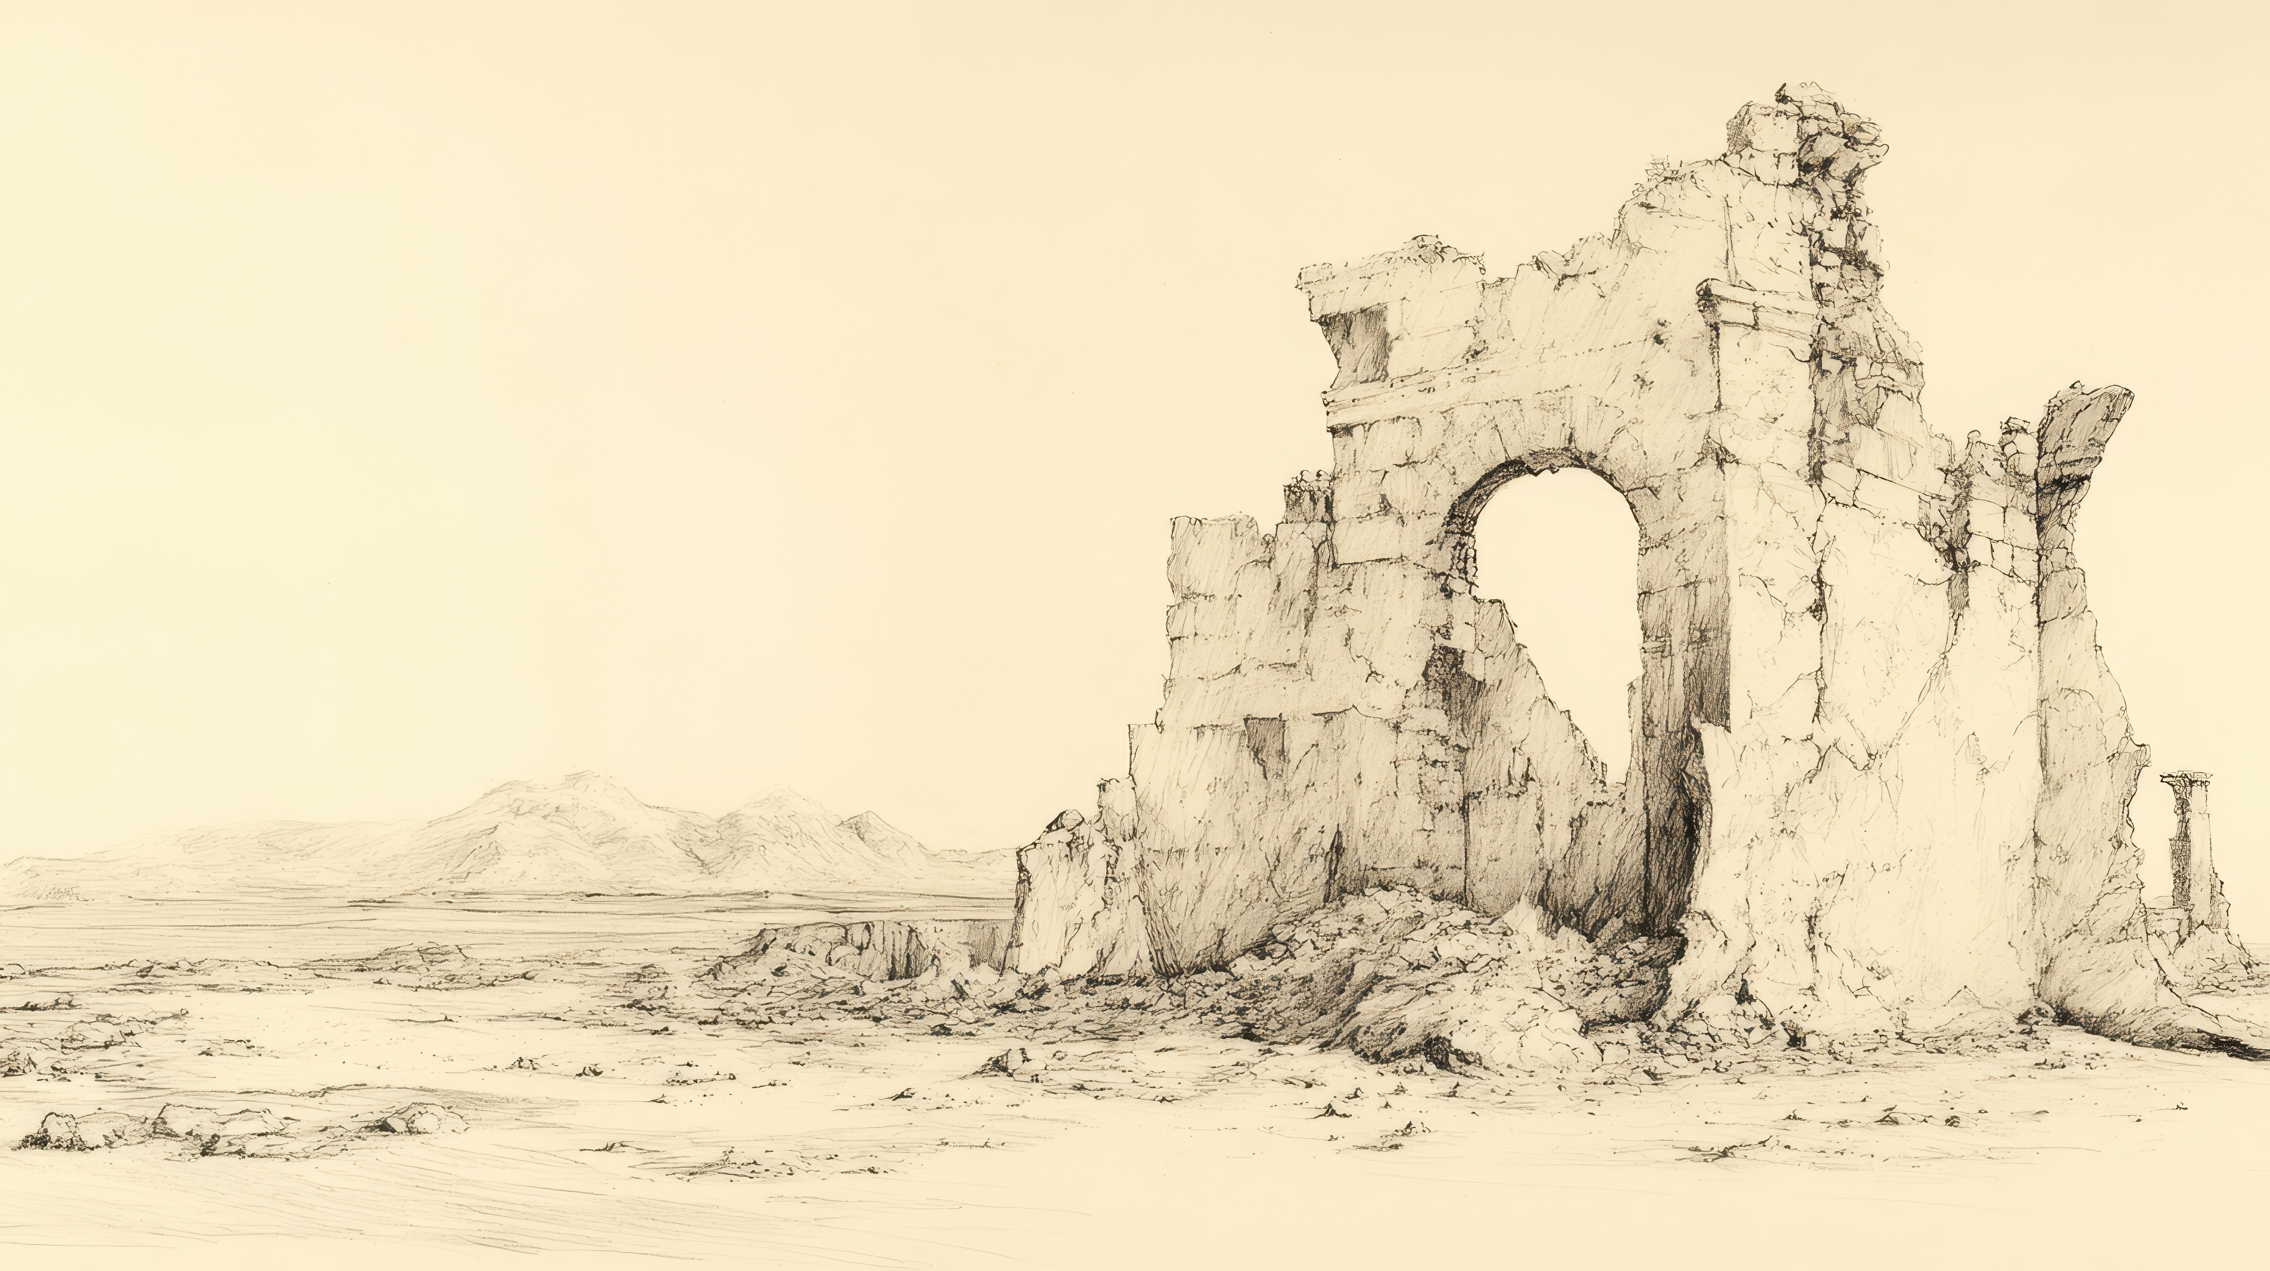
1st Kings 14:14, 16
Moreover, the LORD will raise up for himself a king over Israel who shall cut off the house of Jeroboam today…And he will give Israel up because of the sins of Jeroboam, which he sinned and made Israel to sin.”

Slide 8
The worst thing that can happen to us is to sin
It is especially evil then to cause someone else’s sin
Jesus said it would be better for us to have died

Slide 9
Ephesians 6:4
Fathers, do not provoke your children to anger, but bring them up in the discipline and instruction of the Lord.
Am I the cause for
Sin in my family

Slide 10
Proverbs 15:1
A soft answer turns away wrath, but a harsh word stirs up anger.
Am I the cause for
Sin in my family

Slide 11
I can create such a toxic environment that I cause other people’s anger.
I can prevent sexual fulfillment in marriage and cause my spouse to stumble.
I can fail to lead my family spiritually and cause them to be weak or ultimately lost.
Am I the cause for
Sin in my family

Slide 12

Do not desire her beauty in your heart, and do not let her capture you… (Proverbs 6:25)
Am I the cause for
Sin in Others

Slide 13

For this is the will of God, your sanctification: that you abstain from sexual immorality…(1st Thess. 4:3)
Am I the cause for
Sin in Others

Slide 14
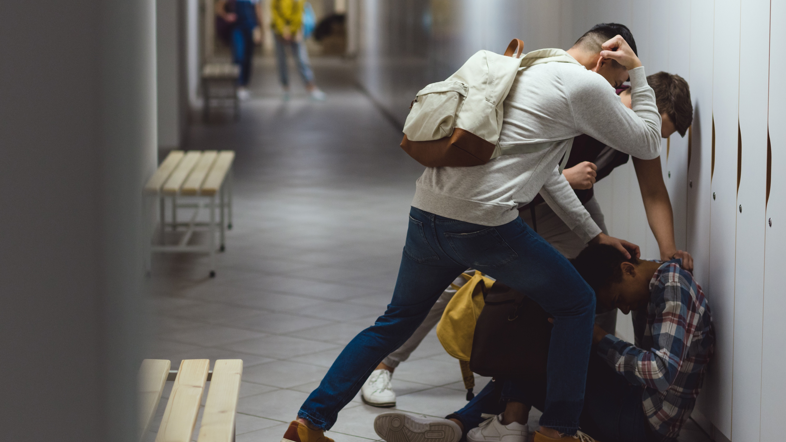
You shall not follow a crowd to do evil… (Exodus 23:2)
Am I the cause for
Sin in Others

Slide 15
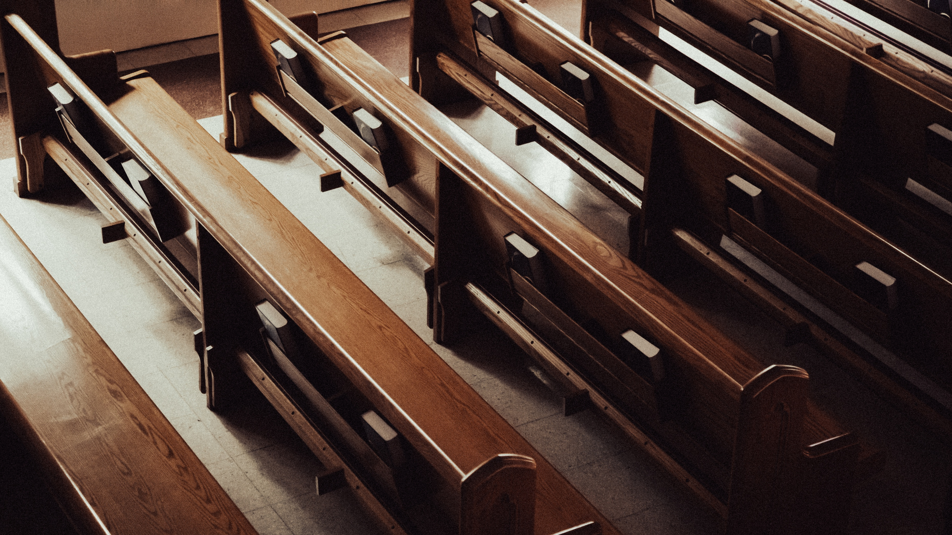
But take care that this right of yours does not somehow become a stumbling block to the weak... Therefore, if food makes my brother stumble, I will never eat meat, lest I make my brother stumble.
(1st Corinthians 8:9,13)
Am I the cause for
Sin in Christians

Slide 16
We should not encourage people to watch something they might find offensive
We should be careful to respect how people feel about holidays and secular celebrations
We should not use our liberty in Christ in such a way that causes someone to sin
Am I the cause for
Sin in Christians

Slide 17
How are my actions influencing others?

