Slide 1
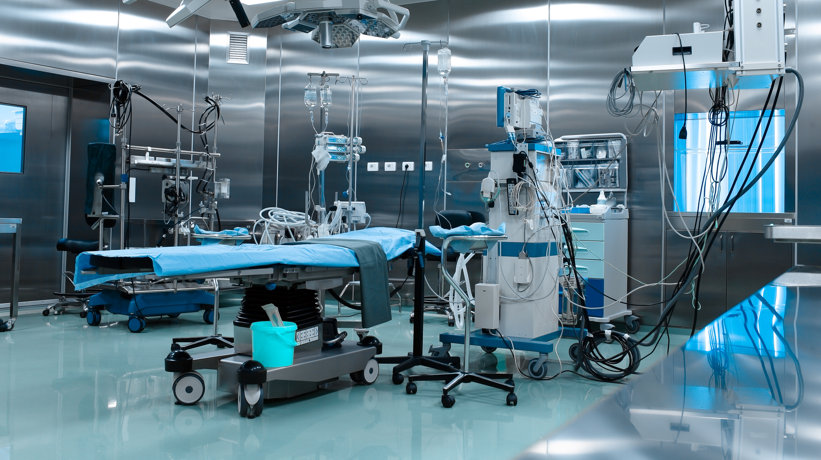

Slide 2
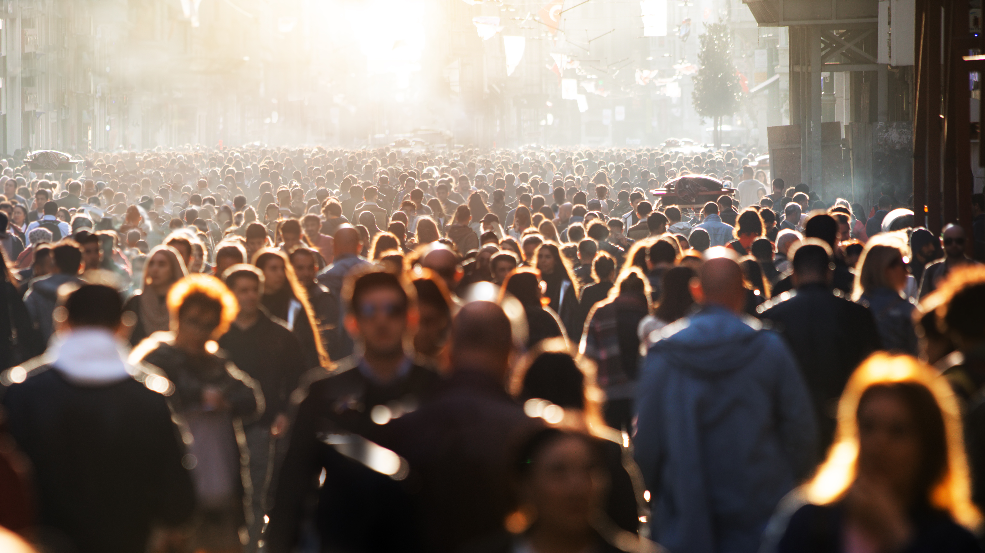

Slide 3


Slide 4


Slide 5
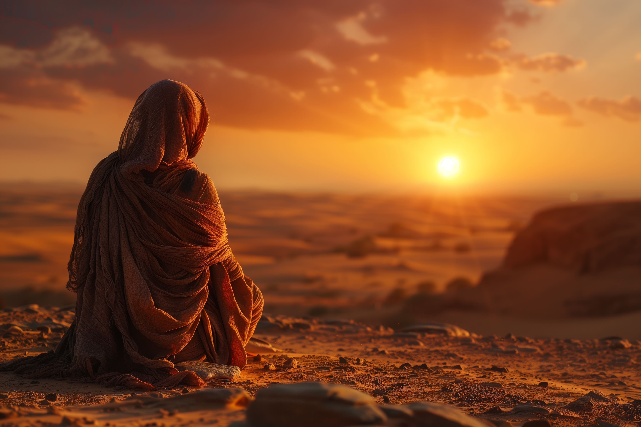
You are the god who sees!

Slide 6
God Knows Our circumstances
2nd Chronicles 16:9
Proverbs 5:21; Matthew 6:4; Psalm 68:5-6
“…the eyes of the LORD run to and fro throughout the whole earth, to give strong support to those whose heart is blameless toward him.”
Even if no one else sees you, know that God sees
He may not act immediately, but He knows immediately!
Think of the contrast with false gods or things of the world

Slide 7
God Knows Our weaknesses
Psalm 103:13-14
Hebrews 2:17-18; 4:14-16; 1st Cor. 10:13
As a father shows compassion to his children, so the LORD shows compassion to those who fear him. For he knows our frame; he remembers that we are dust.
God did the unimaginable – He became a man to experience our life
Whatever you are going through, he lived it too!
Because he understands us, he has care and compassion and forgiveness

Slide 8
God Knows Our Future
Acts 23:11
Genesis 21:16-21; Romans 8:27-28
The following night the Lord stood by him and said, “Take courage, for as you have testified to the facts about me in Jerusalem, so you must testify also in Rome.”
God isn’t limited to knowledge of our present circumstances
He will lead us down the path toward our ultimate good
I can take comfort in His knowledge

Slide 9
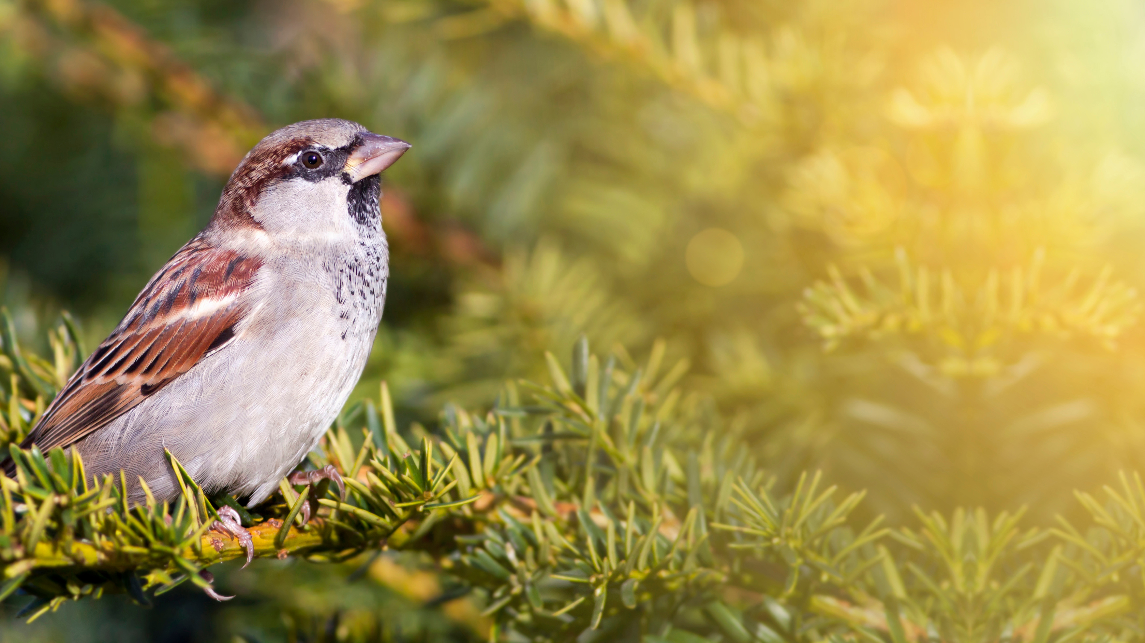
Are not two sparrows sold for a penny? And not one of them will fall to the ground apart from your Father.
Fear not, therefore; you are of more value than many sparrows.

Slide 10
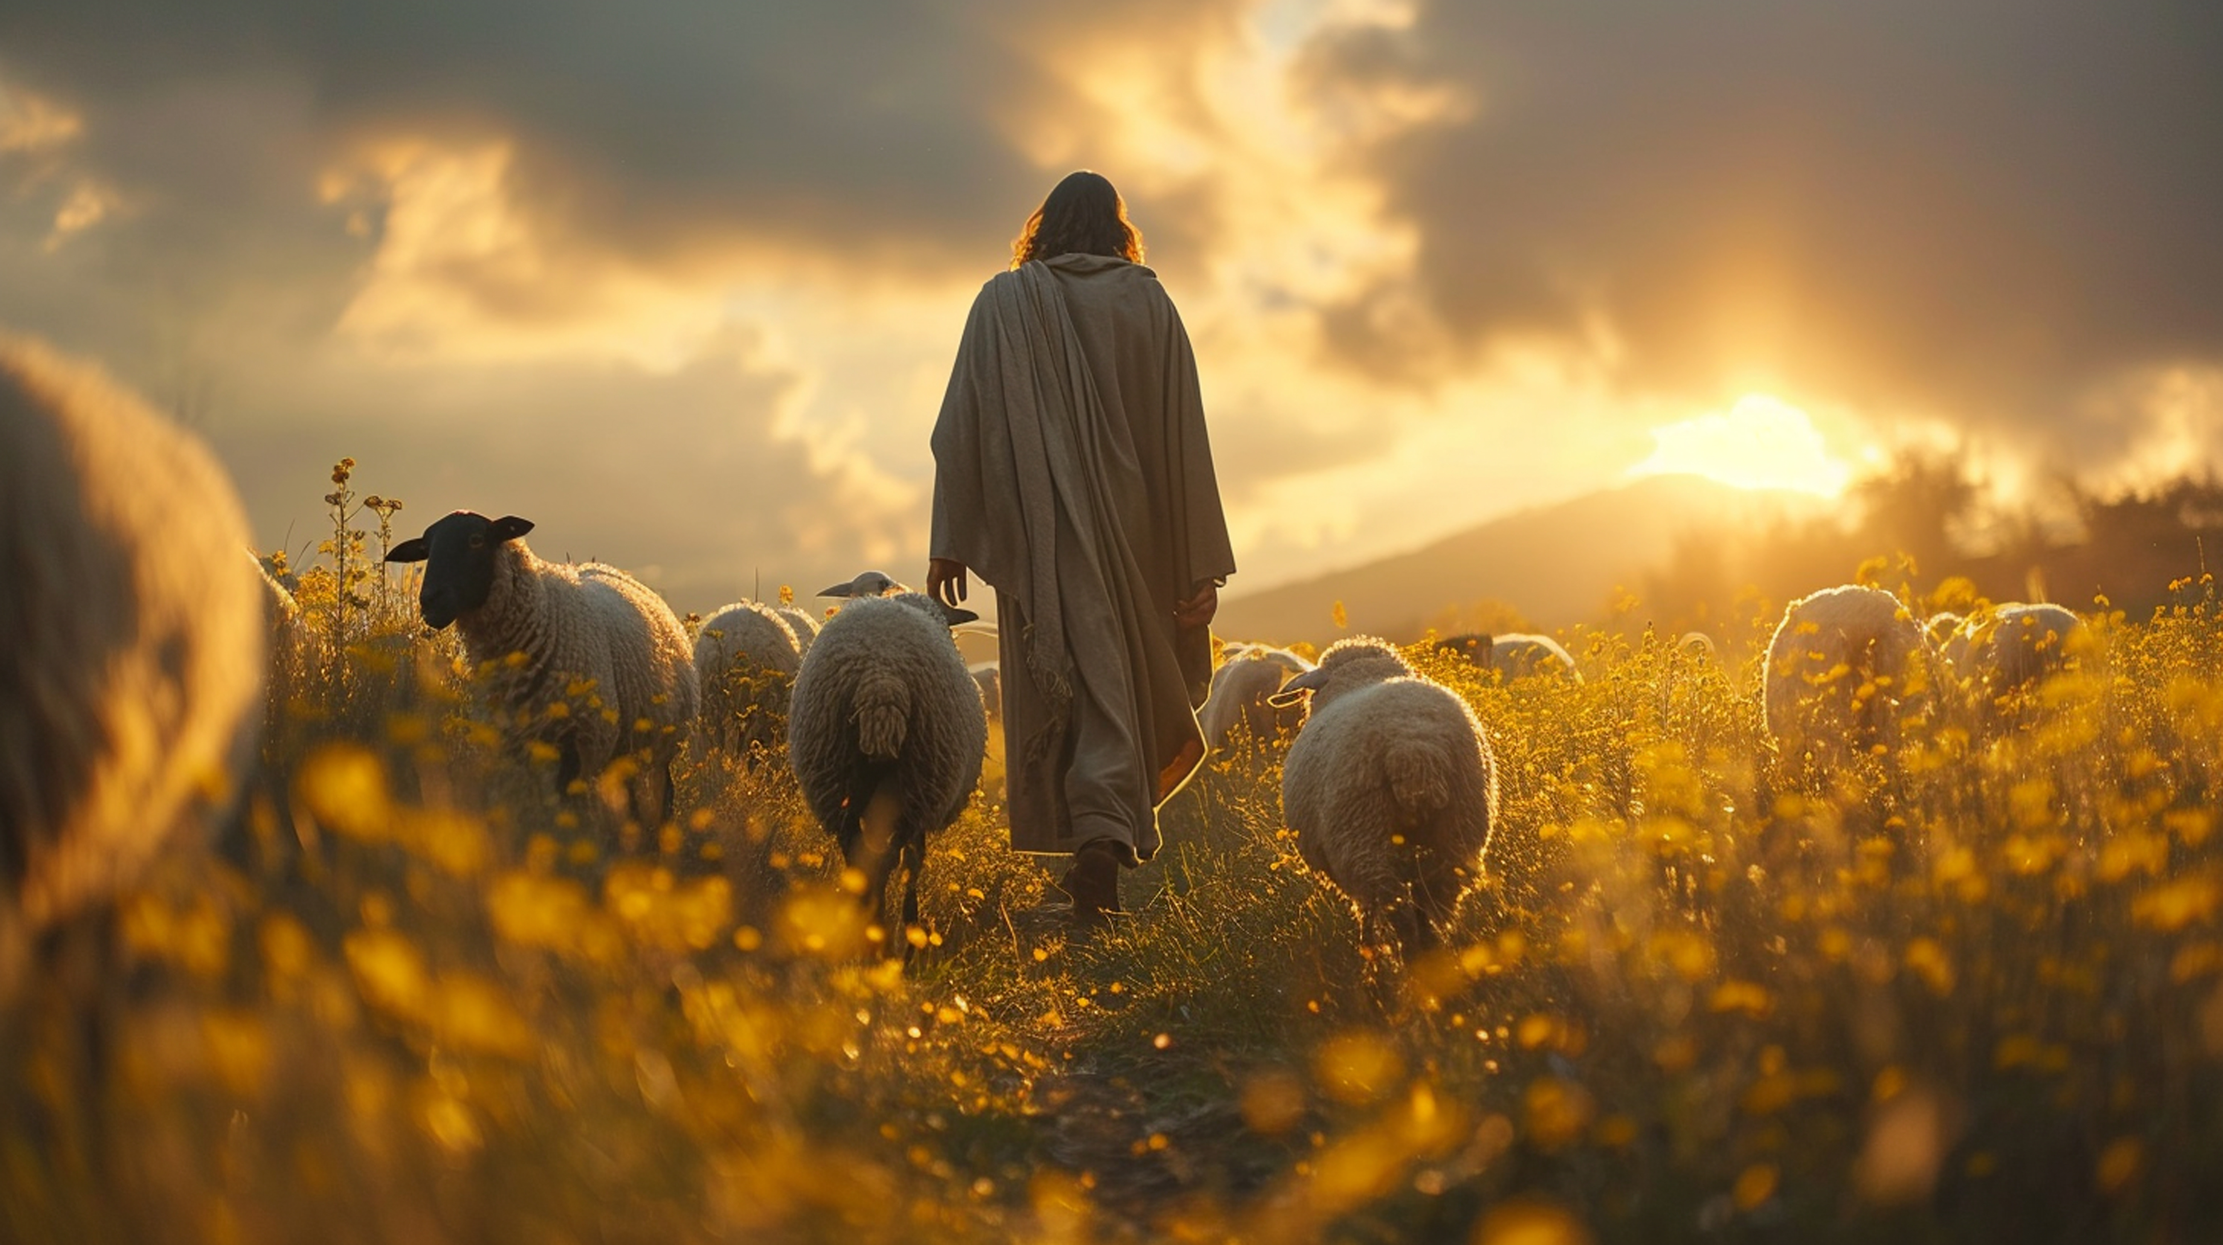
John 10:14-15
I am the good shepherd. I know my own and my own know me,
just as the Father knows me and I know the Father; and I lay down my life for the sheep.

Slide 11
My sheep hear my voice, and I know them, and they follow me.

