Slide 1


Slide 2
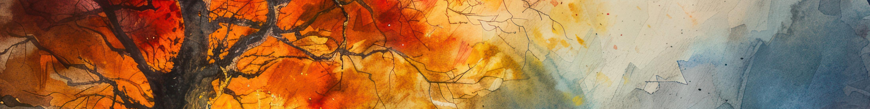

Our Struggle With Identity
What we think about ourselves
What others think about us
Who we really are
What God thinks about us

Slide 3
January
March
A child of God
I have a special relationship with God our Father
February
The
“I AM”
April
I Am Known
Our identity starts in understanding our Creator
God is aware of our struggles and care for us

Slide 4
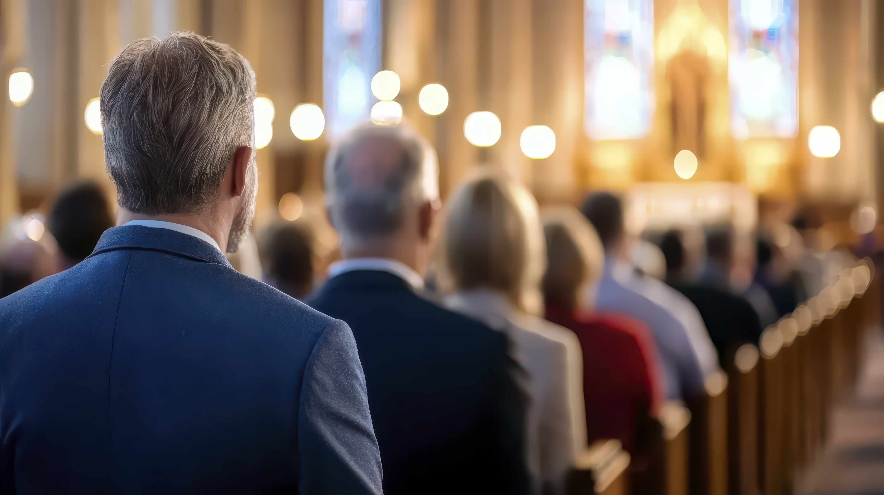
I don’t belong here.
They don’t belong here.

Slide 5
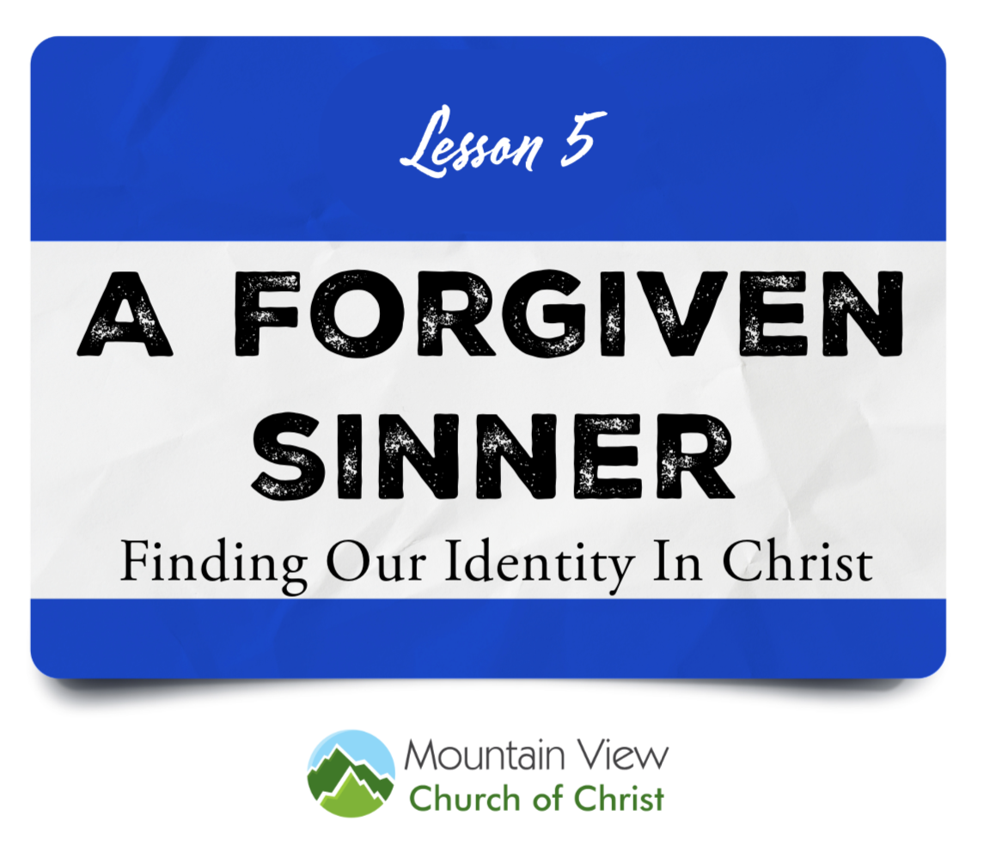

Slide 6
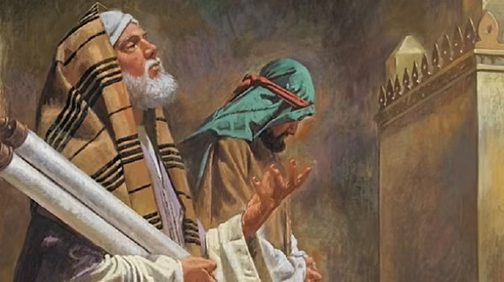
How We Think About Ourself Matters
“Two men went up into the temple to pray, one a Pharisee and the other a tax collector. The Pharisee, standing by himself, prayed thus: ‘God, I thank you that I am not like other men, extortioners, unjust, adulterers, or even like this tax collector. I fast twice a week; I give tithes of all that I get.’ But the tax collector, standing far off, would not even lift up his eyes to heaven, but beat his breast, saying, ‘God, be merciful to me, a sinner!’ I tell you, this man went down to his house justified, rather than the other. For everyone who exalts himself will be humbled, but the one who humbles himself will be exalted.”

Slide 7

1st Timothy 1:15
“This is a faithful saying and worthy of all acceptance, that Christ Jesus came into the world to save sinners, of whom I am chief.”

Slide 8
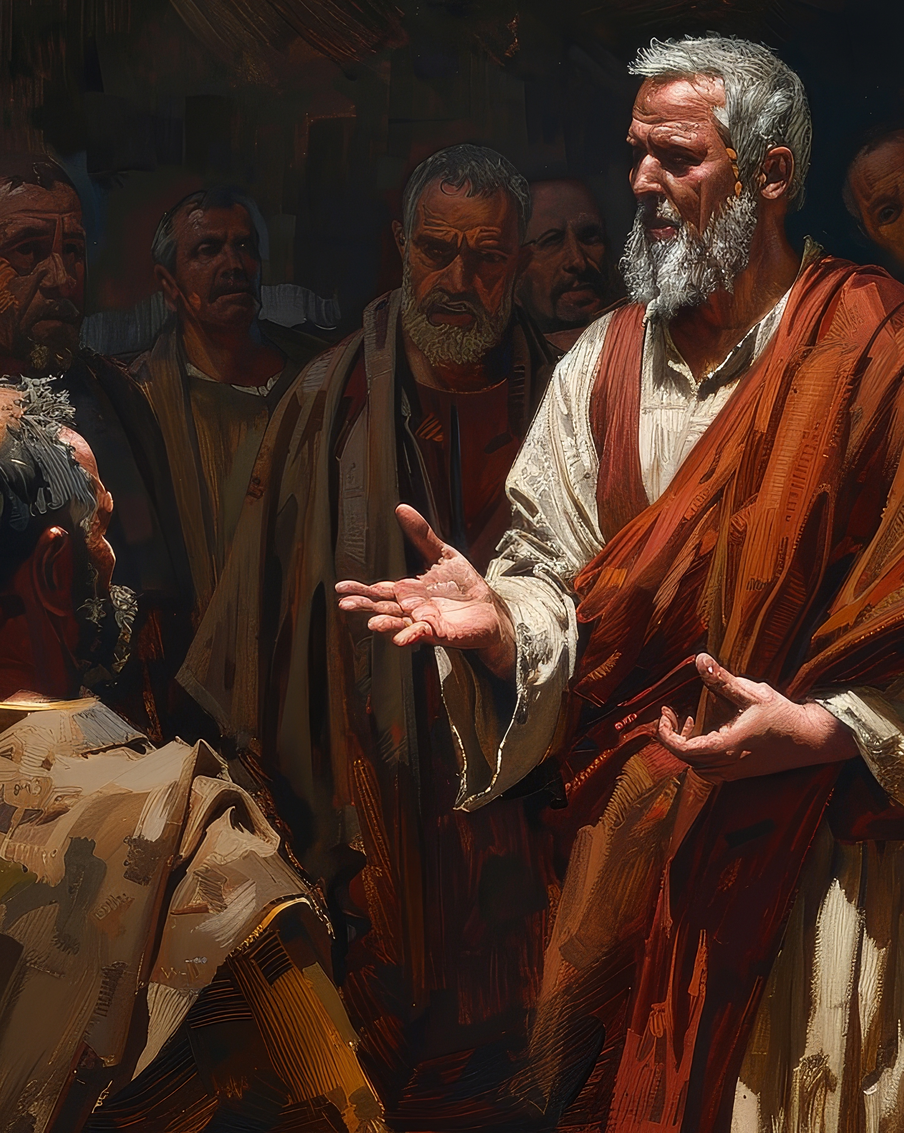
Forgiven
Acts 9:1-15, 19-29
Forgiveness of sins is a spiritual reality that is conferred upon us by God
It can be difficult to feel forgiven when everyone else looks at us and sees our past mistakes
Some of our darkest sins make it seem like it’s impossible to receive mercy
Neither of those thoughts affect the truth that is our forgiveness in Christ

Slide 9
Psalm 103:8-12
The LORD is merciful and gracious, slow to anger and abounding in steadfast love. He will not always chide, nor will he keep his anger forever. He does not deal with us according to our sins, nor repay us according to our iniquities. For as high as the heavens are above the earth, so great is his steadfast love toward those who fear him; as far as the east is from the west, so far does he remove our transgressions from us.

Slide 10
Jeremiah 31:33-34
For this is the covenant that I will make with the house of Israel after those days, declares the LORD: I will put my law within them, and I will write it on their hearts. And I will be their God, and they shall be my people. And no longer shall each one teach his neighbor and each his brother, saying, ‘Know the LORD,’ for they shall all know me, from the least of them to the greatest, declares the LORD. For I will forgive their iniquity, and I will remember their sin no more.”

Slide 11
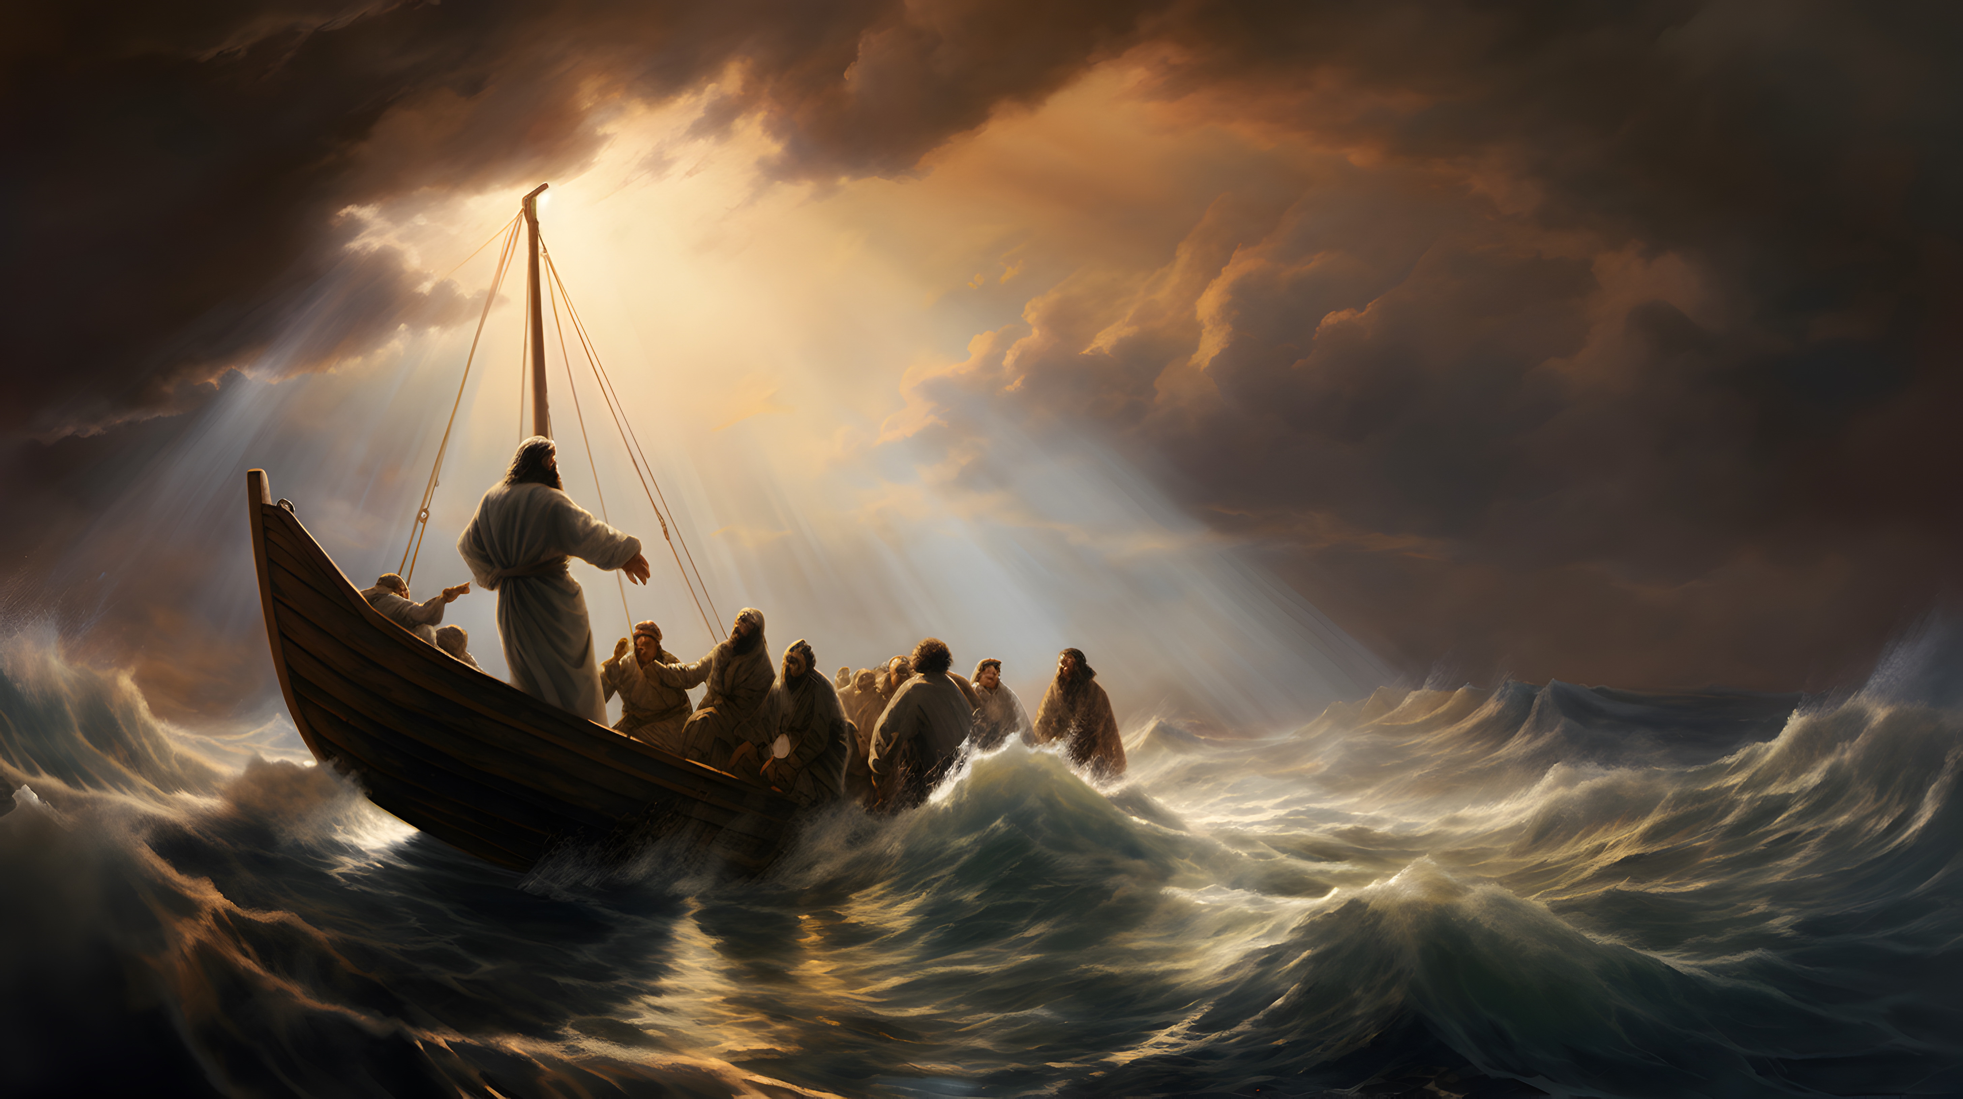
Do Not Doubt
God’s ability or willingness to save us

Slide 12
1. There is equal standing before God for all Christians – regardless of their past or the newness of their conversion
2. God forgiveness past sins completely, and forgets them
3. There is no sense holding onto guilt that God himself has released you from

Slide 13
1st Timothy 1:15
“This is a faithful saying and worthy of all acceptance, that Christ Jesus came into the world to save sinners, of whom I am chief.”

Slide 14
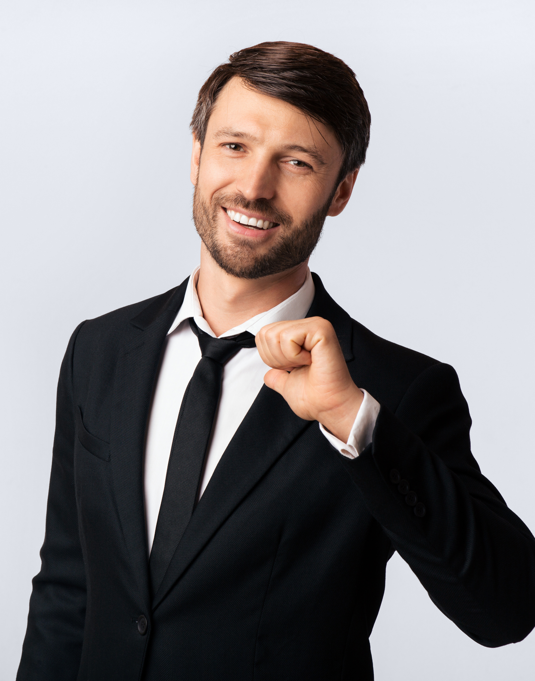
Sinner
1st John 1:5-10, 2:1-6
Our goal is to remove sin from our behavior and our lives
The reality is that we will continue to sin from time to time
We need to have a willingness to acknowledge and confess our sins
The blood of Jesus will always be needed for the Christian

Slide 15
Romans 7:22-24
“For I delight in the law of God, in my inner being, but I see in my members another law waging war against the law of my mind and making me captive to the law of sin that dwells in my members. Wretched man that I am! Who will deliver me from this body of death?”

Slide 16
Philippians 3:12-14
“Not that I have already obtained this or am already perfect, but I press on to make it my own, because Christ Jesus has made me his own. Brothers, I do not consider that I have made it my own. But one thing I do: forgetting what lies behind and straining forward to what lies ahead, I press on toward the goal for the prize of the upward call of God in Christ Jesus.”

Slide 17
Hebrews 12:1-2
“Therefore, since we have so great a cloud of witnesses surrounding us, laying aside every weight and the sin which so easily entangles us, let us run with endurance the race that is set before us, Looking unto Jesus the author and finisher of our faith…”

Slide 18
Galatians 6:3
“Let us not become conceited…For if anyone thinks he is something, when he is nothing, he deceives himself.”

Slide 19
1. Every person still needs the blood of Jesus to cover our transgressions.
2. The reality is that sin can still easily beset us all, throughout our lives.
3. There is a danger of becoming arrogant and losing the humility that is required of all Christians.

