Slide 1

Lessons from Genesis

Slide 2

The first mention of God (notice the writer assumes God, he does not explain Hie existence)
The first family
The first death
The first judgement
The first promises
The first sacrifices
The first examples of faith
A book of “firsts”

Slide 3
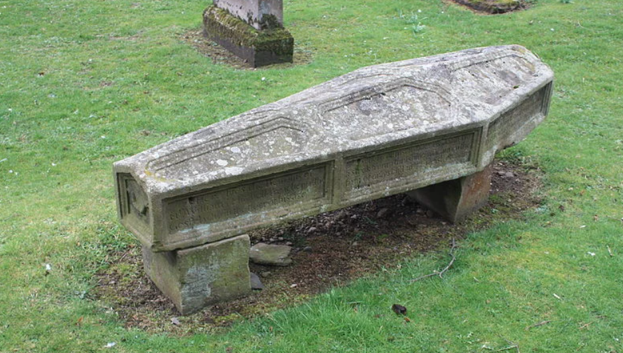
The mortality of man
Hebrews 9:27
Seth lived… and he died. (5:6-8)
Enosh lived… and he died. (v 9-11)
Kenan lived… and he died. (v 12-14)
Mahalalel lived… and he died. (v 15-17)
Jared lived… and he died. (v 18-20)
Enoch lived… and he was not… (v 21-24)

Slide 4
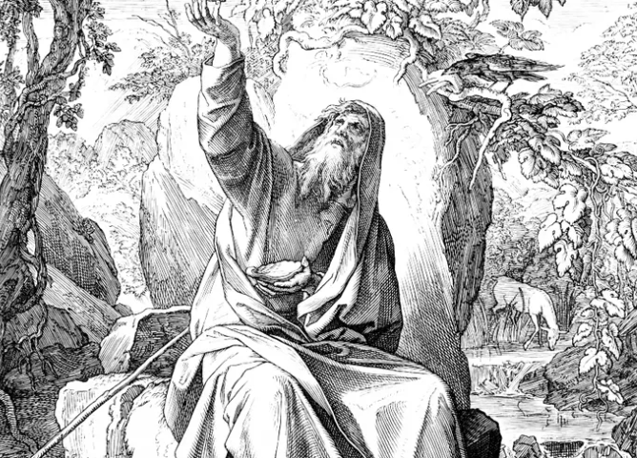
Enoch walked with God
Genesis 5:22, 24

Slide 5
ENOCH
A man of deep faith… included with the Heroes in Hebrews 11 (v 5)
A man of deep conviction (Jude 14)
A man whose life was “in agreement” with God.

Slide 6
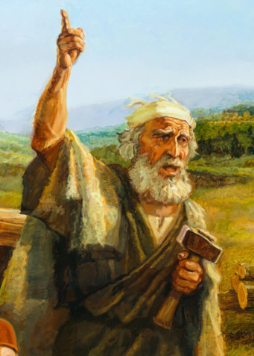
Noah
This one shall give us rest. (5:29)
Who are the sons of God? (6:2)
After seeing man’s sin… and determining man’s judgement, God still demonstrates what? (6:3, 1st Peter 3:20)
How mighty were the Nephilim?
The depravity of man! (6:5)
How does Jesus characterize these days? (Mt 24:38, Lk 17:27)
God’s reaction (6:6-7, Ezekiel 6:9)

Slide 7
Noah
“But Noah… found favor”

Slide 8
Noah
What does the author say to describe Noah’s character? (6:9)
What is one specific component of the wickedness of man? (v 11)
What does God want from Noah, with Noah? (v 18)
What does God expect from Noah? (v 14)
What will God do for Noah? (Second Peter 2:5)
What do we learn from Noah’s example (Hebrews 11:7, 6)

