Slide 1
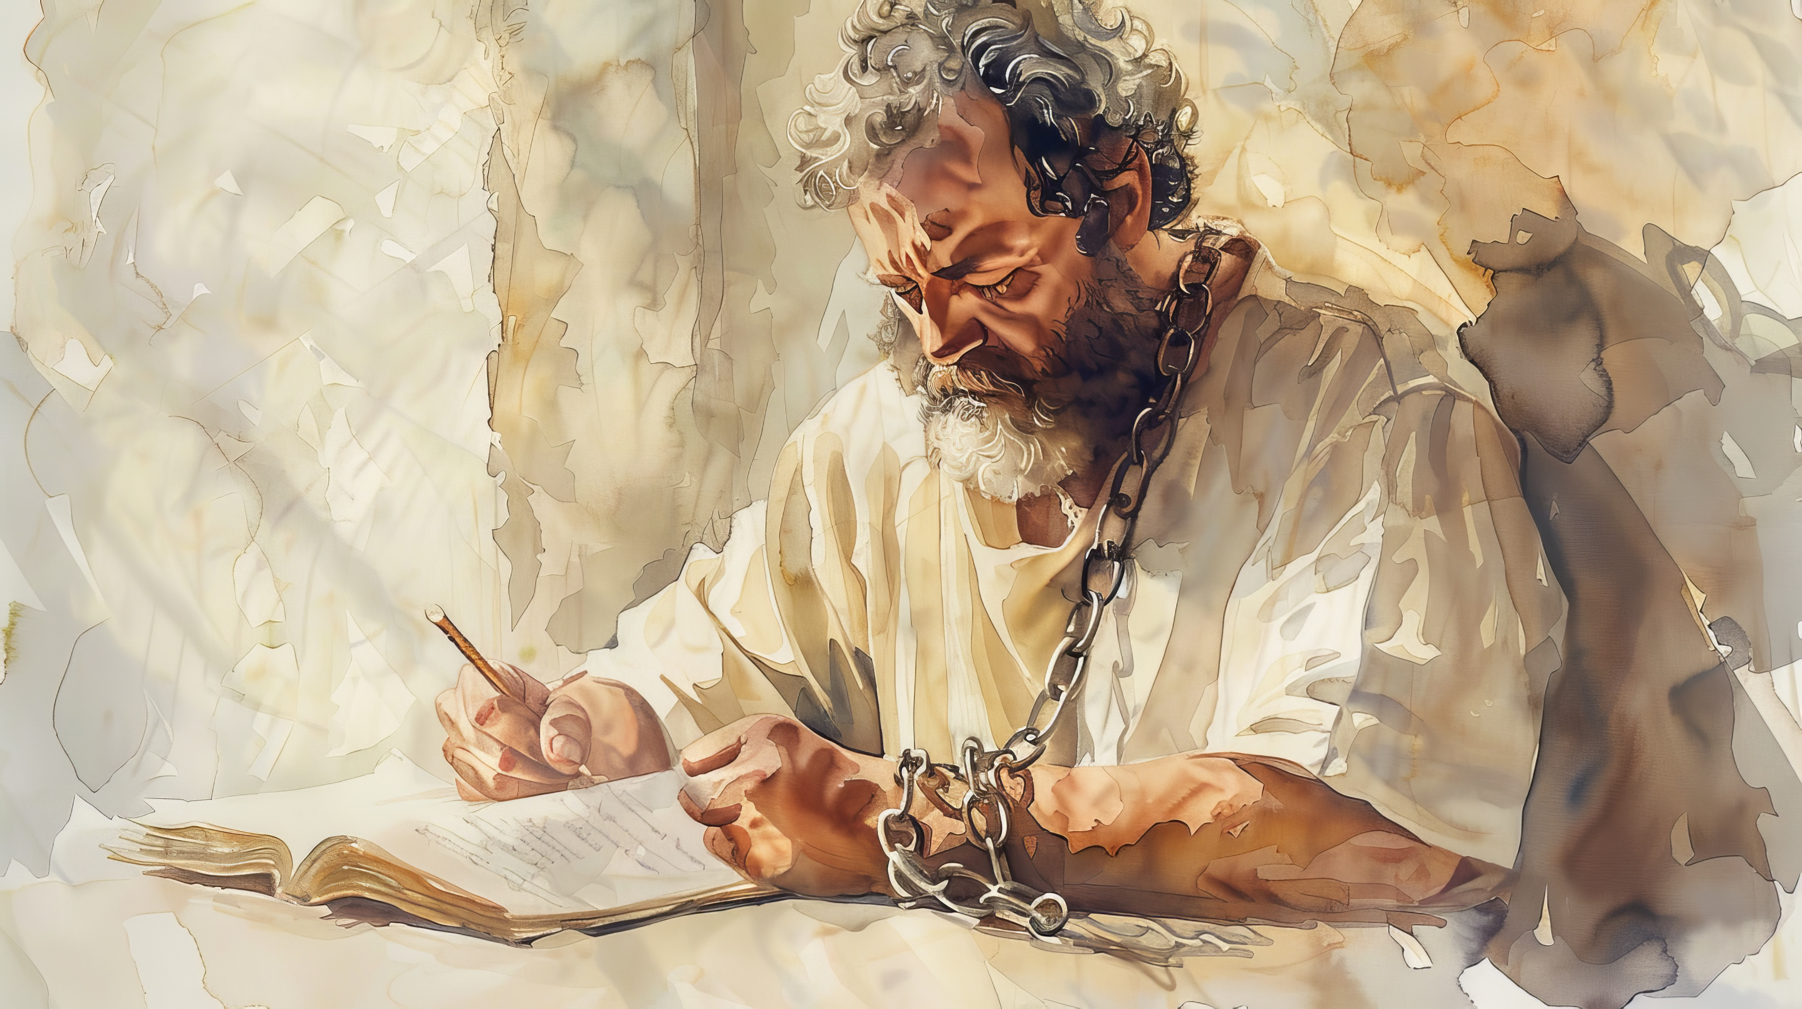

Slide 2

1st timothy 2:9-10
“…likewise also that women should adorn themselves in respectable apparel, with modesty and self-control, not with braided hair and gold or pearls or costly attire, but with what is proper for women who profess godliness—with good works.”

Slide 3
Godliness
Choosing Clothes That Profess

Slide 4

“You’ll represent the brand… and make it easy to recognize you..”
Tops should be free of excessive decoration and not low cut.
No shorts, frayed jeans, leggings, etc.
Failure to comply may result in disciplinary action

Slide 5
Godliness
Professing
Piety
Loyalty
Duty
Reverence
From the Greek word: Eusebeia
“
This word expresses a strongly Christian concept of the new existence in Christ that combines belief in God and a consequent manner of life.

Slide 6
These principles either mean something or they mean nothing.
We should all make decisions about our outward appearance that reflect our calling as Christians.

Slide 7
Purity
Clothes That Profess
1st Corinthians 6:18
Flee from sexual immorality. Every other sin a person commits is outside the body, but the sexually immoral person sins against his own body.

Slide 8
Purity
Clothes That Profess
1st Thessalonians 4:3-6
For this is the will of God, your sanctification: that you abstain from sexual immorality; that each one of you know how to control his own body in holiness and honor, not in the passion of lust like the Gentiles who do not know God; that no one transgress and wrong his brother in this matter, because the Lord is an avenger in all these things, as we told you beforehand and solemnly warned you.

Slide 9
Purity
Clothes That Profess
Matthew 5:27-29
You have heard that it was said, ‘You shall not commit adultery.’ But I say to you that everyone who looks at a woman with lustful intent has already committed adultery with her in his heart. If your right eye causes you to sin, tear it out and throw it away. For it is better that you lose one of your members than that your whole body be thrown into hell.

Slide 10


Slide 11
Purity
Clothes That Profess
Revealing?
Covering?
Accentuating?
Am I…
Minimize?
Encouraging?
Discouraging?

Slide 12
Spirituality
Clothes That Profess
1st John 2:15-17
Do not love the world or the things in the world. If anyone loves the world, the love of the Father is not in him. For all that is in the world—the desires of the flesh and the desires of the eyes and pride of life—is not from the Father but is from the world. And the world is passing away along with its desires, but whoever does the will of God abides forever.

Slide 13
Spirituality
Clothes That Profess
2nd Corinthians 4:16, 18
Though our outer self is wasting away, our inner self is being renewed day by day… as we look not to the things that are seen but to the things that are unseen. For the things that are seen are temporary, but the things that are unseen are eternal.

Slide 14
Spirituality
Clothes That Profess
1st Timothy 6:11-12
For the love of money is a root of all kinds of evils. It is through this craving that some have wandered away from the faith and pierced themselves with many pangs. But as for you, O man of God, flee these things. Pursue righteousness, godliness, faith, love, steadfastness, gentleness.

Slide 15
Spirituality
Clothes That Profess
Do I…
Find myself content with what I have, knowing that these things are temporary and vain?
Feel my self worth is tied to my appearance and how people perceive me?
Spend too much money on my appearance that could be better used elsewhere?

Slide 16
The wearing costly array is directly opposite to the being adorned with good works. Nothing can be more evident than this; for the more you lay out on your own apparel, the less you have left to clothe the naked, to feed the hungry, to lodge the strangers, to relieve those that are sick and in prison, and to lessen the numberless afflictions to which we are exposed in this vale of tears. And here is no room for the evasion used before: "I may be as humble in cloth of gold, as in sackcloth." If you could be as humble when you choose costly as when you choose plain apparel, (which I flatly deny,) yet you could not be as beneficent, -- as plenteous in good works. Every shilling which you save from your own apparel, you may expend in clothing the naked, and relieving the various necessities of the poor, whom ye "have always with you." Therefore, every shilling which you needlessly spend on your apparel is, in effect, stolen from God and the poor!

Slide 17
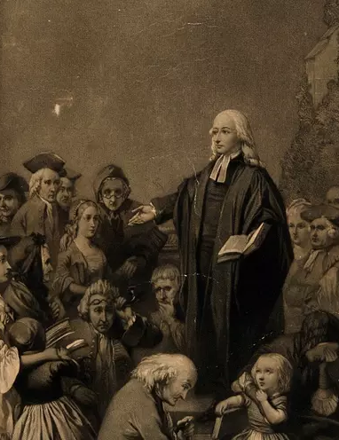
And how many precious opportunities of
doing good have you defrauded yourself of! How often have you disabled yourself from doing good by purchasing what you did not want! For what end did you buy these ornaments? To please God? No; but to please your own fancy, or to gain the admiration and applause of those that were no wiser than yourself. How much good might you have done with that money! And what an irreparable loss have you sustained by not doing it, if it be true that the day is at hand when "every man shall receive his own reward, according to his own labour!"

Slide 18
Humility
Clothes That Profess
Matthew 6:5
“And when you pray, you must not be like the hypocrites. For they love to stand and pray in the synagogues and at the street corners, that they may be seen by others. Truly, I say to you, they have received their reward.

Slide 19
Humility
Clothes That Profess
1st Peter 3:3-4
Do not let your adorning be external—the braiding of hair and the putting on of gold jewelry, or the clothing you wear— but let your adorning be the hidden person of the heart with the imperishable beauty of a gentle and quiet spirit, which in God's sight is very precious.

Slide 20
Humility
Clothes That Profess
Matthew 23:12
Whoever exalts himself will be humbled, and whoever humbles himself will be exalted.

Slide 21
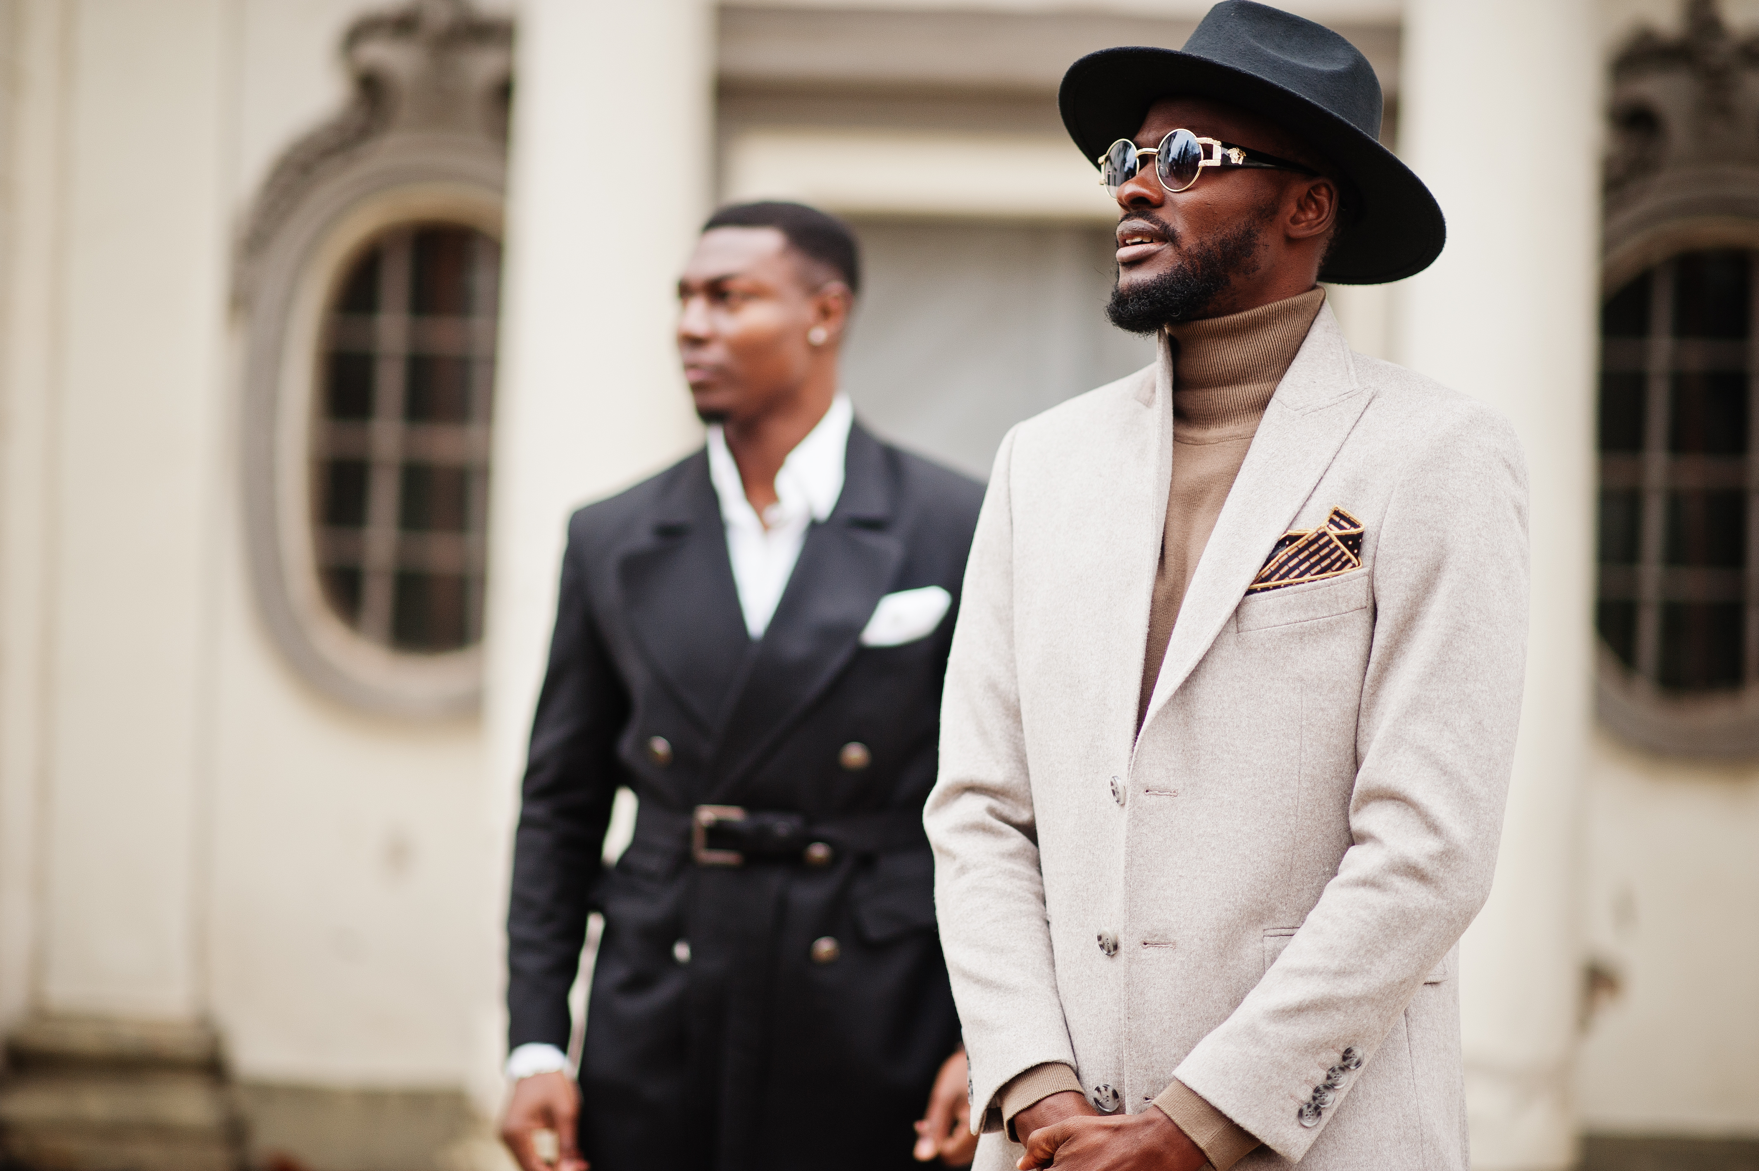

Slide 22
Humility
Clothes That Profess
Am I…
Seeking the attention of others through how I look?
Undermining the importance of character through the elevation of my clothes?
Willing to lower myself so God can raise me in due time?

Slide 23

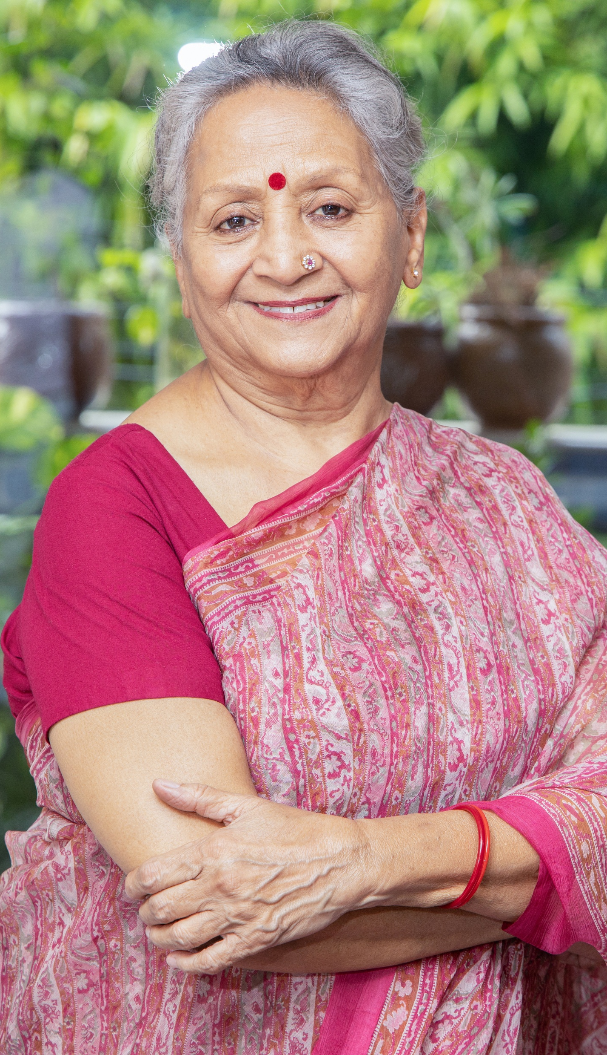

Me?

Slide 24
Godliness
Choose Clothes That Profess

