Slide 1
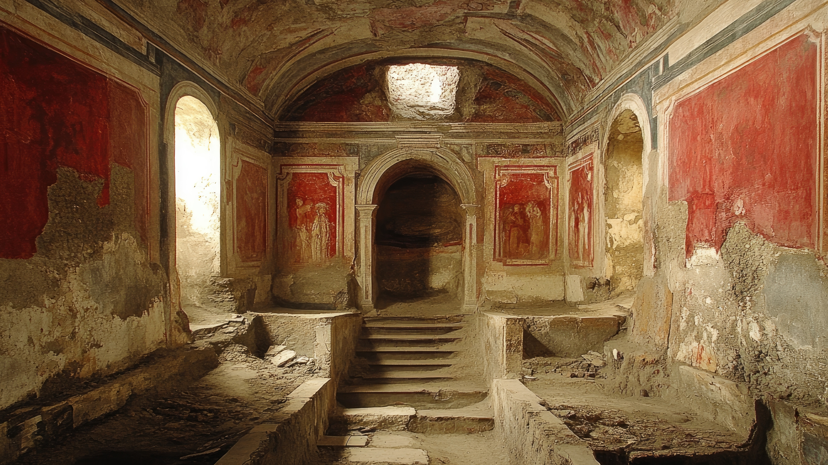

Slide 2
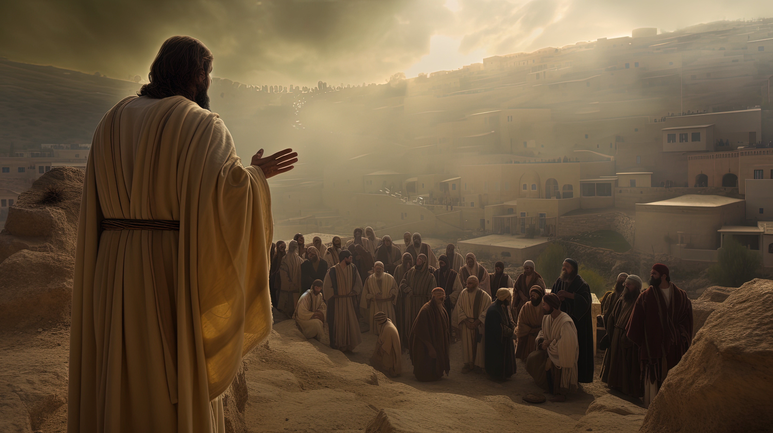
Teaching and Learning

Slide 3
The Importance of Instruction
Ephesians 5:8-10
“…for at one time you were darkness, but now you are light in the Lord. Walk as children of light (for the fruit of light is found in all that is good and right and true), as you try to learn what is pleasing to the Lord.”

Slide 4
Ephesians 4:11-13
“And He gave some as apostles, and some as prophets, and some as evangelists, and some as pastors and teachers, for the equipping of the saints for the work of service, to the building up of the body of Christ; until we all attain to the unity of the faith, and of the knowledge of the Son of God, to a mature man, to the measure of the stature which belongs to the fullness of Christ.”

Slide 5
The Importance of Instruction
Acts 28:30-31
“…He lived there two whole years at his own expense, and welcomed all who came to him, proclaiming the kingdom of God and teaching about the Lord Jesus Christ with all boldness and without hindrance.

Slide 6
The Importance of Instruction
1st Timothy 4:16
“…Keep a close watch on yourself and on the teaching. Persist in this, for by so doing you will save both yourself and your hearers.”

Slide 7
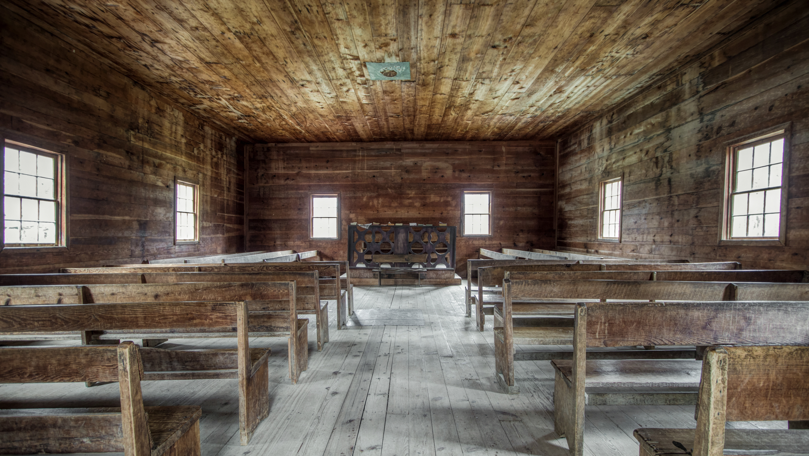
How?

Slide 8
Opportunities for Instruction
Weekly Preaching
Sunday/Wednesday Bible Classes
Monthly Ladies Class (evenings)
Twice a month Ladies Class (daytime)
Men’s Study group (Saturday morning)
Middle/High School devotional (monthly)
Podcasts
Lectureships/Meetings
I may show up at your house

Slide 9

Isn’t Bible Class Optional?

Slide 10

But my teacher is horrible!

Slide 11

No one talked to me!

Slide 12

How to get the most out of your bible classes

Slide 13
Take It Seriously
Acts 13:42-44
As they went out, the people begged that these things might be told them the next Sabbath. And after the meeting of the synagogue broke up, many Jews and devout converts to Judaism followed Paul and Barnabas, who, as they spoke with them, urged them to continue in the grace of God. The next Sabbath almost the whole city gathered to hear the word of the Lord.

Slide 14
Give a Good Foundation at Home
2nd Timothy 3:14-15
“… But as for you, continue in what you have learned and have firmly believed, knowing from whom you learned it and how from childhood you have been acquainted with the sacred writings, which are able to make you wise for salvation through faith in Christ Jesus.”

Slide 15
Engage In the Class
Luke 2:46-47
After three days they found him in the temple, sitting among the teachers, listening to them and asking them questions. And all who heard him were amazed at his understanding and his answers.

Slide 16

My people are destroyed for lack of knowledge
Hosea 4:6

