Slide 1


Slide 2

The Power of Spiritual
Habits

Slide 3

Daniel’s character and behavior had developed consistency

Slide 4
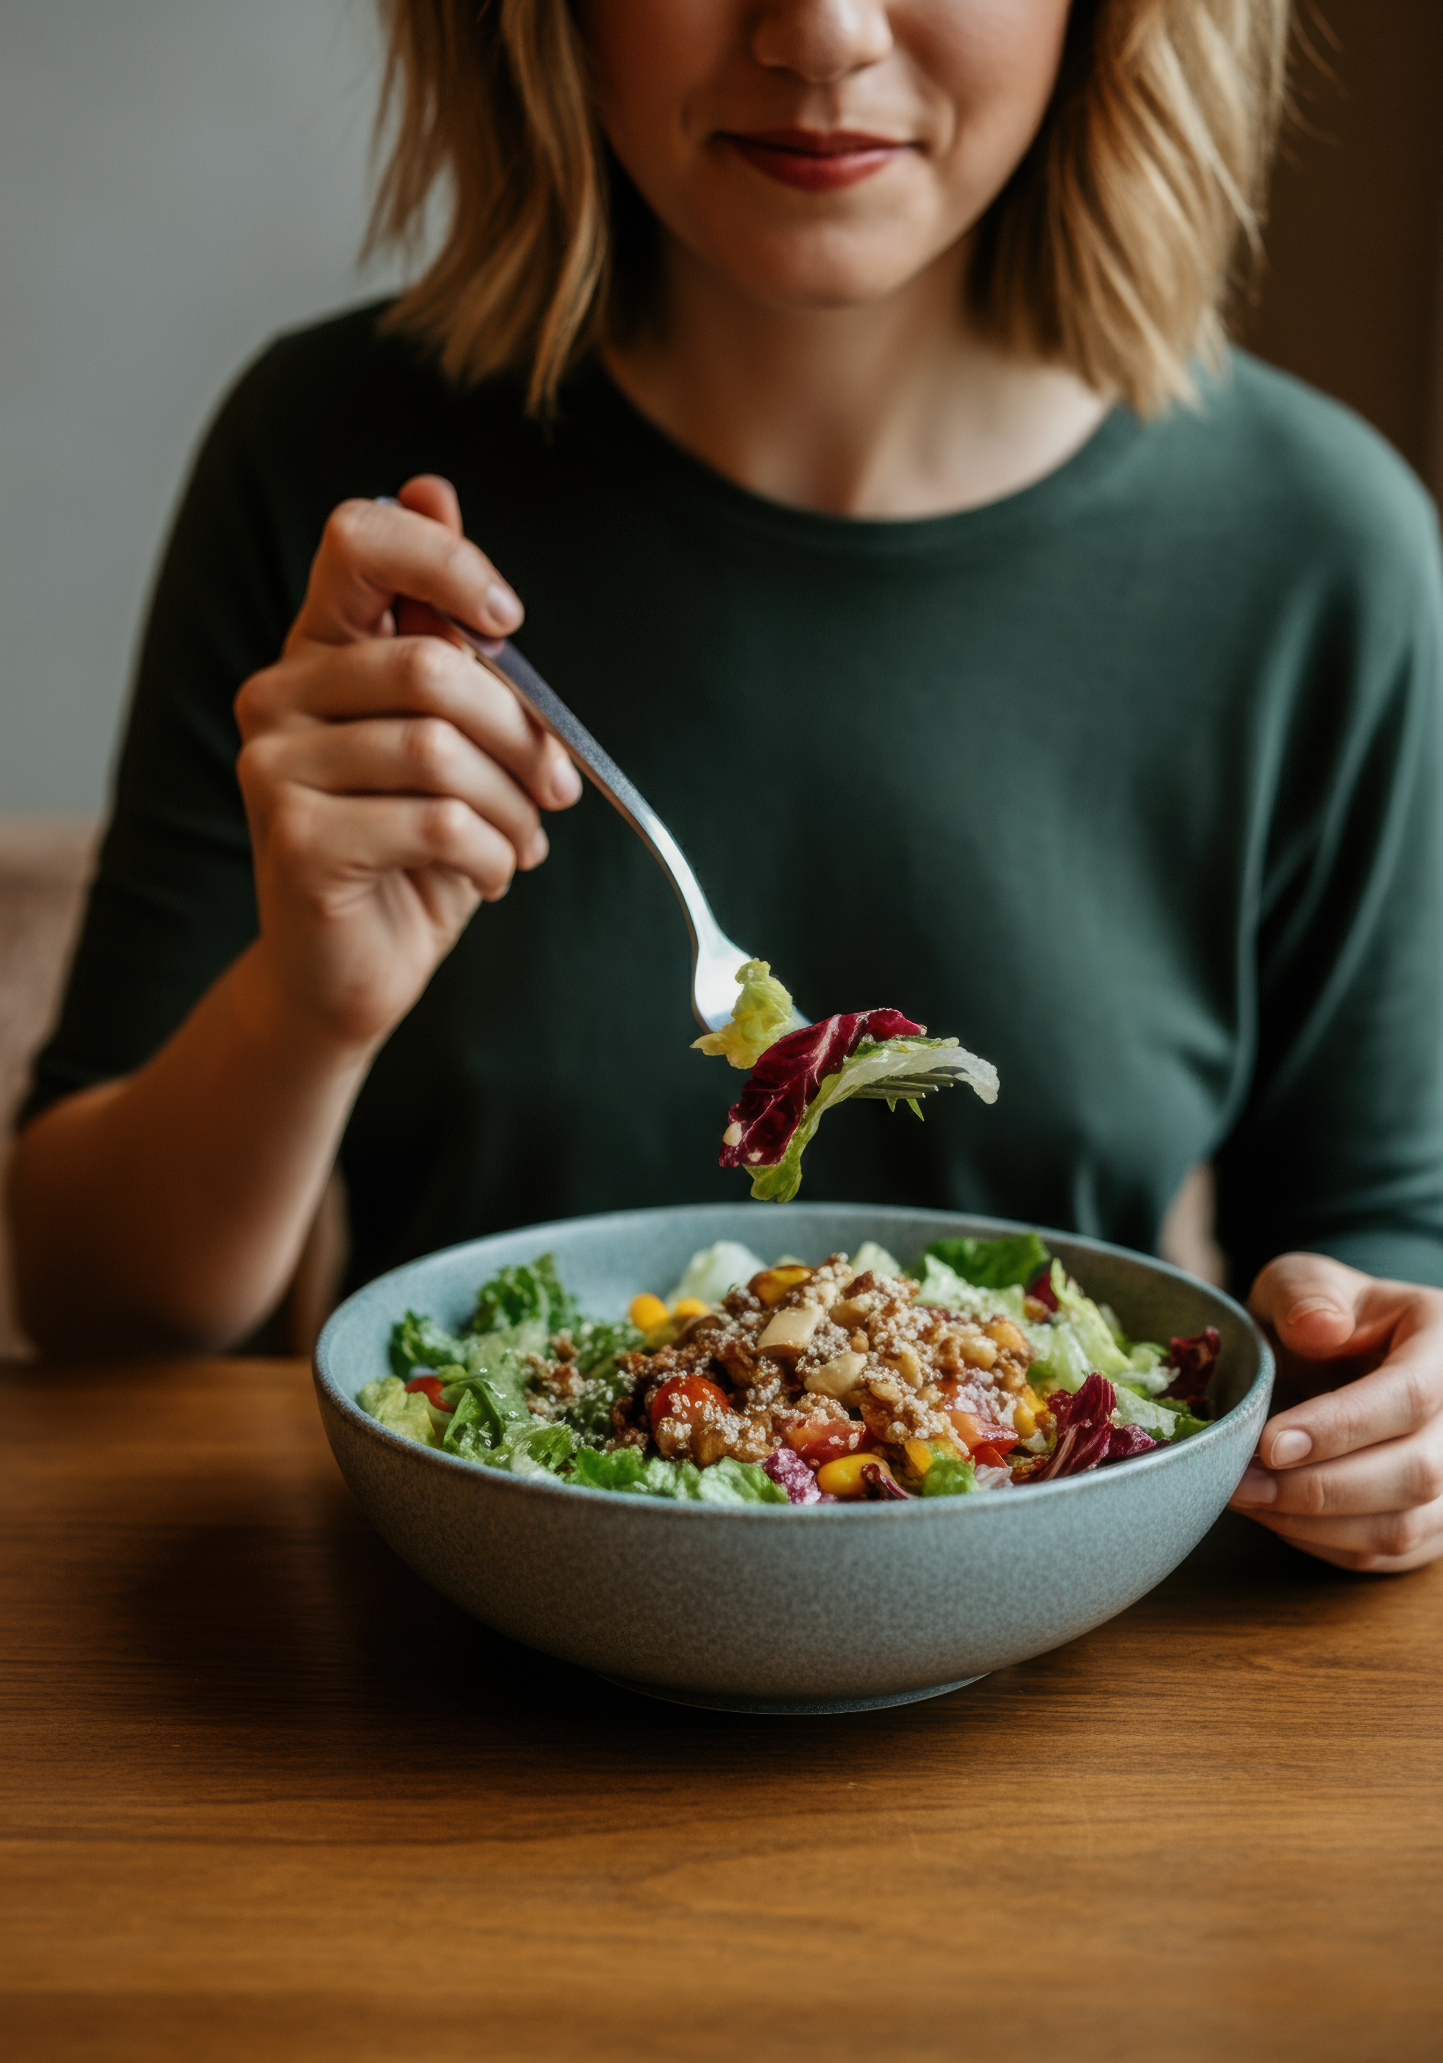
Deuteronomy 6:6-9
Habits require intention and frequency
And these words that I command you today shall be on your heart. You shall teach them diligently to your children, and shall talk of them when you sit in your house, and when you walk by the way, and when you lie down, and when you rise. You shall bind them as a sign on your hand, and they shall be as frontlets between your eyes. You shall write them on the doorposts of your house and on your gates.

Slide 5
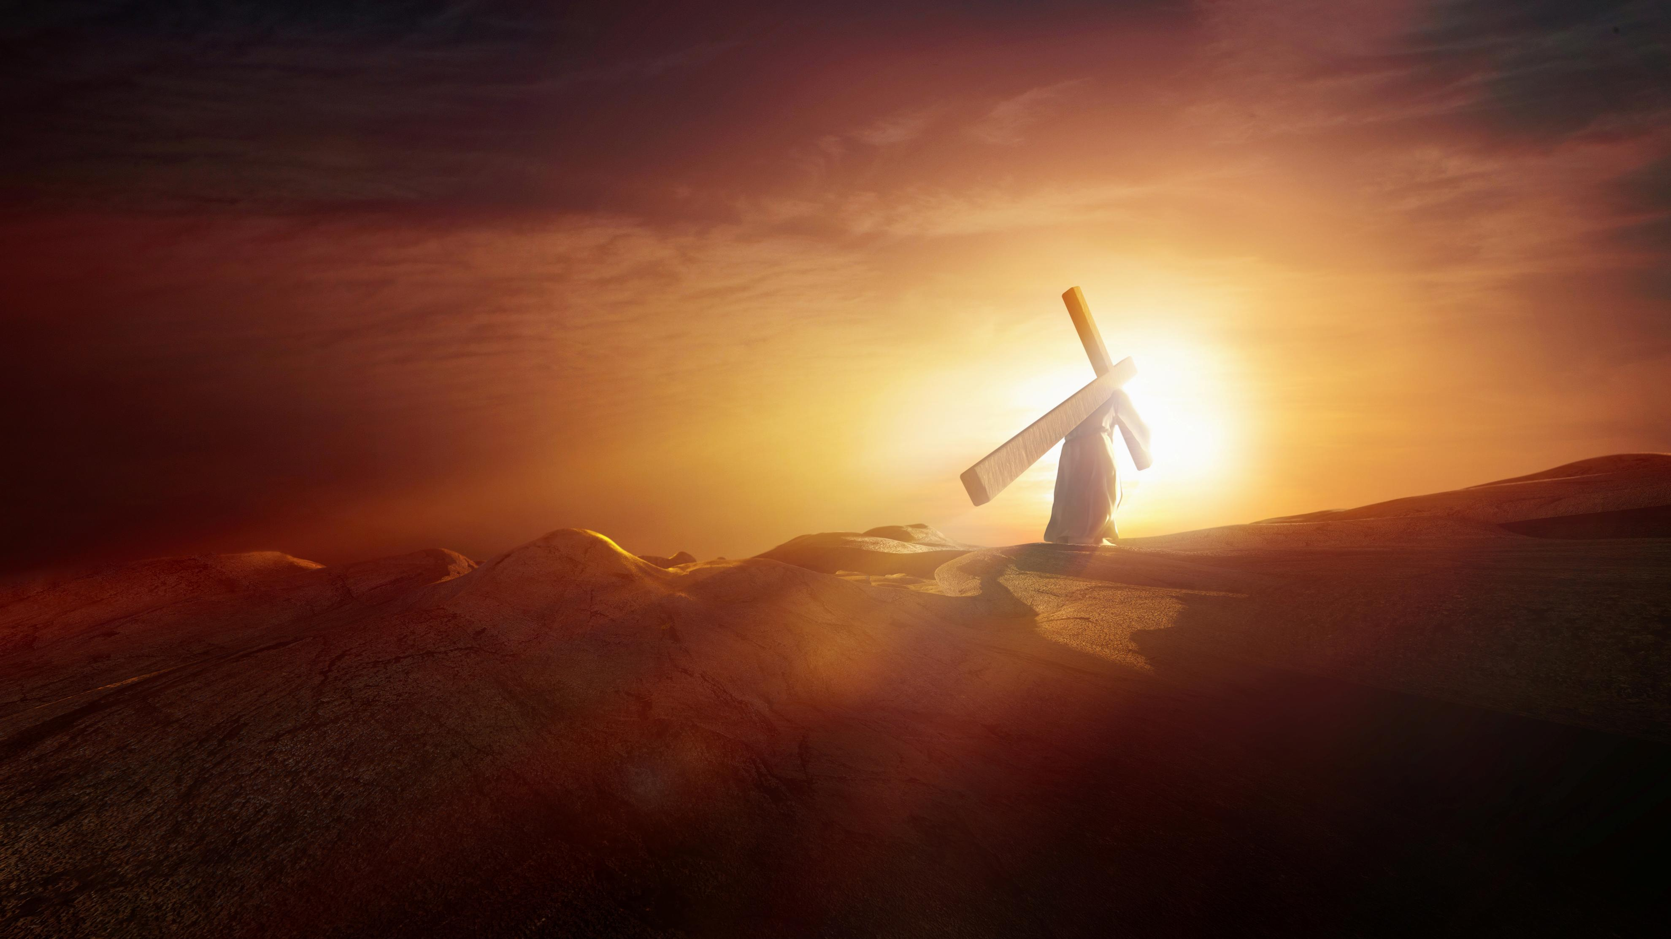
Luke 9:23
And he said to all, “If anyone would come after me, let him deny himself and take up his cross daily and follow me.”

Slide 6
The Habit of Prayer
Acts 10:1-2
The language used to describe the prayer frequency of Christians is “without ceasing”, “continually”, “at all times”
At Caesarea there was a man named Cornelius, a centurion of what was known as the Italian Cohort, a devout man who feared God with all his household, gave alms generously to the people, and prayed continually to God.
A solid goal would be to pray three times daily at a minimum – Psalm 55:16-18
Pray together, pray alone, but set aside time to make it happen

Slide 7
The Habit of Service
Titus 3:8
2nd Kings 2:1-10
The saying is trustworthy, and I want you to insist on these things, so that those who have believed in God may be careful to devote themselves to good works. These things are excellent and profitable for people.
Building in a habit of serving others is going to take some effort
There are distractions at every turn to keep us from serving
Our children need to be in the habit of learning to serve instead of being served

Slide 8
The Habit of Worship
Luke 2:36-37
Acts 26:7; James 5:13
“And there was a prophetess, Anna, the daughter of Phanuel, of the tribe of Asher... She did not depart from the temple, worshiping with fasting and prayer night and day.”
God is deserving of our admiration, attention, and affection
How often do we acknowledge God in whatever events happened during the day?
This is not a time for focus on you, it’s a time of focus on God

Slide 9
The Habit of Self Discipline
1st Cor. 9:25-27
Our bodies want to become the master over us!
Every athlete exercises self-control in all things. They do it to receive a perishable wreath, but we an imperishable…I discipline my body and keep it under control, lest after preaching to others I myself should be disqualified.
Paul worked to bring it under subjection – literally to subdue it
Find a way every day to tell your passions and desires NO!

Slide 10
The Habit of Thankfulness
Philippians 1:3-5
Most are in the habit of finding daily reasons to complain
I thank my God in all my remembrance of you, always in every prayer of mine for you all making my prayer with joy, because of your partnership in the gospel from the first day until now.
Daily gratitude for our blessings will lead to a positive change in our mindset
What if it was Mother’s day every day?!
Find someone or something to be grateful for and let them know

Slide 11

Prayer - 3x Daily
Service - 1x Weekly
Worship - 2x Daily
Discipline - 1x Daily
Gratitude - 1x Daily

Slide 12

If we aren’t doing those things, what are we doing?

