Slide 2

That’s
life!
Lessons from the Life of Moses
(Deuteronomy 1:19-38)

Slide 3

That’s
life!
Lessons from the Life of Moses
Deuteronomy 1:19-38
Sometimes things don’t turn out the way we hoped (dreamed) they would in life.
What did Moses think was going to happen in his life?
Acts 7:20-25

Slide 4
“Moses was educated in all the learning of the Egyptians, and he was a man of power in words and deeds.” Acts 7:22

Slide 5
And he supposed that his brethren understood that God was granting them deliverance through him, but they did not understand.” Acts 7:25

Slide 6
There is this thing in life called expectations!

Slide 7


Slide 8


Slide 9


Slide 10
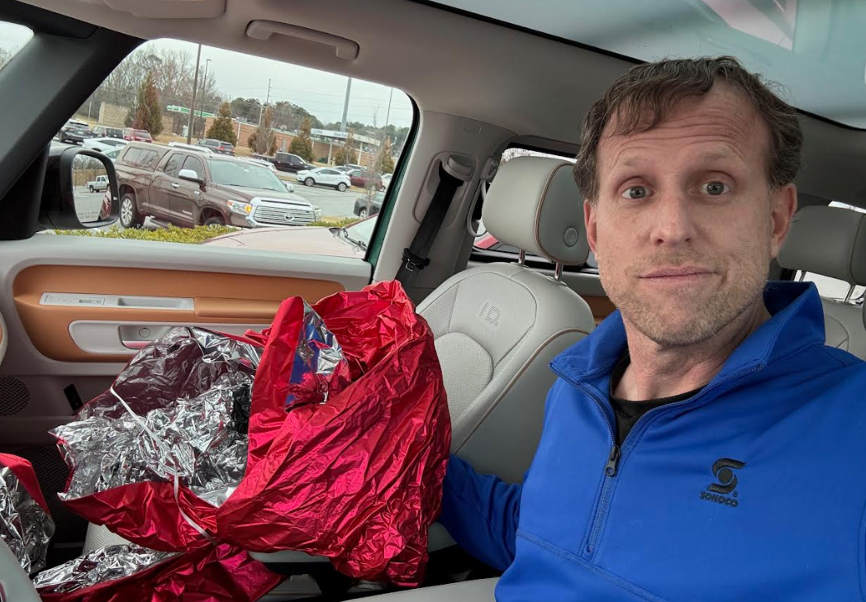

Slide 11
And he supposed that his brethren understood that God was granting them deliverance through him, but they did not understand.” Acts 7:25
There might have been something Moses didn’t understand.

Slide 12
So “moses fled and became an alien in the land of Midian” for 40 years!
Acts 7:29-30
Sometimes your career doesn’t work out like you hoped.

Slide 13





Slide 14
That’s
life!
Lessons from the Life of Moses
Deuteronomy 1:19-38
Sometimes, when what you hoped for does work out, it doesn’t happen in the way you wanted it to work out!
“Who am I that I should go?” Exodus 3:11
Another 40 years! Num. 14:33

Slide 15
“You are indeed a bridegroom of blood to me!” Exodus 4:25
Sometimes your marriage doesn’t work out like you hoped.

Slide 16
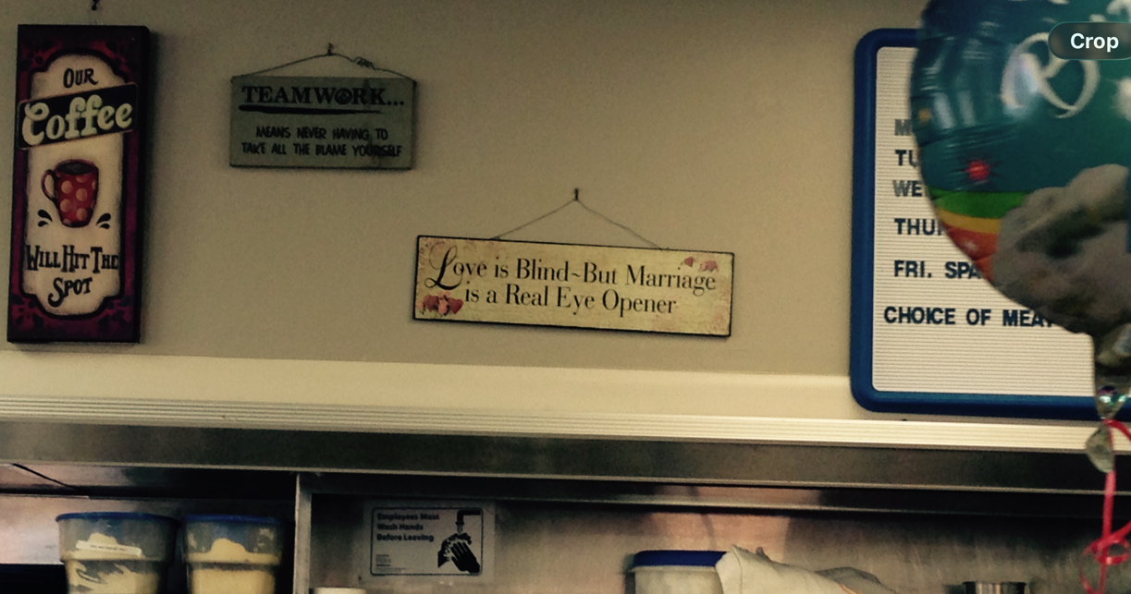

Slide 17
What did this do to Moses?
What did this do for Moses?

Slide 18
“(Now the man Moses was very humble, more than any man who was on the face of the earth.)”
Numbers 12:3

Slide 19
Deuteronomy 1:19-38
Sometimes, what you wanted is given to another!
Deuteronomy 1:37-38
After 40 years in the wilderness as a shepherd… and 40 more years in the wilderness with 1 million complainers, God says no.
That’s
life!
Lessons from the Life of Moses

Slide 20
Lord, please…
Deuteronomy 4:25
I don’t want to hear one more word out of you.
Deuteronomy 4:26

Slide 21
Deuteronomy 1:19-38
Sometimes, what you wanted is given to another!
And sometimes, God want you to go ENCOURAGE the one receiving what you wanted!!
That’s
life!
Lessons from the Life of Moses

Slide 22
“Encourage him.”
Deuteronomy 1:38

Slide 23
to make strong,
to restore strength, give strength
to strengthen, sustain
to make strong, make bold
to make firm
to make rigid, make hard
Don’t ever underestimate the power of encouraging someone.

Slide 24
Deuteronomy 1:19-38
So what is the point of it all?
God has something better in store for His servants who persevere through the “THAT’S LIFE” moments.
Matthew 17:1-3… Moses is with Jesus in the promised land!
That’s
life!
Lessons from the Life of Moses

Slide 25
“Walk in a manner worthy of the calling with which you have been called.” Ephesians 4:25

