Slide 1
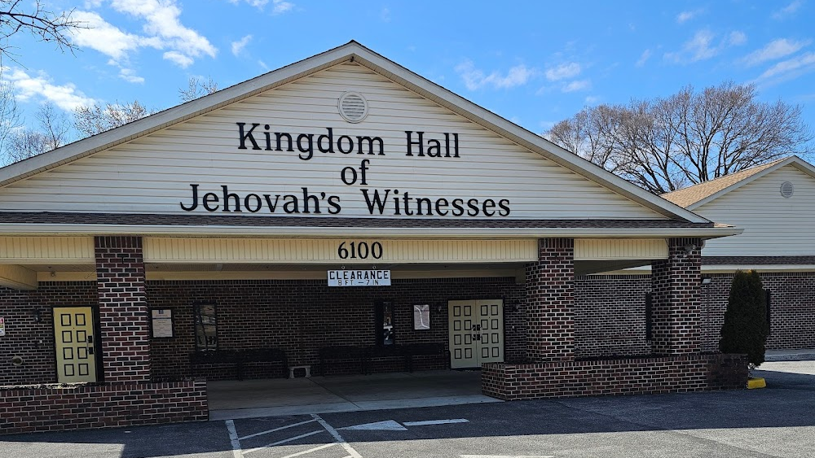

Slide 2

Ephesians 4:14
“…we are no longer to be children, tossed here and there by waves and carried about by every wind of doctrine, by the trickery of men, by craftiness in deceitful scheming…”

Slide 3

2026 Theme
WALK WORTHY
STABILITY
standing strong against false teaching

Slide 4
It can’t be that bad, can it?
“I mean, the followers are pretty good people!”
“We are all wrong in some ways, so who am I to judge?”
“They may have some quirks, but they have good ideas too.”

Slide 5



Forms of False Teaching
What We Believe
What We Practice
What We Teach
“For many deceivers have gone out into the world, those who do not acknowledge Jesus Christ as coming in the flesh. This is the deceiver and the antichrist.”
“…men who forbid marriage and advocate abstaining from foods which God has created to be gratefully shared in by those who believe and know the truth.”
“If anyone thinks that he is a prophet, or spiritual, he should acknowledge that the things I am writing to you are a command of the Lord.”

Slide 6
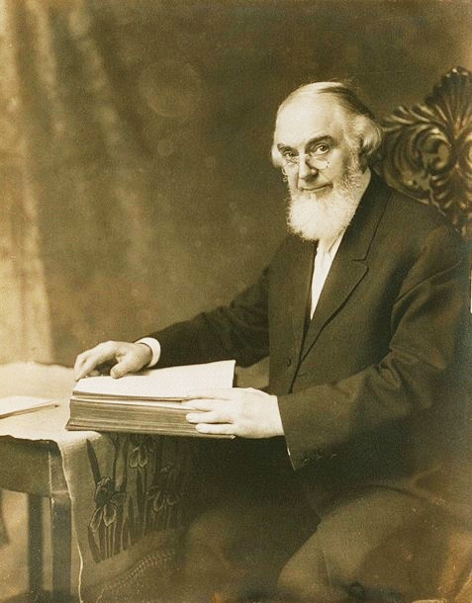
History of Jehovah’s Witnesses
1870’s -1910’s: Charles Taze Russell started a series of Bible studies that culminated in publications called the Watch Tower Bible and Tract Society
1930’s: “Judge” Rutherford used the term Jehovah’s Witnesses to identify their group.
1950’s and beyond: Focus on the authority of their organization and a heavy focus on door to door evangelism.

Slide 7
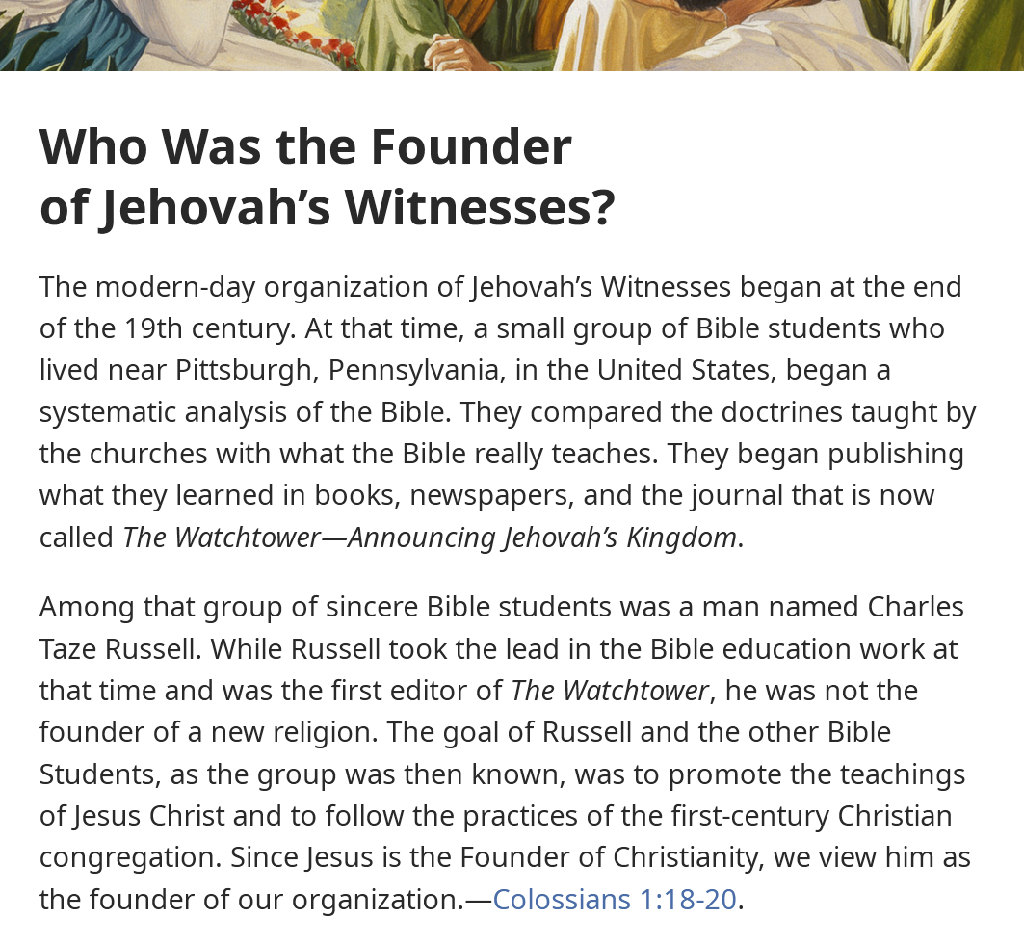
“We are just following Jesus.”
The Reality:
If you don’t follow the teachings of the Jehovah’s Witnesses, you won’t be saved.

Slide 8
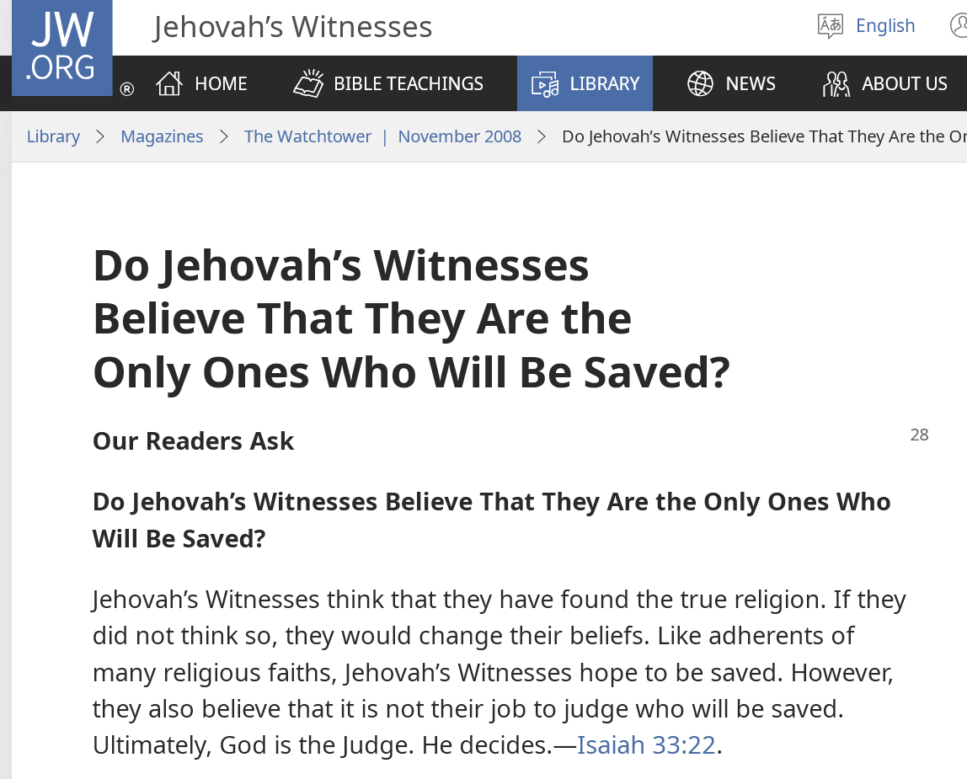
“God will judge who is saved.”
The Reality:
If you leave the Jehovah’s Witnesses, you are shunned for life.

Slide 9
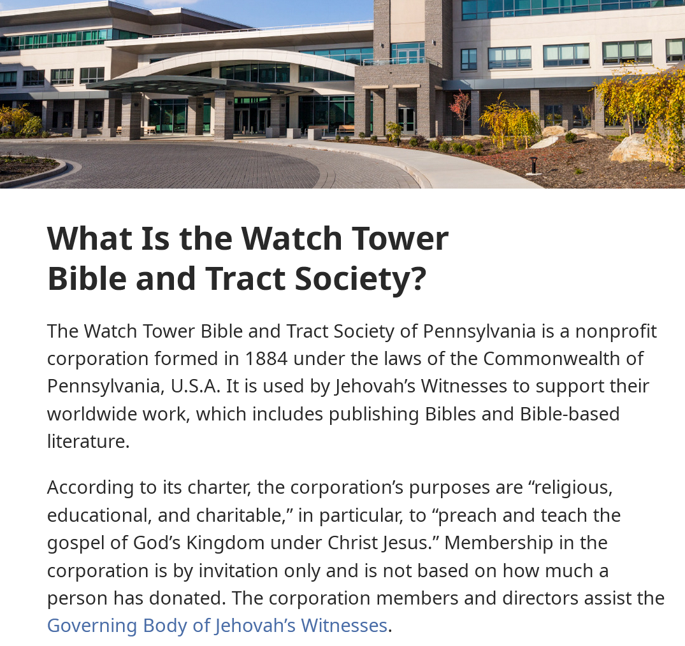
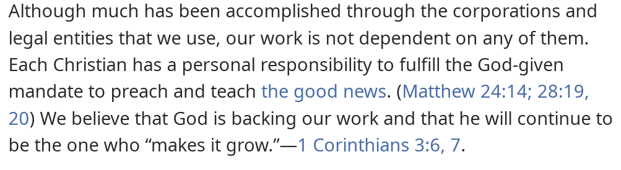
“The org is helpful, but not required.”
The Reality:
You cannot know the truth without their Watchtower society telling it to you.

Slide 10
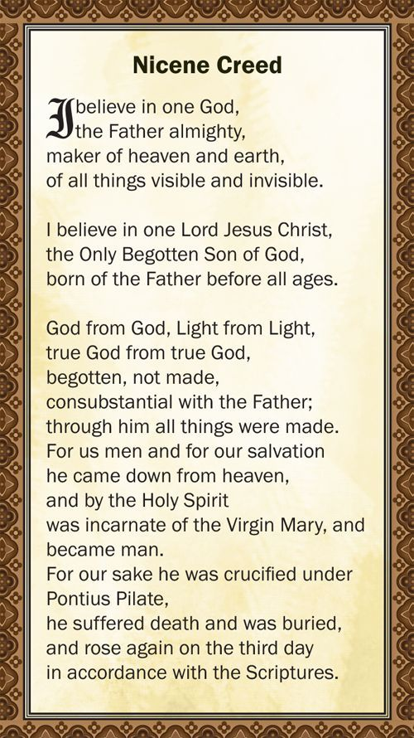
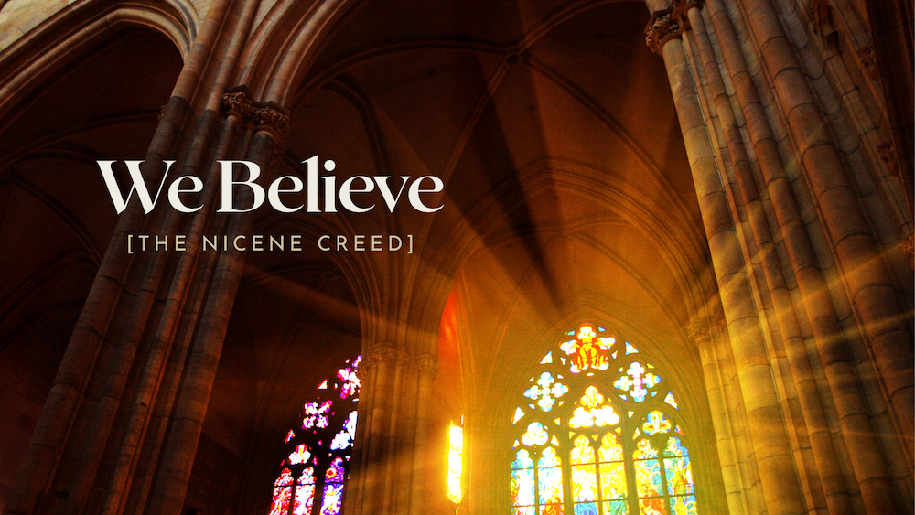

Slide 11
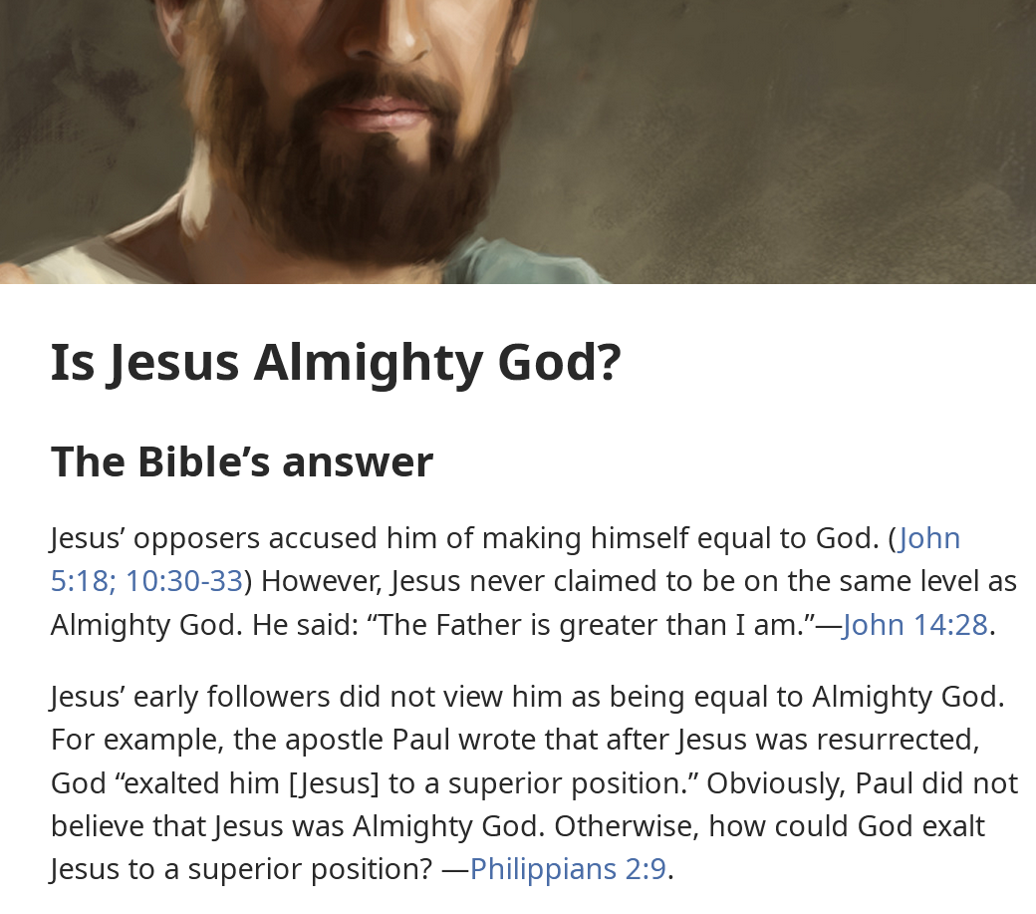


Slide 12
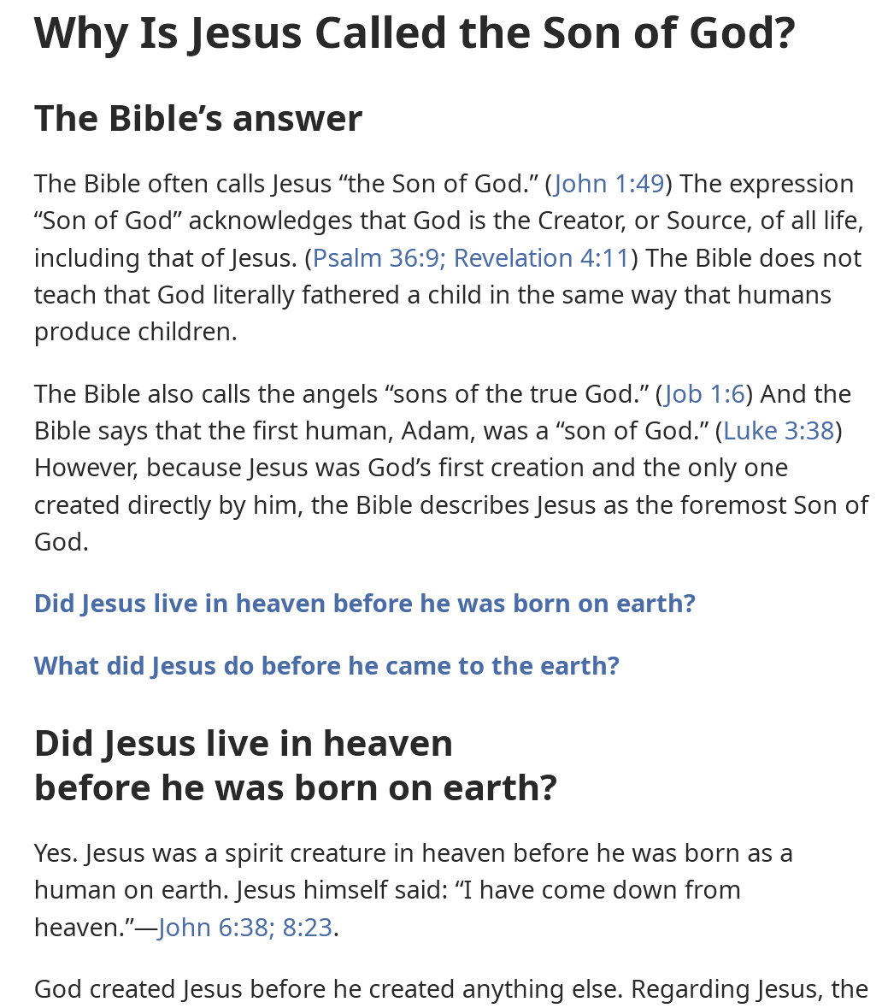

Slide 13
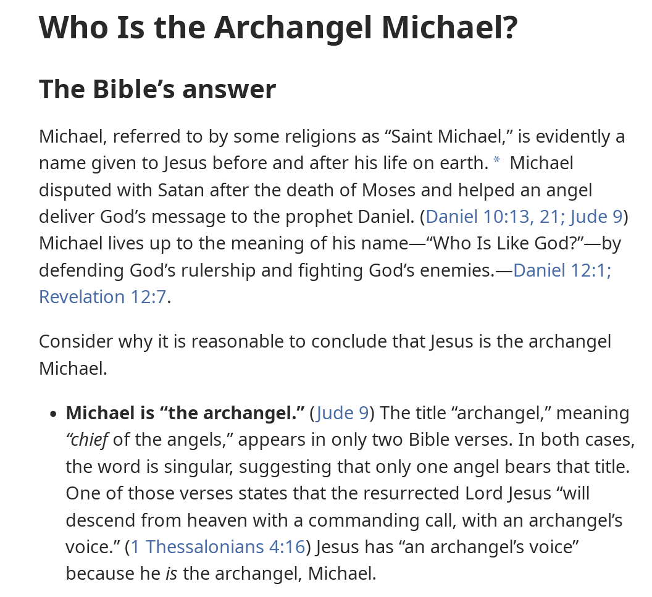
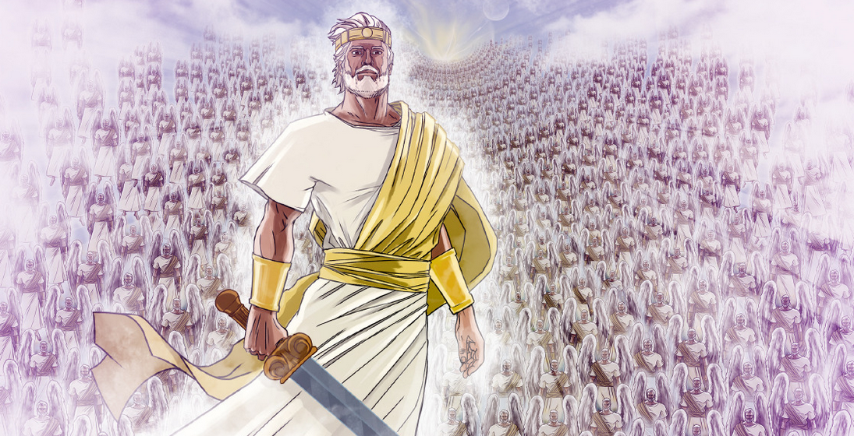

Slide 14
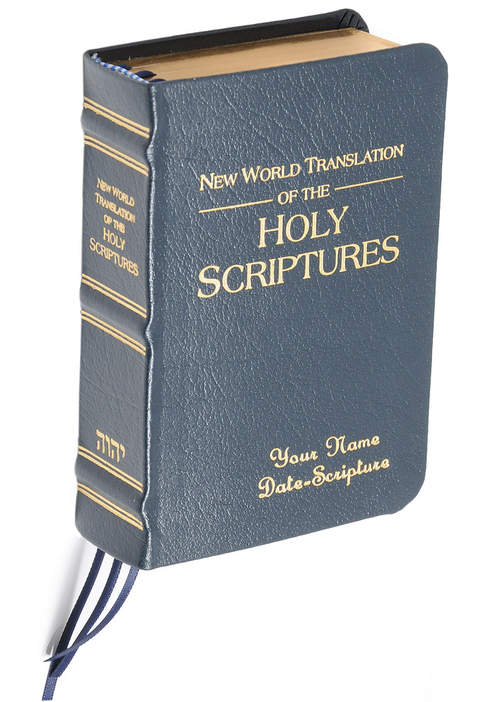
Their Own Translation of the Bible
Jehovah’s Witnesses created their own version of the Bible to support their beliefs
They used anonymous Greek and Hebrew scholars, and when some were found out, they had no credentials regarding the languages
Purposely altered verses that would show the Divinity of Jesus
Added the name Jehovah thousands of times, even in the New Testament where it was never found

Slide 15
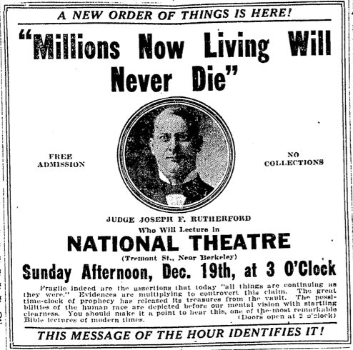
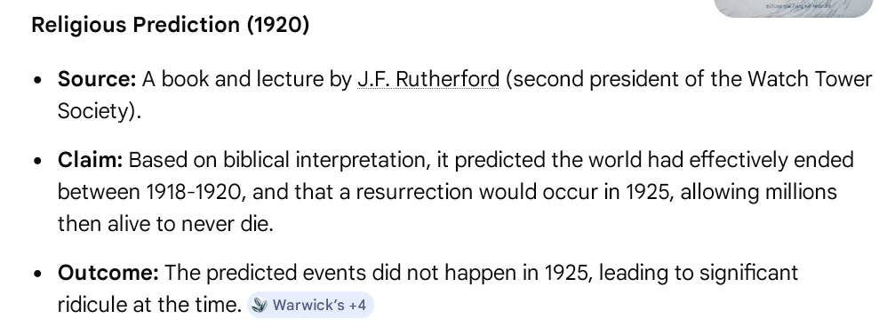
False Prophecies of the Jehovah’s Witnesses

Slide 16
Jehovah’s Witnesses
Believe you cannot be saved outside of their specific organization
Teach error on the nature of Jesus Christ
Perpetuated “end of the world” false prophecies
Force everyone to use their in-house corrupted translation of the Bible
Sow further division among the people of God

Slide 17
1st John 4:1-3
“…Beloved, do not believe every spirit, but test the spirits to see whether they are from God, for many false prophets have gone out into the world. By this you know the Spirit of God: every spirit that confesses that Jesus Christ has come in the flesh is from God, and every spirit that does not confess Jesus is not from God.

